Slide 1
Application of interpolation in estimation of live weight of a child or adult based on age :
Roll Number | Name
75 | Ibhaan Swamy
76 | Saloni Tayshete
77 | Gargi Tendulkar
79 | Prati Thakkar

Slide 2

Introduction
Interpolation is helpful whenever you have to scale things up or down.
Interpolation, also known as intermediate value, is a scientific term that could be defined as arriving at an unknown intermediate value or values of a function by using known values.
Different types of interpolation methods are: rational interpolation, polynomial interpolation, spline interpolation, and trigonometric interpolation A general approach for interpolation is to approximate with a polynomial of nth degree.

Slide 3
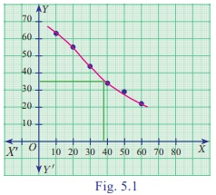
Methods of interpolation
Graphical method
Step 1- We are given ‘n’ values of x and the corresponding values of y for given function y = f (x). Step 2- x and the corresponding values of y for given function y = f (x) . Step 3- draw a free hand curve passing through these plotted points. Step 4- From this graph we can find the corresponding values of y for x
(Example of Graphical method given in the graph, If we want to estimate the corresponding value of y when x = 38 we can see from the graph that the value comes up to 35)
This way has many drawbacks as when there are many values graphical representation becomes difficult)

Slide 4
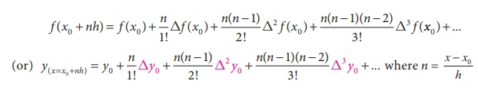
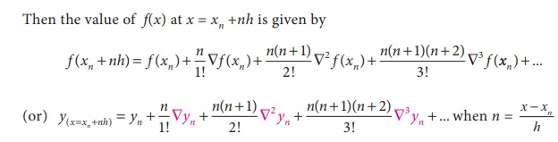
Methods of interpolation
Algebraic method :
Newton’s Gregory forward interpolation formula (or) Newton’s forward interpolation formula (for equal intervals).
Newton’s Gregory backward interpolation Formula.

Slide 5
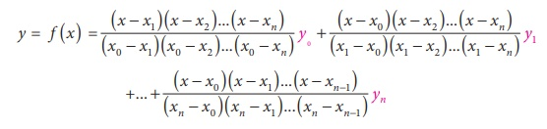
Methods of interpolation
3. Lagrange’s interpolation formula
Lagrange’s interpolation is used when the difference between the class (h) is not constant.
For the data that we need to use interpolation i.e estimating live weight for a particular age, can be done by any of the method (but the best method would be Lagrange’s Interpolation)

Slide 6
Example
Age (in years) | Weight (in pounds)
20 | 128.0
30 | 161.9
40 | 169.1
50 | 168.0
60 | 170.0
70 | 170.5
Assumption : -
This example is carried on for the weight of the girls
Average weight of the population is taken into consideration
It ignores all other factors (while estimating) like height, eating habits or where the person lives
Question: - Estimate the weight of the women who is 35 years old.

Slide 7
x (age = 35)
y (Weight) = ?
We can solve the sum by any method algebraic or graphical.
Here I have taken algebraic method to solve it (Newton’s Forward Interpolation)
x | y
20 | 128.0
30 | 161.9
40 | 169.1
50 | 168.0
60 | 170.0
70 | 170.5
Δ y
33.9
7.2
-1.1
2.0
0.5
Δ² y
-26.7
-8.3
3.1
-1.5
Δ ³ y
18.4
11.4
-4.6
Δ ⁴ y
-7
-16
Δ⁵ y
-9
f(35) = 128 + 50.85 - 10.0125 - 1.15 - 0.1640625 + 0.10546875
= 167.6289063
Therefore at the age of 35 the average weight is 168 (approximately)

Slide 8
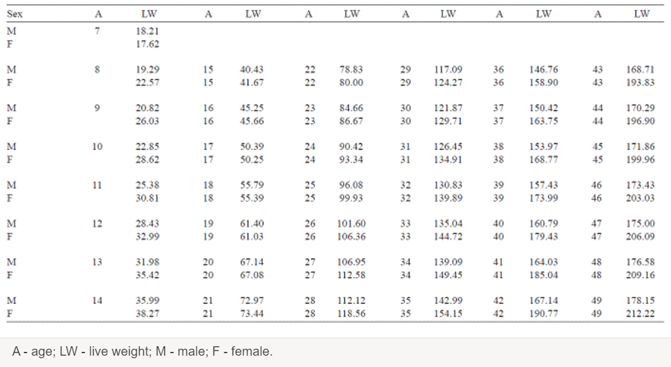
Case Study- Interpolation method for live weight estimation based on age in Japanese quails
The objective of this study was to demonstrate live weight estimation based on age by using Newton Interpolation method for male and female quails for seven weeks of fattening.
The animal material used in this study was 138 (53 males and 85 females) Japanese quail. Birds were divided into three groups randomly, with three replicates each. Quail were identified for sex on the third week of age. During the experimental period, quail were kept in the brooder for the first week and then transferred to the multi-deck cages. The study lasted seven weeks.
Diets were designed to meet approximate needs of the quail, consisting of dry matter, energy, and other nutrients.
From the 7th to 49th days, quail age is the variable X in equal intervals. Corresponding live weight averages to age is the variable Y. Points have equal intervals of 7.
Estimated live weight of male and female quails between 7 and 49 days of age

Slide 9
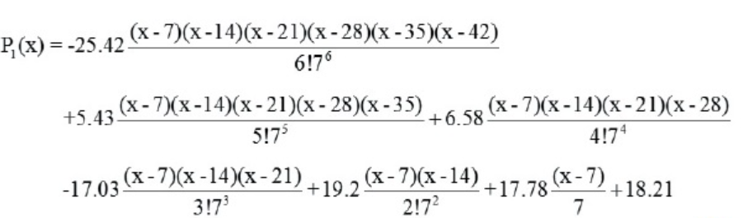
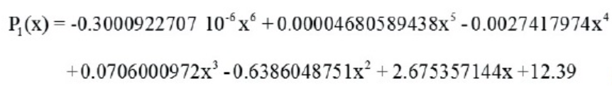
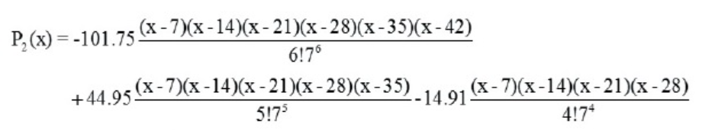

Newton Interpolation constructed to predict live weight of male quail :
Similarly, the following Newton Interpolation was constructed to predict live weight of female quail based on age
And when it was regularized, the following 6-th degree polynomial was achieved

Slide 10
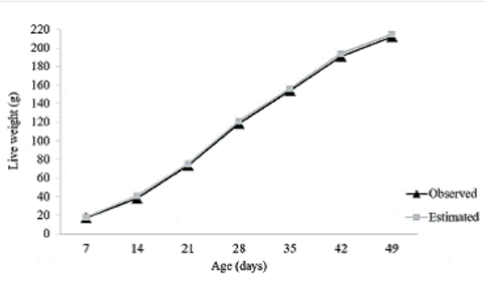
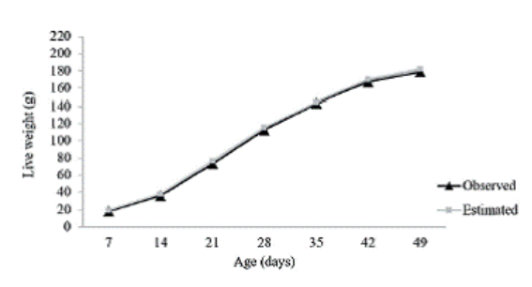
Since y values are obtained by assigning various x values in interpolation polynomials, x values of 7 to 49 days were assigned in the devised interpolations to predict live weight values (y).Graphs were plotted for the determined interpolation polynomial.
Figure 1
Newton Interpolation graph for live weight as a function of age in male quails.
Figure 2
Newton Interpolation graph for live weight as a function of age in female quails.

Slide 11
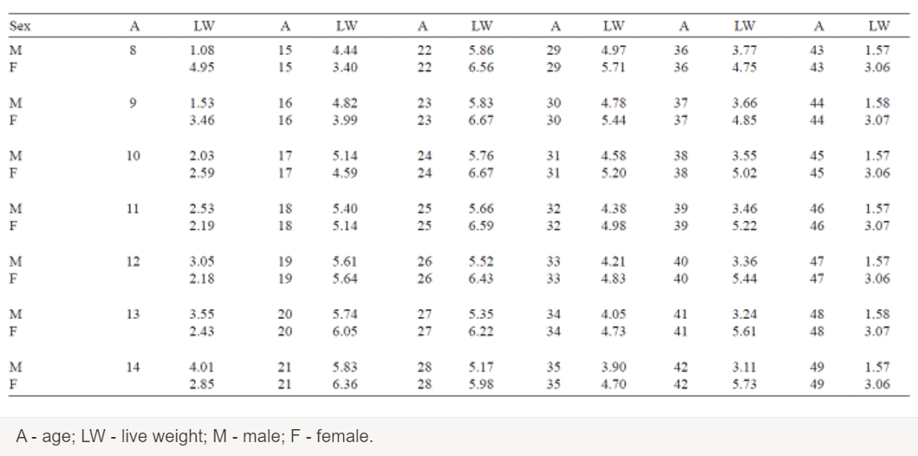
Daily live weight increase in quail was determined based on the daily live weight predictions
Table 1
Estimated daily live weight gain of male and female quails between 8 and 49 days of age
>Daily live weight for male quail increased by 4 kg or over after the 14th day and reached 4.01-5.86 g between days 14 and 34 (Table 1). From day 35, daily live weight increase was 1.57-3.90 g until day 49. In the 7th week (days 43-49), daily live weight increase was predicted as 1.57 and 1.58 g. The predicted daily live weight increase was 4 g or over after day 17 for female quail and determined as 4.59-6.67 g between days 17 and 42 (Table 1). In the 7th week (days 43-49), daily live weight increase was 3.06 and 3.07 g.
>Between days 11 and 18, live weight increase in male quail was higher than in females; after the 19th day, live weight increase was higher in females. The highest daily live weight increase was on day 22 for males (5.86 g); and on days 23 and 24 for females (6.67 g). Thus, for both for male and female quails, the highest daily weight increase was observed in the fourth week of age.

Slide 12
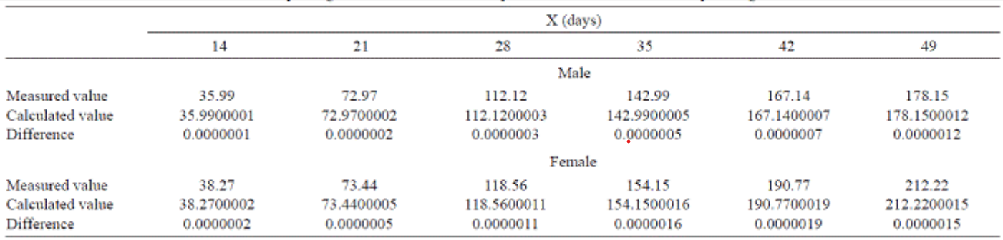
Here, "X" variable in equation was determined as an age of quails for 6th degree Newton Interpolation
Table 2
Calculated and measured body weight of male and female quails between 14 and 49 days of age
In addition to this calculation, the obtained interpolation polynomials for male and female quails at 49 days of age were P1(x) and P2(x) in equations 8 and 10, respectively.
From these data, 6th-degree Newton's forward-difference interpolation polynomials were achieved.
According to this polynomial, real live weight of male and female quails at 14, 21, 28, 35, 42 and 49 days of age, the value of live weight calculated with P1(x) and P2(x) polynomial in equations 8 and 10, and differences (errors) between real measurement and calculated one were given in Table 2.

Slide 13


The errors with equation 4 for male quails were found as
In here, p1VII(x) expression is the (6+1)-th differentiation of the 6th degree of interpolation polynomial. Similarly to this, error calculation for female quails is
Obtaining very low values for the differences between calculated and measured live weight indicates that the generated interpolation polynomials were suitable.
If very low differences by 7-digit sensitivity and a 6th-degree equation are estimated for quail live weight, it would be understood that the interpolation equation obtained with calculated errors is accurate.
After obtaining these results, general sum of squares was calculated for the fit of the model, and the F test was performed.

Slide 14
In this study,
Weight of a seven-week-old male quail | 178.15 g
Weight of a seven-week-old female quail | 212.22 g
Average live weight increases for male quail | 3.81 g
Average live weight increases for female quail | 4.63 g
Thus the interpolation method is useful in animal data in terms of live weight.

Slide 15
Relevance of interpolation
Interpolation is extremely relevant as in case of interpolation we need to remove the mid point of something suppose someone might be 77 kilos and someone might be 79 kilos and we want to find if an equipment can hold someone’s weight we can find it out by interpolating.
Interpolation is extremely in estimating the age of an adult because age is a phenomenon that keeps on changing everyday in terms of days and in terms of months so someone might be between 34 years old but he might be way older than 35 he might be approximately 35 so interpolation helps in estimating the exact date

Slide 16
Conclusion
Interpolation is a very important tool that is developed and it is used in each and every segment if interpolation would not have been there then we would have to be stuck in the number game sometimes also for estimating inputs we use interpolation
The main aim of this presentation is to present the importance of interpolating ideas in various areas of computer applications for researches that they can use interpolating concepts for the research.
An overview is presented especially to project the idea of interpolation. So, the interpolating section of each paper is given importance than to the other sections

Slide 17
Members and project assigned to them
75 Ibhaan Swamy - Relevance of Interpolation
76 Saloni Tayshete - Case Study
77 Gargi Tendulkar - Introduction , Case Study
79 Prati Thakkar - Methods, Example and Formatting

Slide 18
References
For methods of interpolation:-
https://www.brainkart.com/article/Exercise-5-2--Interpolation_38964/
In the example for average weight:-
https://www.disabled-world.com/calculators-charts/height-weight-teens.php
For case study:-
SciELO - Brazil - Interpolation method for live weight estimation based on age in Japanese quails Interpolation method for live weight estimation based on age in Japanese quails

Slide 19
THANK YOU

