Slide 1
Calculus Project
Indrayani Bhatawdekar (07)
Simran Bhurji (08)
Devyani Chaudhari (09)
Ganesh Chaudhary (10)
Nimitt Chauhan (11)
Gurleen Chilotre (12)

Slide 2
Acknowledgement
Working on the calculus project was very interesting. We would like to thank our professor Mr. Anurag Gupta who gave us this unique opportunity to work on this project through which we could understand the real life application of calculus in movie making.
Our group should excellent team spirit due to which we could successfully complete our project within the given time frame

Slide 3
Calculus in movie making
The film industry is a vast profession that encompasses several different types of occupations that each manage a different aspect of the film. When people think about this industry, they imagine the blinding lights, dedicated actors, and elaborate set. They rarely imagine how deeply math is integrated into the movies we watch. Math plays a critical role in several careers involved in the film industry, such as producers, camera operators, costume and set designers, editors, and most importantly animators.
In the old days for animation, it took 24 frames to capture 1 second of motion, so you’d need that calculation for timing the shots.
Producers and directors are often asked to calculate and compile detailed and elaborate budgets for movie making

Slide 4
Math and animation
All types of math are essential in the art of animation. For example integral calculus is used to stimulate the bouncing of light, subdivision and geometry are used in creating smooth surfaces and harmonic coordinates are used in making characters move realistically.
Calculus generally plays a role in contributing to two main functions that are used in animation:
Powering physical engines
Rendering objects

Slide 5
Animators are arguably those in the film industry who use mathematics the most. An animator may use trigonometry, algebra, integral calculus, subdivision surfaces, and harmonic coordinates, depending on which element of animation that they are controlling. Subdivision surfaces are generally used while the animator is creating a setting, for they control the smoothness of the surface. This process incorporates much geometry, for it is a specific math inspired by the film industry that allows even an uneven surface to maintain a realistic smoothness. Integral calculus is used to determine how light reflects upon these smooth surfaces, and this is done by calculating how much light is traveling from one point to another and later creating a rendering equation for this factor. Basic algebra is also incorporated in this process because it is used to give the light and objects additional shine. Character movement is determined by harmonic coordinates, a type of math that applies to any dimension and uses Laplace’s equation. The combination of trigonometry and harmonic coordinates simplify how the characters move, and it allows the animators to move the characters with less effort.

Slide 6
Physical engines
What are physical engines?
A physical engine is a computer software that provides an approximate simulation of certain physical systems, such as rigid body dynamics, soft body dynamics and fluid dynamics, often used in the domains of computer graphics, video games and film.
Application of Physical engines in animation
Since Physics Engines were originally created for video games, they specialize in character interactions and movements. Animated movies like Klaus and Frozen 2 are the perfect example of how much thought and details are put into animation these days.The movements are realistic and smooth thanks to the artificial intelligence that comes embedded in Physics Engines. You can even add layers upon layers of scenery to give it depth and give the viewer an immersive and mesmerizing experience.

Slide 7
Calculus in physical engines
In animation calculus is used in the physical concept of motion. Different mediums such as hair, smoke, fire all react differently to the environment and move differently. Therefore they all need their own physical engines. These basic engines are designed to produce specific outcomes in movement.
In the last few decades the engines have been updated to adopt more advanced calculus to the effect of more believable interactions. In order to apply the level of calculus necessary to achieve such effects, physics engines use a segment of code called an integrator. The integrator of a physics engine would take in information of an object at time t and apply that information to formulas in order to determine the new position/vector of said object.

Slide 8
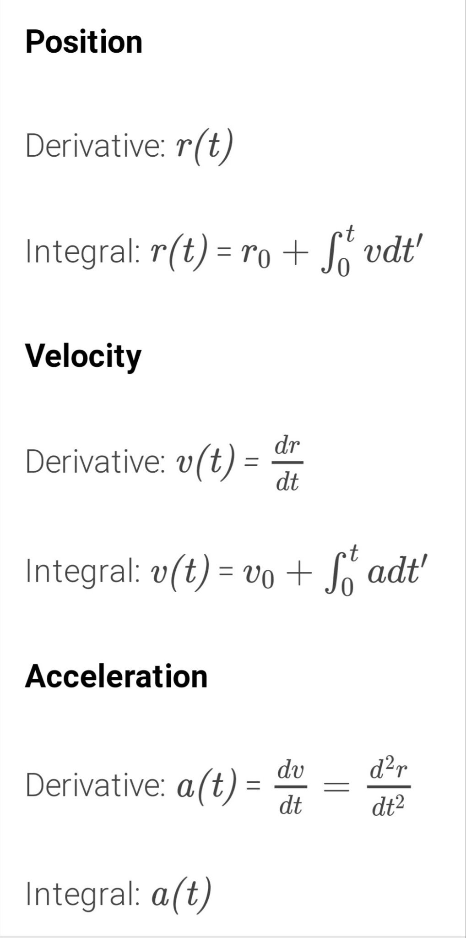
Here are some of the formulas used by a physical engine integrator

Slide 9
Rendering objects
What is rendering objects?
Rendering is the process of turning a 3D model into a 2D image, which requires the simulation of light bouncing around in a scene as it finally makes its way to the camera or viewpoint.
Application of rendering in animation
To render a object, we must know the amount of light arriving from different sources and the amount of light reflected from other sources in the scene. This is a recursive problem. The rendering procedures simulates the lighting of 3D model, based on the methods and techniques it is categorised into. Ray casting is a popular method and it is popularly used in various games like Wolfestein3D

Slide 10
Calculations in rendering objects
To know how much light arrives at point zero, we must sum up all the incoming light rays. Kajiya’s rendering equation is the most fundamental equation and describes the process for the integral. Some example which include the algorithm is path tracing, photo mapping and bidirectional path tracing.
Most current rendering algorithms are stochastic of this integral. Though, there are other non-stochastic rendering methods such as radiosity. It simulates heat transfer between objects and adapt to simulate light transfer and rendering. The main difference between them is how they choose to sample rays of light.

Slide 11
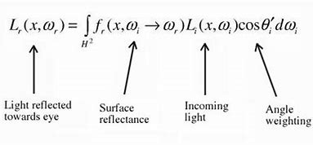
The rendering equation
The rending equations contains many parameters: rendering light at a point, absorption, reflection, and refraction. They take the sum of all incoming light rays to compute the light at one given point, and this sum is represented as an integral over hemisphere. It is as follows-

Slide 12
Camera control in movie making using approximation

Slide 13
What do we know about approximation?
Approximation is something which is similar to but not same as something else.
Approximation is used in many fields like in mathematics, science and also in our day to day life.
Approximation theory is one of the parts of mathematics.
Approximation is used when it is difficult to find the exact value of any number.
It is also used to round off the errors leading to approximation.
We use differentiation to find the approximate values of the certain quantities. If there is a very small change in one variable correspond to the other variable then we use the differentiation to find the approximate value.

Slide 14
Calculus in the film industry
There are many factors that have to be kept in mind while making a movie.
One such factor is camera control. The person behind the camera has to keep in mind a lot of things such as near distance, far distance, point of focus , relative aperture and focal length.
To make such calculations easy, we use a mathematical tool called approximation.

Slide 15
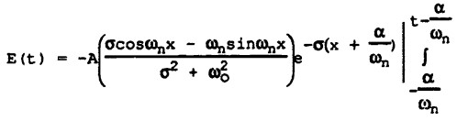
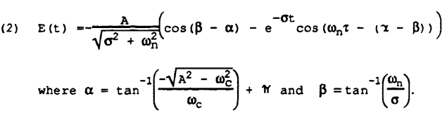
Some formulas used by cinematographers are:

Slide 16
The following quantities can be computed using the formulas:
i) The Chief's angular rate -- a constant w_{c}t deciradians per second.
ii) The Chief's angular position -- w_{c}t deciradians
iii) The angular rate of the camera platform
iv) The angular position error of the camera platform
v) The angular position of the camera -- given by (w_{c}t + the platform angular position error.

Slide 17

Reasonable approximation for the solution numerically
The position error is found by evaluating the following integral
and this can be approximated by summing the "signed areas" between the angular rate of the platform and the Chief. The "signed area" is positive when the platform rate exceeds the Chief's rate and negative if the reverse is true.

Slide 18
Math and film are not two things commonly associated with one another, but if a person is to look at the specifics of film, they will find that mathematics is integrated into various aspects of the different occupations. Producers, editors, costume and set designers, producers, and animators are all careers that have ample amounts of various mathematics. The types of mathematics involved also include multiple different types, ranging from the basics of algebra and trigonometry to integral calculus and harmonic coordinates, and the combination with the above mentioned math techniques and the film industry show a practical use that students often demand in a theoretical classroom setting.

Slide 19
THANK YOU

