Slide 1

Communicate & Integrate
Staying ahead of industry changes

Slide 2


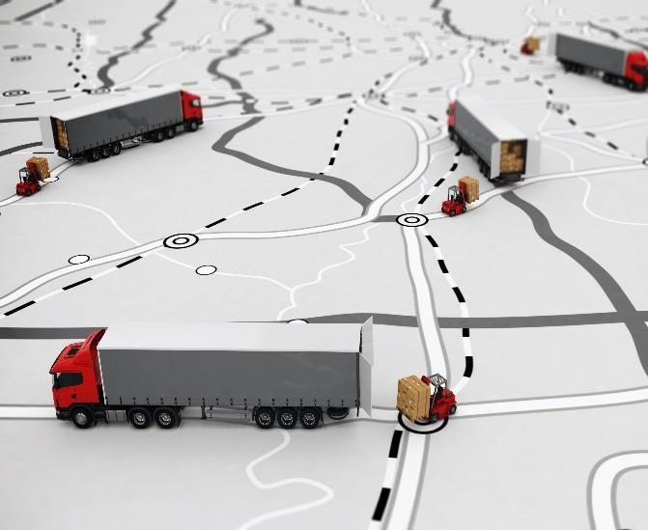

Pain Points in Logistic
CLEINT DEMAND
SUPPLY ISSUE
lack of visibility
lack of control on transport operation
manual process
billing inaccuracies/hidden cost
long cash to cash cycle
difficulty getting new business
low tech adaption

Slide 3




MARKET DYANAMICS
t
Transformation in freight industry
ISSUES
High Fragmentation
Layers of Intermediaries
Low Level of Digitization.
Infrastructure Gap
High Cost
Manual Processes
Lack of Real-time Visibility
Pricing Opacity
Limited Economies of Scale
Limited Optimization.
OPPORTUNITIES
GAME CHANGER
Digitize Processes
Real-time Reporting
Aggregation of Market
Future of Automation and Mobility
Big Data Analytic
Cloud Computing
Artificial Intelligence

Slide 4


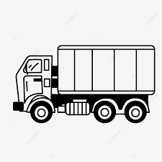



OUR REVENUE MODEL
Digital Platform to Connect

Slide 5

KEY FACTORS
Flawless and reliable execution of shipping order with little human interaction.
Reliability
Broad Regional Coverage to enable carriers to fulfil loads.
Scale & Network
Digital Services
Convenient customer service with efficient, digital processes .
Smart Pricing Algorithm.
Reduce Overall Transportation Cost.
High Load Matching Transportation.
Smart Pricing

Slide 6
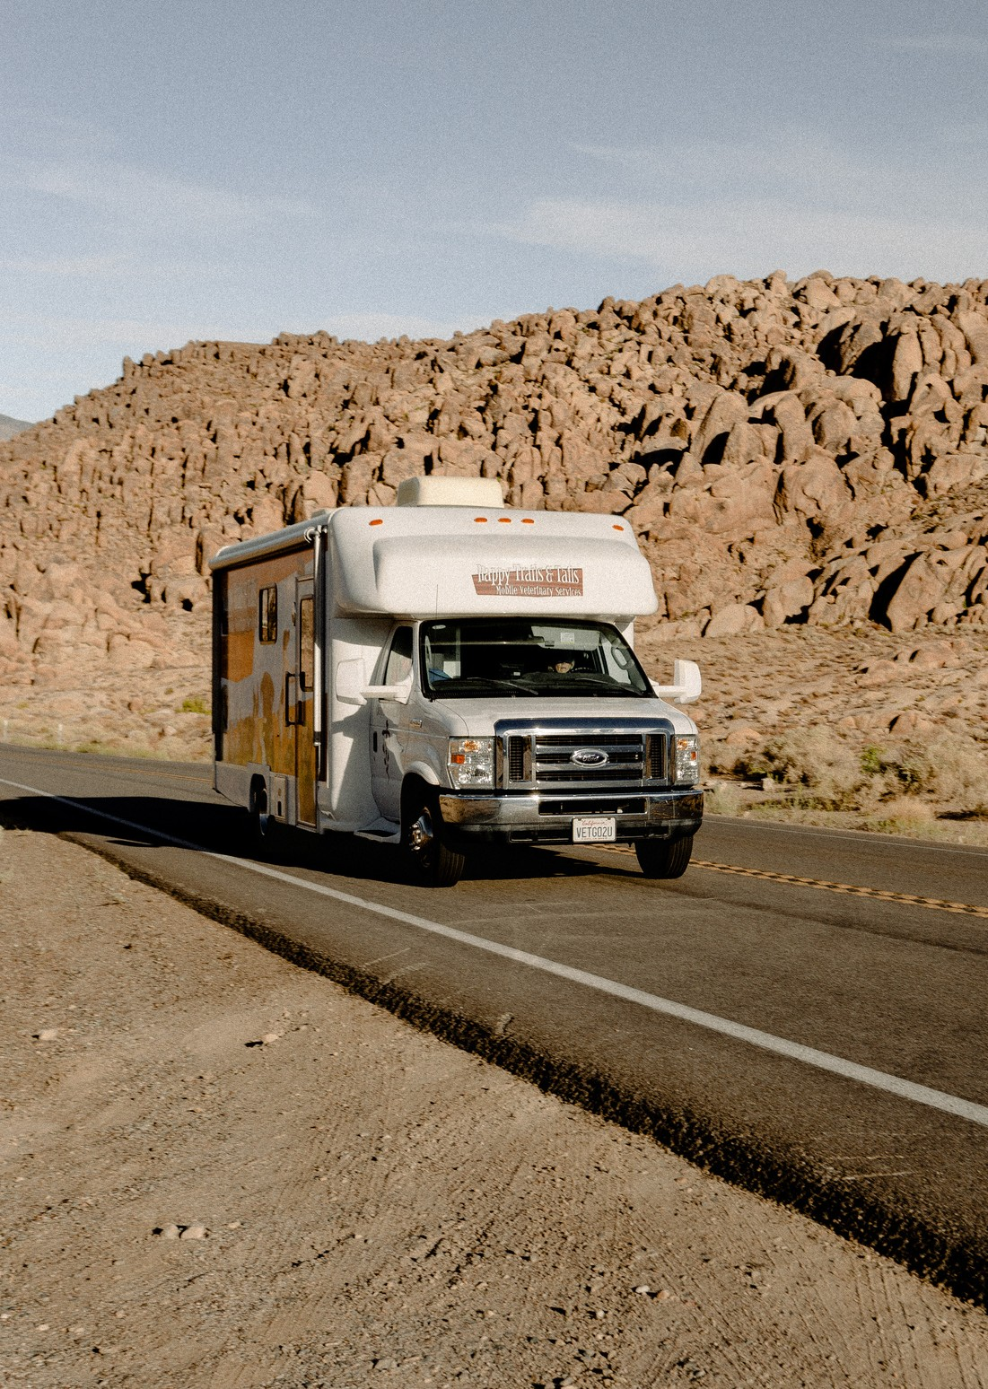
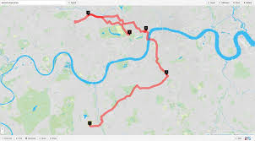


POTENTIAL FOR TRANSFORMATION
Route , Load and Price Optimization
Cloud Based Management
Integrating IOT Device

Slide 7

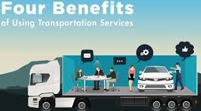


Benefits To Customer
Save Time
Increase Control
Quick online booking of trucks
Real-time visibility
Optimize
Transportation
Optimize Cost
Reduce overall transportation costs
Reduce Truck Miles and Movements

Slide 8




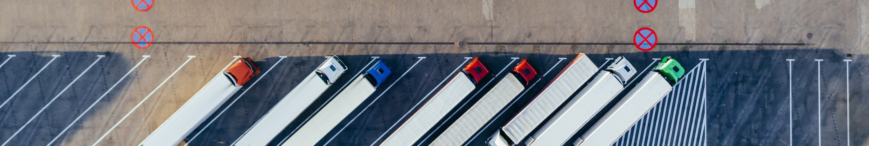
Benefits To Transporter
Fuel
Finance
Insurance
Toll
Fuel discounts and favorable credit terms
Vendor invoice financing (early payment) Truck and trailer lease / loan / rental
Better deals on liability and cargo-in- transit insurances
Use of toll cards with payments

Slide 9




WORKING OF THE SYSTEM
VISIBILITY
OPTIMISATION
DIGITIZATION
DATA ANALYTICS
Access to all transport orders, shipments and bookings
Real time tracking of Shipment
Details of Assigned carriers
Route Planning
Easy access
Scheduling
Images of Pickup and drop
Scan Sign Documents
Trend of App
Truck usage
Waiting time Analysis

Slide 10






Digital Freight Solution
1. Electronic Booking of Transport order
5. System Driven Allocation and Assignment
Challenges To Tackle
4. Real Time Tracking
2. Dynamic Route
Optimization
3. Transport Digitization

Slide 11

MARKET OPPORTUNITY OVERVIEW
215 BILLION
(US $)
32.5 BILLION
TOTAL MARKET TO ADDRESS(TMA)
US $ 215 Billion
TOTAL ONLINE MARKET
US$30 Billion
3 0 BILLION
ESTABLISHED PLAYER
3 2 . 5 Billion

Slide 12

THANK YOU
Reach out to us for inquiries or comments
+91 9865325611
PHONE NUMBER
fastit@gmail.ocm
EMAIL ADDRESS
www.fastit.com
WEBSITE

