Slide 1
APPLICATIONS OF CALCULUS IN REAL LIFE
By Tanishq Navin Upreti

Slide 2
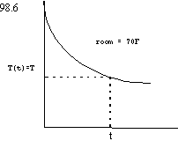

Calculus At Time of Death
An experiment in guessing the time of death was performed where a potato was used instead of a human body. The time of death for the potato was carefully thought about to be the time it was taken out of the oven. The temperature of the potato at the time of death was 194 F. Temperature readings of the potato were taken every fifteen minutes for three hours.Guesses for the time of death at the similar temperatures were calculated with an average percent error of 7.29%. The room’s temperature was 75.2 F. Newton's Law of Cooling states that the rate of cooling of an object is the temperature difference between the object and its , gave that this difference is not too large. When guessing the time of death, one needs to know the temperature of the and the temperature of the body at two different times in order to make a guess . It is assumed that the temperature of the body T(t) is ruled managed by Newton's Law of Cooling.where k is a negative constant, is the the room's temperature, and time t is the number of hours since the time of death. Also, the temperature of a human body at the time of death is carefully thought about/believed to be 98.6 F, T(0) = 98.6 . Think about/believe a crime scene in Wilmington in which a man is killed in his apartment. The body was discovered in the apartment early in the morning and at 7:00 A.M. The coroner measured its temperature, at that time. One hour later another temperature, , was taken. The coroner noted that the temperature of the murder victim's apartment was maintained at a constant temperature of 70 F. The the room's temperature in this case remained constant, but keep in mind this is not always the case.

Slide 3
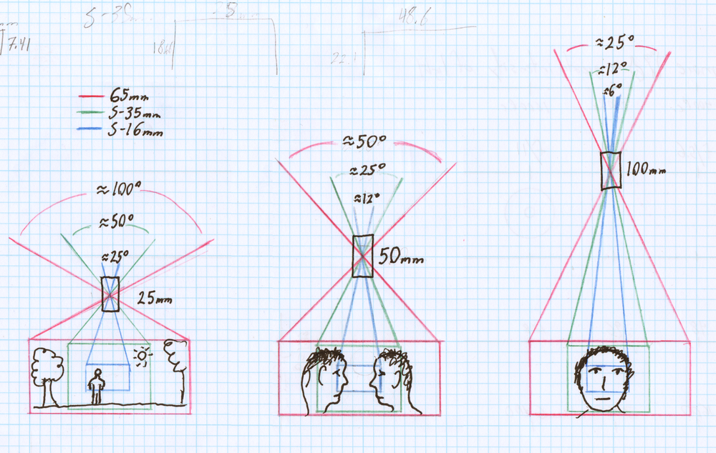
Use Of Calculus During Movie Making
An understanding of mathematics seems necessary to scientific research or engineering, but not to the cinematographer as artist.The relationship between light strength, exposure time, sensitivity of the sensor, and the iris of the lens is held in tight two-way.. All of these coordinate scales rise and fall by a factor of two, which is very simple mathematical relationship. There is some complex difficulty in the fact that each of these scales are in different units this way needing/ordering a student to be knowledgeable with the meaning of the numbers. Anyway, the decisions made to correct exposure are completely mathematically base.Another, maybe more common use is the geometry needed to calculate skinny having angles field of view because of its relation to format size and therefore the choice of focal length of lens. Now there is constant moving/changing of format size unlike the analog time in history where the choice of format was mostly kept to/restricted to 16mm or 35mm. Now digital cameras have APS sized sensors, S-35mm sized sensors, full frame 35mm sensors, and camera manufacturers such as Red are constantly increasing the area of the format as they increase . Moving between these cameras means becoming knowledgeable with problem of picking focal lengths to an equal field of view, especially when different cameras are working on the same set. Surprisingly this must still be explained to not only students, but often professionals working in the field.

Slide 4
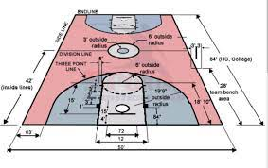
Sports: Application of sports in sports science
Athletes, trainers, and coaches often use (branch of math/method of planning) to gain benefits over their partners. (branch of math/method of planning) can also be used to calculate the (something thrown or fired at high speed) movement of baseball's arc-like path, speed of baseball when hit, and (describe a possible future event) if runners can make it to the next base on time, given their running Speed.
Keller’s theory, which is based on Newton’s second law and the calculus of variations, provides an optimum strategy for running one-lap and half-lap races. Keller wrote the equation of motion as:
dυ /dt + υ τ =f(t).

Slide 5
Automobiles-application of calculus in car design
Computer-helped modeling has done a lot for framework (of a car, etc.) engineers, who can now digitally "build" a framework (of a car, etc.) in a computer, and "crash test" it over and over again using fancy or smart branch of math/method of planning) and physics sets of computer instructions.
Fractional derivative viscoelastic model is used in the analysis of a frontal hit/effect of a vehicle against a stiff/not flexible (thing that blocks or stops). The frontal part of the vehicle is first modeled as a viscoelastic fractional rod and then it is modeled as two different viscoelastic fractional rods with a different length

Slide 6
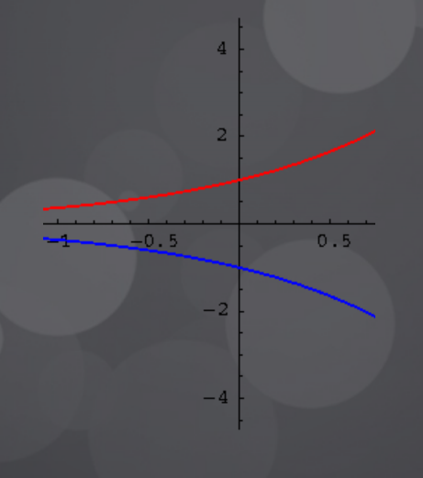
Architecture-Application of calculus in skyscraper design
Designers/builders also use integral calculus to calculate the amount of materials needed for construction and the type of support systems needed/demanded to prevent constructions from collapsing. Even the Eiffel tower was built with (branch of math/method of planning) in mind, focusing only on wind resistance.
Designers/builders also use integral calculus to calculate the amount of materials needed for construction and the type of support systems needed/demanded to prevent constructions from collapsing.

Slide 7
Finance- Application of calculus by credit card companies
The minimum monthly payment on your credit card statement may vary from month to month depending on how much you owe ,but it is not a number the credit card company arbitrarily decided.
They use calculus to determine a minimum payment at the exact time your bill is due based on fluctuation of interest rates and changes in your available balance .
This falls under differentiation branch of Calculus .

Slide 8
ECONOMICS-Application of calculus by central bank
Functions and Derivatives of Calculus can relate to relevant concepts in economics.
Economic Research uses calculus functional relationships, relation of income ,market prediction etc.
Differentiation is used to find optimum solutions of economics.
Calculus is also used to maximise the efficiency of products or to minimize their costs.
Credit card companies use calculus for monthly payments.

Slide 9
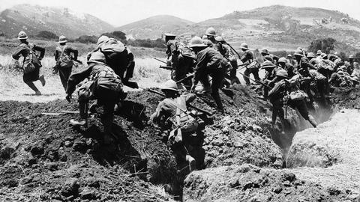
WARFARE- Use of Calculus in weaponry
All police officers who use radar guns are actually taking advantage of the easy use of derivatives.
When a radar gun is pointed ,and fired the gun is able to determine the time and distance at which radar was able to hit a certain section of your vehicle .
With the use of derivative it is able to calculate the speed at which the car was going and also report the distance that the car was from the radar gun.

