Slide 1
Application of arithmetic progression in OLA/ UBER taxi sequence system
80 – Raj Tripathi
81 – Sakshi Tripathi
82 – Krishangi Trivedi
83 – Harshita Tyagi
84 - Tanishq Upreti

Slide 2
HOW IS ARITHMETIC PROGRESSION USED IN REAL LIFE
Arithmetic progression can be applied in real life by analysing a certain pattern, for example, AP used in straight line depreciation.
AP used in prediction of any sequence like when someone is waiting for a cab. Assuming that the traffic is moving at a constant speed he/she can predict when the next cab will come.

Slide 3


Uber is a transportation company with an app that allows passengers to hail a ride and drivers to charge fares and get paid. More specifically, Uber is a ridesharing company that hires independent contractors as drivers.
Ola is India’s largest mobility platform and one of the world’s largest ride-hailing companies, serving 250+ cities across India, Australia, New Zealand, and the UK. The Ola app offers mobility solutions by connecting customers to drivers and a wide range of vehicles across bikes, auto-rickshaws, metered taxis, and cabs.

Slide 4
HOW AP IS USED IN UBER/OLA TAXI SEQUENCE
One of the uses of AP in real life is the calculation of taxi fare.
There are three ways of calculating taxi fares:
The zone system
The flat rate system
The taxi meter system

Slide 5
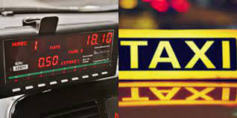
THE TAXI METER SYSTEM
Arithmetic Progression method calculates the taxi fare based on three categories:
Initial Fee – A flat fee charged at the beginning of every ride.
Cost per mile/km – How much you are charged for each mile/km of your journey
Cost per minute – How much you are charged for each minute of the ride where the car is moving very slowly or is standing still

Slide 6
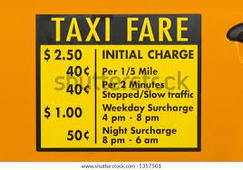
THE INITIAL FEE
Immediately, upon entering a taxi, you will be charged an initial fee. This is the entry fee that one pays simply for getting into the taxi.
This would be regarded as the first term of an arithmetic progression.
This first term is denoted by ‘a’.

Slide 7
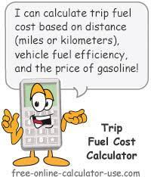
COST PER MILE/KM
Once the taxi starts moving, the meter will start adding up how many miles/kms you have travelled and will charge you the set price for each mile.

Slide 8
COST PER MINUTE
If the taxi slows down (typically below 10mph) or is stuck still in traffic, the meter will switch over and will start charging you by the minute instead of by mile/km. This ensures that the cab driver is still getting paid for his/her time while sitting at red lights or in traffic.

Slide 9
USE OF AP IN THE TAXI METER SYSTEM
To sum up how meters work the following formula can be used.
Taxi fare =
Base Fare +
(Cost per mile * ride distance) +
(Cost per minute * time in taxi while taxi is standing still or traveling very slowly)

Slide 10
USE OF AP IN THE TAXI METER SYSTEM
The set price is the common difference ‘d’ between two successive terms in an AP.
Hence, if ‘d’ is the set price per kilometre and ‘a’ is the initial fare for the first km
the taxi fare for 2km would approximately be the initial fare + the set price i.e ‘a+d’
This ‘a+d’ will be the second term (a2) of the arithmetic progression.

Slide 11
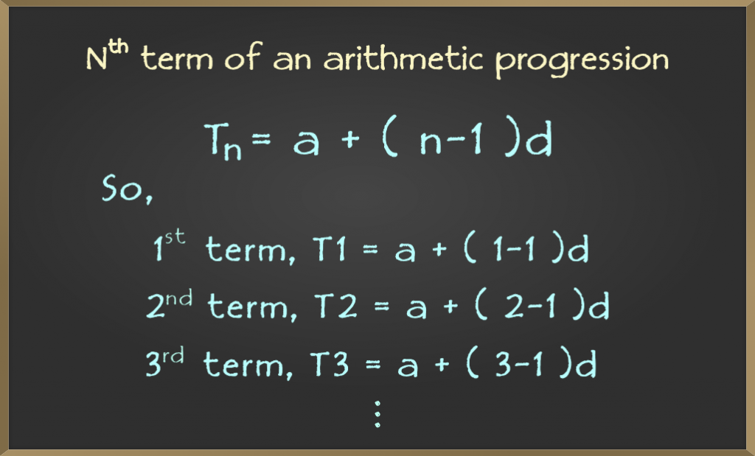
USE OF AP IN THE TAXI METER SYSTEM
3rd term a3 = a2 + d = (a + d) + d = a + 2d = a + (3-1)d
4th term a4 = a3 + d = (a + d) + d = a + 3d = a + (4-1)d
likewise, nth term an = a + (n-1) d
Therefore, we can find the nth term of an AP by using the formula,
an = (a + (n – 1) d)

Slide 12
EXAMPLE
Say the base price of a taxi is Rs. 20 for the first 2 kms
This is ‘a’ the first term.
And the set price (by the mile + by the minute) is Rs. 10 per km.
This will be the common difference ‘d’ of the AP.
Hence, the charge for 3km will be a2 = ‘a + d’ = Rs. 30
the charge for 4km will be a3 = ‘a + d + d’ = ‘a + 2d’ = Rs. 40
Similarly the charge for (n+1) km will be an = ‘a + (n-1)d’

Slide 13
EXAMPLE
The sequence of taxi fares
20, 30, 40, 50,…….
Observe that these taxi fares form a pattern. In which, we get the next fare by adding a fixed number to the previous fare. Such a sequence of numbers is said to be in Arithmetic Progression.

Slide 14
APPLICATION OF AP IN TAXI SEQUENCE
Another case is when you are waiting for a cab. Expecting that the traffic is moving at a steady speed you can anticipate the when the cab will come.

Slide 15
ACKNOLEDGEMENT
We would like to thank our teacher for Numerical Methods of Algebra, Mr. Anurag Gupta who gave me a golden opportunity to work on this project. We had also like to express my gratitude to our program coordinator, Mr. Devarshi Shah wholeheartedly.
We must also thank our 5 team members, Sakshi Tripathi, Harshita Tyagi, Krishangi Trivedi, Tanishq Navin Upreti, and Raj Tripathi for the immense support and help during this project. Without their help, completing this project would have been very difficult.
We seek the blessings of our parents and look forward to work on such challenging projects again in the future.

Slide 16
BIBLIOGRAPHY
https://byjus.com/jee-questions/what-is-the-use-of-arithmetic-progression-in-daily-life/
https://www.taxifarefinder.com/newsroom/2016/05/24/how-to-calculate-your-taxi-fare/
https://www.techtarget.com/whatis/definition/Uber
https://www.olacabs.com/about.html

