Slide 1

CALCULATING VaR USING MONTE CARLO SIMULATION
Project done by: Rishika Kudav, Aliya Fernandis, Jash Dattani, Kshitij Srivastava, Drashti Shah, Sayali Chinchwalkar, Priyanshu Mehta, Devansh Jain
Roll No. 425-432

Slide 2
INTRODUCTION
In this project, we have estimated the Value at Risk using Monte Carlo Simulation in VBA for different confidence intervals.
The following 5 stocks have been considered with equal weightage for our hypothetical portfolio.
RELIANCE
IDEA
SUNPHARMA
TATAELXSI
COALINDIA

Slide 3

ASSUMPTIONS
The stocks considered have equal weightage. There are 252 trading days in a year.
Risk free rate has been taken as the 10 year Indian Government Bond rate as on 5/5/2022 which is 7.40%.
The portfolio is worth INR 100,000.
10,000 iterations have been taken to generate the Monte Carlo Simulation.
We have taken 3 year daily stock data for our calculations ranging from 6/5/2019 to 4/5/2022.

Slide 4
METHODOLOGY
Understanding the project Building a diversified portfolio Getting raw data for these stocks
Calculating the individual stock return Calculating the portfolio return Performing the Monte Carlo Simulation Conclusion

Slide 5
VaR & MONTE CARLO SIMULATION
Value at risk (VaR) is a statistic that quantifies the extent of potential financial losses within a portfolio, over a specific time frame.
Monte Carlo simulation performs risk analysis by building models of possible results by substituting a range of values—a probability distribution—for any factor that has inherent uncertainty.

Slide 6
RATIONAL BEHIND THESE STOCKS
Tata elxsi - highest quaterly sales volatility Vodafone idea - highest trading volume in a year Coal India - least volatile stock
Sun pharma - highest annual ROCE Reliance industries - highest market cap
All of these stocks are from different Industries

Slide 7
RAW DATA
The raw data was obtained from Yahoo Finance.
The daily stock prices for the past three years was obtained because: The stock market has gone through an extreme dip and recovery in the past 3 years (Covid-19) and it was an important sample to predict a stock's behaviour under these extreme scenarios.
There was enough data to create the simulation without overcomplicating it with too much data.

Slide 8
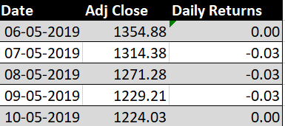
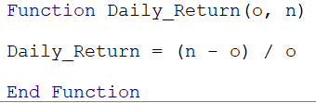
INDIVIDUAL STOCK RETURN
Method of calculating the individual stock returns
Created a function "Daily_Returns" where n and o stands for new and old stock price respectively.
This function gives the change in the price.

Slide 9
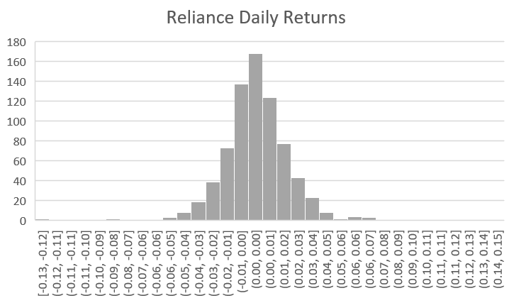
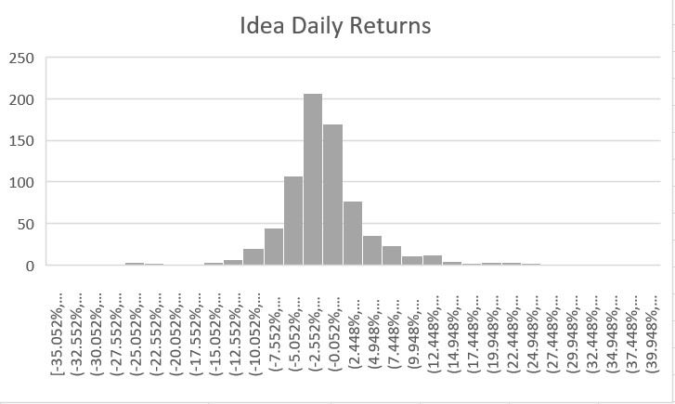
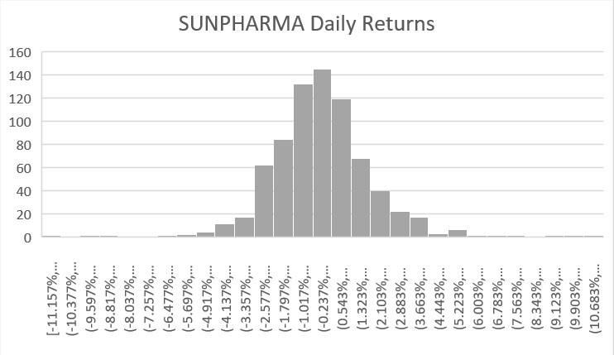
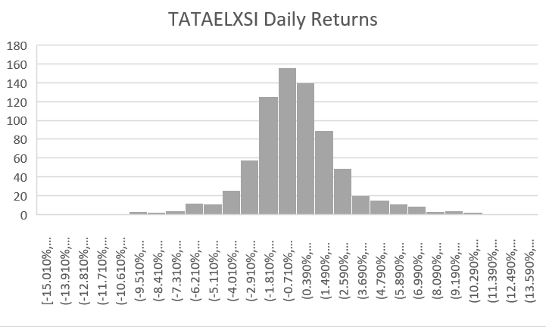
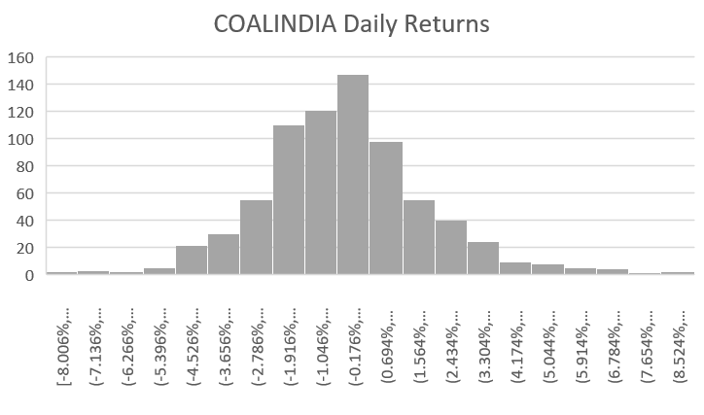
INDIVIDUAL STOCK RETURN
Graphically, all the individual stocks approximately represent normal distribution, in some cases outliers are observed.

Slide 10
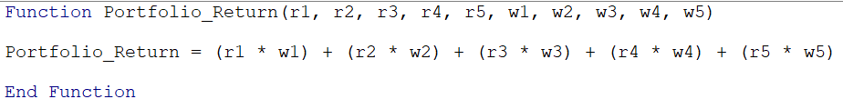
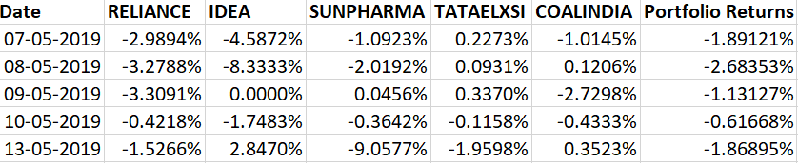
PORTFOLIO RETURN
Method of calculating portfolio return
Created a function "Portfolio_Return" which incorporated the returns of all the 5 selected stocks at their specified time and corresponding weights.

Slide 11
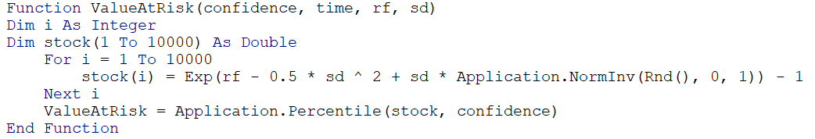
MONTE CARLO SIMULATION
Monte Carlo simulation involves:
Defining the possible inputs, confidence interval, time frame, risk-free rate, standard deviation.
Generating random inputs, which is the seed value, using the following formula
"=EXP($B$11-.5*$B$10^2)+$B$10*NORM.S.INV(RAND())"
Created the following function to calculate the Percentage VaR

Slide 12
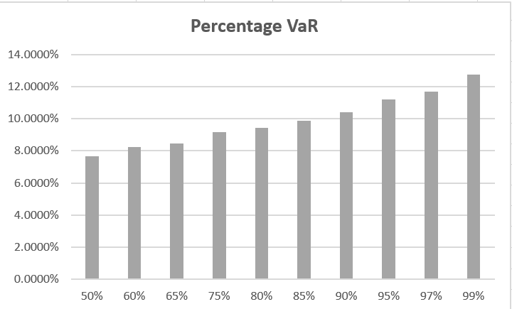
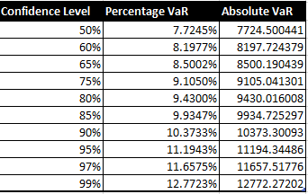
MONTE CARLO SIMULATION
We can see that there is a direct relationship between confidence intervals and VaR

Slide 13
CONCLUSION
Risk can be further diversified by making alternative investments.
Portfolio is equally weighted, one should weight each stock according to his/her own investing strategy.
Monte Carlo simulation is not the only method to calculate VaR, like the historical method, and variance-covariance method.
VaR is calculated over a short time-frame rather than a longer one depending on ones investing strategy.

