Slide 1
Application Of Calculus by Central Bank
-Prepared by Group no. 7

Slide 2
Group Details
S.no | Name | Roll Number
1) | Kshiti Vartak | 86
2) | Monisha Vaswani | 87
3) | Sujoy Banerjee | 88
4) | Shrunkhala Kambale | 89
5) | Kartik Sundrani | 90

Slide 3
Introduction:
Calculus provides comprehensive services in the credit sector of a financial institution, by achieving the improvement of the organization, the structure and functionality and the increase of revenues by the simultaneous reduction of the expected risk.
In the sector of banking calculus helps us in the understanding of bank accounts , salaries , raises, calculus helps us to find related patterns
It also assists in the field of investment banking.

Slide 4
In Economics, calculus is used to compute marginal cost and marginal revenue, enabling economists to predict maximum profit in a specific setting.
Calculus is useful outside the hard sciences . If you have a pattern or formula and want to examine some behaviour, calculus is the tool for you.
Textbook Calculus involves memorising the rules to derive and integrate formulas. Our brain power is better spent learning how to translate our thoughts into the language of math

Slide 5
Application of CALCULUS in the banking sector!
Through the overview of the credit processes, the credit criteria, the credit structure, the approval authorities, the application processes and the application form, we provide clear and comprehensive recommendations for optimization, always compatible to the needs of your financial organization.
Through the use of the latest statistical tools, we provide the development of contemporary risk models, their validation and integration to comprehensive solutions for the optimization of credit procedures methodologies.

Slide 6
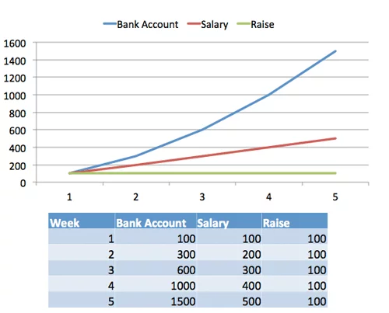
Understanding the relationship between bank account, salary, and raise with the help of graphical representation!

Slide 7
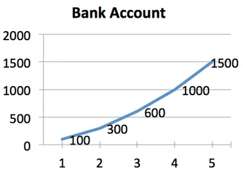
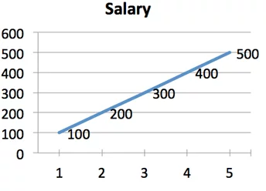
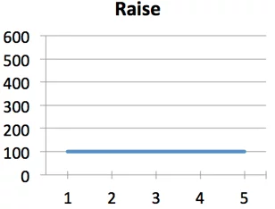

Slide 8
This is our first CALCULUS relationship!
A constant raise $100/week) leads to a…
Linear increase in salary (100, 200, 300, 400) which leads to a…
Quadratic (something * n^2) increase in bank account (100, 300, 600, 1000..you see it curve!)
Now, why is it roughly 1/2 * n2 and not n2? One intuition: The linear increase in salary (100, 200, 300) gives us a triangle. The area of the triangle represents all the payments so far, and the area is 1/2 * base * height. The base is n (the number of weeks) and the height (income) is 100 * n.

Slide 9
Optimisation
Calculus provides solutions through integrated strategies for the optimum management of the non-performing loans. As the volume of the portfolio increases and thus non performing loans multiply, empirical approaches are not sufficient for efficient management. In Calculus, we provide comprehensive management services and are able to develop successful collections strategies, through the use of advanced statistical tools.
Through specialized analysis, we develop specific strategies aiming at the increase of recoveries, cost reduction, operational optimization and improved customer management based on the valuable information obtained in the collections phase.

Slide 10
In the context of procedures' optimization, contained in the life cycle of credit products, Calculus provides the overview of services and proceeds with specific recommendations per phase, so that the financial institution can adopt best practices that will ensure functionality in structure, effective processes, reduction in operational cost and revenue growth.
Professionals at Calculus provide specialized consulting services so as to adopt the optimum solution for the entire life & risk management of the credit products, from the product planning up to the legal procedures of the non-performing loans.
Unprecedented regulatory changes and demands are challenging global banks’ path to growth and profitability. If your goal is to manage risk, ensure compliance with new rules, improve operating models or raise capital, then we can help you adapt to the new rules of the road so that your organization can reach its full potential.

Slide 11






Slide 12
Key Takeaways
Here's the key points:
Calculus helps us find related patterns (bank account, to salary, to raises
The "derivative" is going "down" (finding week-by-week changes to get your salary)
The "integral" is going "up" (adding up your salary to get your bank account)
We can figure out a formula for a pattern (given my bank account, predict my salary) or get a specific value (what's my salary at week 3?)
Calculus is useful outside the hard sciences. If you have a pattern or formula (production rate, size of a population, GDP of a country) and want to examine its behavior, calculus is the tool for you.

Slide 13
:)
!THANK YOU!

