Slide 1
Application of Algebra in Civil Structures
Indrayani Bhatawdekar (07)
Simran Bhurji (08)
Ganesh Chaudhary (10)
Nimitt Chauhan (11)
Gurleen Chilotre (12)

Slide 2
Acknowledgement
Working on the Numerical Method and Algebra assignment was very interesting. We would like to thank our professor Mr. Anurag Gupta who gave us the opportunity to work on this project through which we could understand the practical application of vector calculus in civil engineering.
Our group showed excellent efforts and team spirit due to which we could successfully complete our project within the given time period.

Slide 3
Introduction to vectors
.A vector is a mathematical object that has magnitude and direction, and satisfies the laws of vector addition. Vectors are used to represent physical quantities that have a magnitude and direction associated with them. For example, The velocity of an object is a vector.
Vector is of the form : aî+bĵ+ck̂
Basic vector formulae:
If A and B are vectors
Addition of vectors: R=A+B
Scalar product: A ⋅ B = |A| |B| cos θ
Vector product: A × B = |A| |B| sin θ n̂

Slide 4
Vector in civil structures
Vectors are used in engineering mechanics to represent quantities that have both a magnitude and a direction. Many engineering quantities, such as forces, displacements, velocities, and accelerations, will need to be represented as vectors for analysis. Vector quantities contrast with scalar values (such as mass, area, or speed) which have a magnitude but no direction.

Slide 5
Force vectors
A vector is typically represented by an arrow in the direction of the force and with a length proportional to the force’s magnitude.
A force vector is a representation of a force that has both magnitude and direction. This is opposed to simply giving the magnitude of the force, which is called a scalar quantity.
A major feature of force vectors is that they can be broken into components, according to the application of the force. Vector components are usually perpendicular to each other, although they also can be in a parallelogram configuration.
Any other use of vector algebra is that its miles are used to degree angles and distance among panels in satellites, in the production of community pipes in diverse industries, and in calculating angles and distance among beams and systems in civil engineering.
How is vector used in civil engineering?
Vectors are used in engineering mechanics to represent quantities that have both a magnitude and a direction.

Slide 6
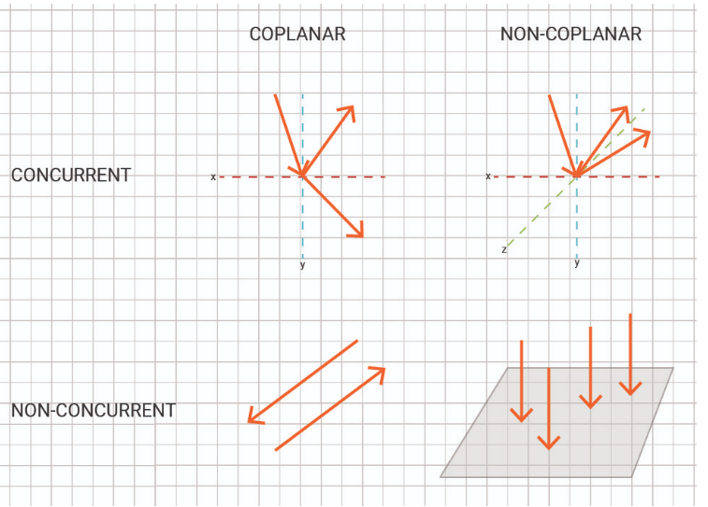
Force vectors may pass through a single point (concurrent) or be parallel (non-concurrent). Furthermore, force vectors may lay in a single plane (coplanar) or cannot be in a single plane (non-coplanar). Therefore, four different force systems can be identified:
Concurrent – Coplanar
Non-concurrent – Coplanar
Concurrent – Non-coplanar
Non-concurrent – Non-coplanar
Concurrent: If forces applied to a body are such that
their lines of action meet at a single point then they are
called concurrent forces.
Non- concurrent: Non-concurrent forces are two or
more forces whose magnitudes are equal but act in
opposite directions with a common line of action.

Slide 7
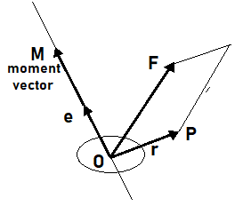
Vector Moments
The moment of a force is a measure of its tendency to cause a body to rotate about a specific point of axis.
The moment arm is the perpendicular distance between the line of action of force and center of moments.
Moment= Force × Displacement×(angle between the vectors)
𝑀=⃑𝑟×⃑𝐹

Slide 8
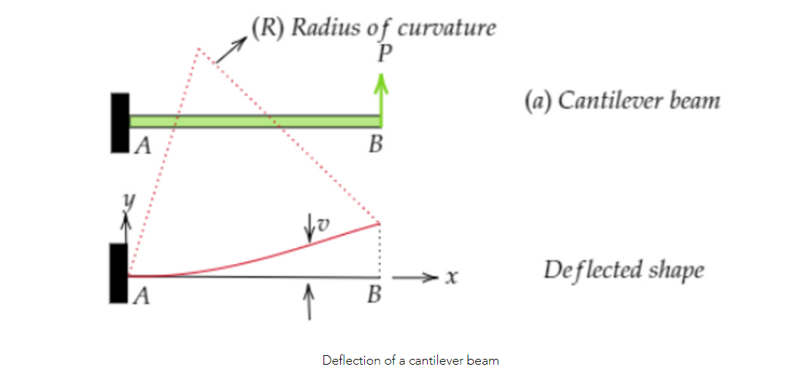
Calculating angles and distance between beams and structures
In building construction, a beam is a horizontal member spanning an opening and carrying a load that may be a brick or stone wall above the opening, in which case the beam is often called a lintel
What is Deflection?
Deflection means bending or displacement of a structural member(beam) from its original position. When a beam is loaded, it bends. This displacement of all beam points in the y-direction is called the deflection of the beam.
The point which earlier was on the x-straight axis has moved up in the y-direction. This displacement of all beam points in the y-direction is called the deflection of the beam.

Slide 9
What is the slope of a beam?
Slope(θ) is the angle between the original and deflected beam at a particular point. The slope at any section in a deflected beam is defined as the angle in radians which the tangent at the section makes with the original axis of the beam.
There are different methods to find slope and deflection of a beam:
Double Integration Method
Moment Area Method
Method of superposition
Double Integration Method
From the Euler-Bernoulli bending theory, at a point along a beam, we have:
1/R = M/EI
where: R is the radius of curvature of the point, M is the bending moment at that point, EI is the flexural rigidity of the member.
We also have, dx = R dθ and so 1/R = dθ/dx. Again for small displacements, θ ≃ tan θ ≃ dy/dx and so:
1 / R = d²y / dx² = M / EI

Slide 10

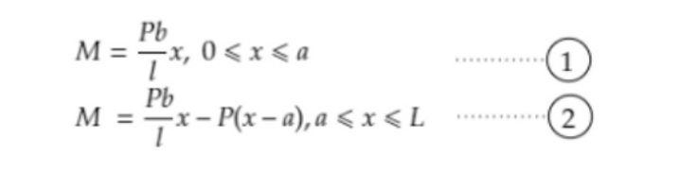
Formula used to find the slope and deflection of the beam :
Where,
M is the Bending Moment at a particular section
EI is the flexural rigidity of the member
y represents the vertical deflection of the beam and x is the lateral direction.
dy/dx represents the slope of the beam at that particular point.
Detailed Steps for double integration method:
Step 1: Finding the reactions at support(s)
We can use the horizontal equilibrium (ΣH = 0), vertical equilibrium (ΣV = 0) and moment equation (ΣMx = 0) for the reaction calculation.The reaction at A is Pb/L and B is Pa/L.
Step 2: Writing bending moment pattern at different sections of beam
In this case, the bending moment from L = 0 to L = a follows one pattern and the bending moment from L = a to L = a + b, follows another pattern.

Slide 11
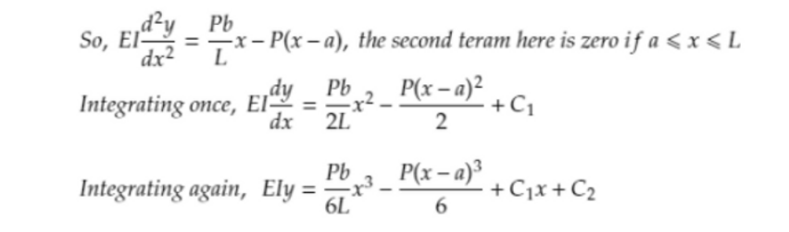
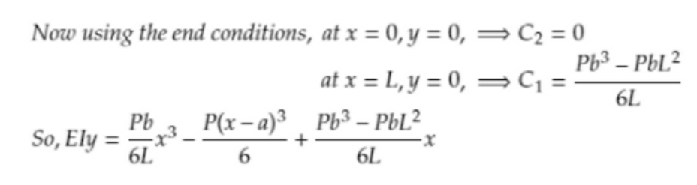
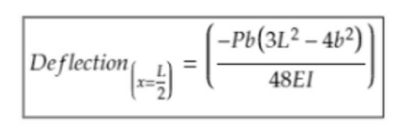
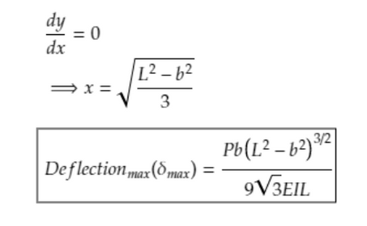
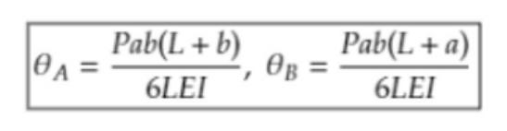
Step 3: Putting the bending moment value in double integration formula
Step 4: Solving the integration constants using boundary conditions
In this step we will apply the boundary conditions (at x = 0, y = 0 and at x = L, y = 0)
Step 5: Find deflection at any point
Step 6: Finding maximum deflection
At the point of maximum deflection, the slop should be zero. Equating the slope to zero, we can find the value of x.
Step 7: Finding slope
To find the rotation or slope, the equation of dy/dx(Refer step 3 for the equation) should be written again. Now putting the value of x (depending on the point where slope is to be found) the slope value can be determined.
In this case, to find slope of point A, x = 0 and for slope of point B, x = L.

Slide 12
Moment Area Method
This method is one of the most effective and mostly used methods for getting the bending deflections in beams as well as frames. Here in the method, the area of the bending moment diagrams is used for determining the slope and or deflections at specific points along the axis of the beam. There are two theorems,
First-moment area theorem: Used to find the slope at any point of a beam.
Second-moment area theorem: Used to find the deflection at any point of a beam.
Macaulay's method
Macaulay's method is a subcase of double integration method, in Macaulay’s method there is only one bending moment equation written across the whole span of beam, instead of writing different moment equations for different sections of the beam.

Slide 13
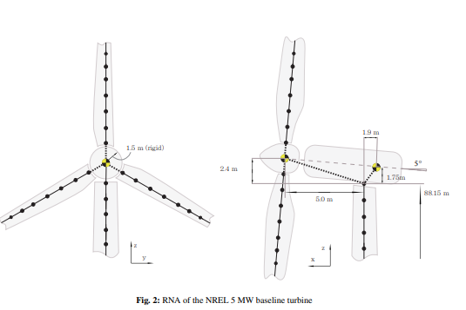
Application of Vectors for modelling of Wind Turbines
Traditionally, wind turbine dynamics are analyzed using aero-elastic codes based on geometrically simplified models. As hundreds of simulations are required per wind farm for verification purposes, such coarse models allow reasonable computation while still capturing the overall dynamic behavior.
Hence in this work we propose to use the concept of modal truncation augmentation, which consists in extending the reduction basis by adding “residual vectors”.

Slide 14

Model Truncation Augmentation
As a starting point we take the equations of motion of a discretized dynamic component model s:
Here M(s) , C (s) and K(s) are the components mass, damping and stiffness matrix, respectively. Vector u (s) (t) denotes the degrees of freedom, and ˙u (s) (t) and ¨u (s) (t) its respective time derivatives, f (s) (t) the external force vector and g (s) (t) the vector of the connection forces with other component models.

Slide 15


This gives the partitioned equations of motion of a component model as:
The reduction matrix of the Craig-Bampton method is now found as:
These formulas and the appropriate residual vectors, are being used in Superelement Modelling of an Offshore Wind Turbine Foundation

Slide 16
Conclusion
Vectors have many real life applications as it used to represent quantities that have magnitude as well as direction. Vectors is also used in our basc day-to-day activities like the motion of a car. Hence vectors are an important mathematical phenomenon for every field of studies including our topic for the project i.e civil structures

Slide 17
Bibliography
https://www.apsed.in/post/quick-guide-to-deflection-of-beams
http://wiki.dtonline.org/index.php/Calculating_Forces_in_Beams#Vectors
https://pdx.pressbooks.pub/archistructures/chapter/chapter-2-forces-and-vector-addition/
https://web.mit.edu/4.441/1_lectures/1_lecture5/1_lecture5.html

Slide 18
Thank You

