Slide 1
INTERPOLATION IN BANKING SYSTEM
ROLL NO.(69-73)

Slide 2
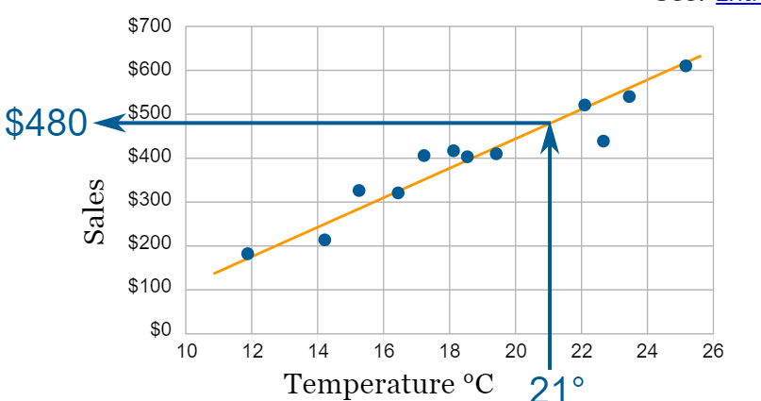
WHAT IS INTERPOLATION?
In the mathematical field of numerical analysis, interpolation is a type of estimation, a method of constructing new data points based on the range of a discrete set of known data points.
It is a statistical method by which related known values are used to estimate an unknown price or potential yield of a security. Interpolation is achieved by using other established values that are located in sequence with the unknown value.

Slide 3
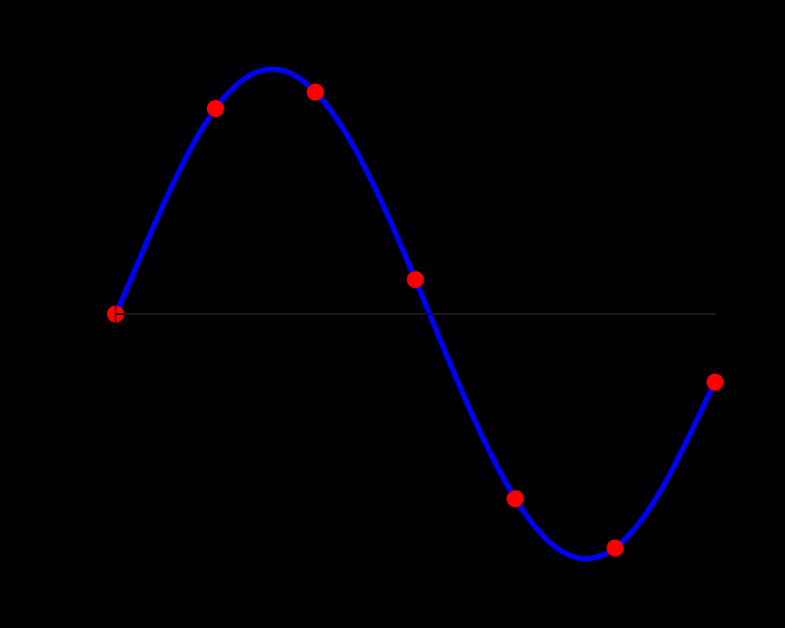
Interpolation is a method of deriving a simple function from the given discrete data set such that the function passes through the provided data points. This helps to determine the data points in between the given data ones.
It has a various number of applications in engineering and science, that are used to construct new data points within the range of a discrete data set of known data points or can be used for determining a formula of the function that will pass from the given set of points (x,y).

Slide 4
What is the Interpolation Formula?
So, it can be understood that the formula for Interpolation is a method of curve fitting using the linear polynomials and hence to construct new data points within the given range of a discrete set of known data points(the data points).
Linear Interpolation can be used since very early antiquity for filling the unknown values in any table.
As we know, Interpolation can be defined as a process of using the points with known values or the given sample points to estimate values at other unknown points.
Interpolation Methods can be used to predict unknown values for any geographic point data, for example, elevation, rainfall, chemical concentrations, noise levels, and so on.

Slide 5
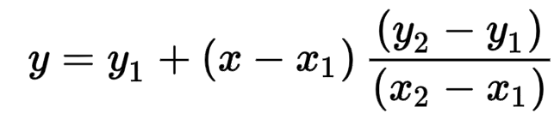
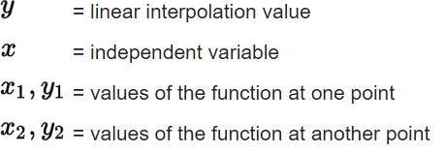
INTERPOLATION - Mathematical Formula
The formula
for interpolation —->
Is as follows
Where:

Slide 6
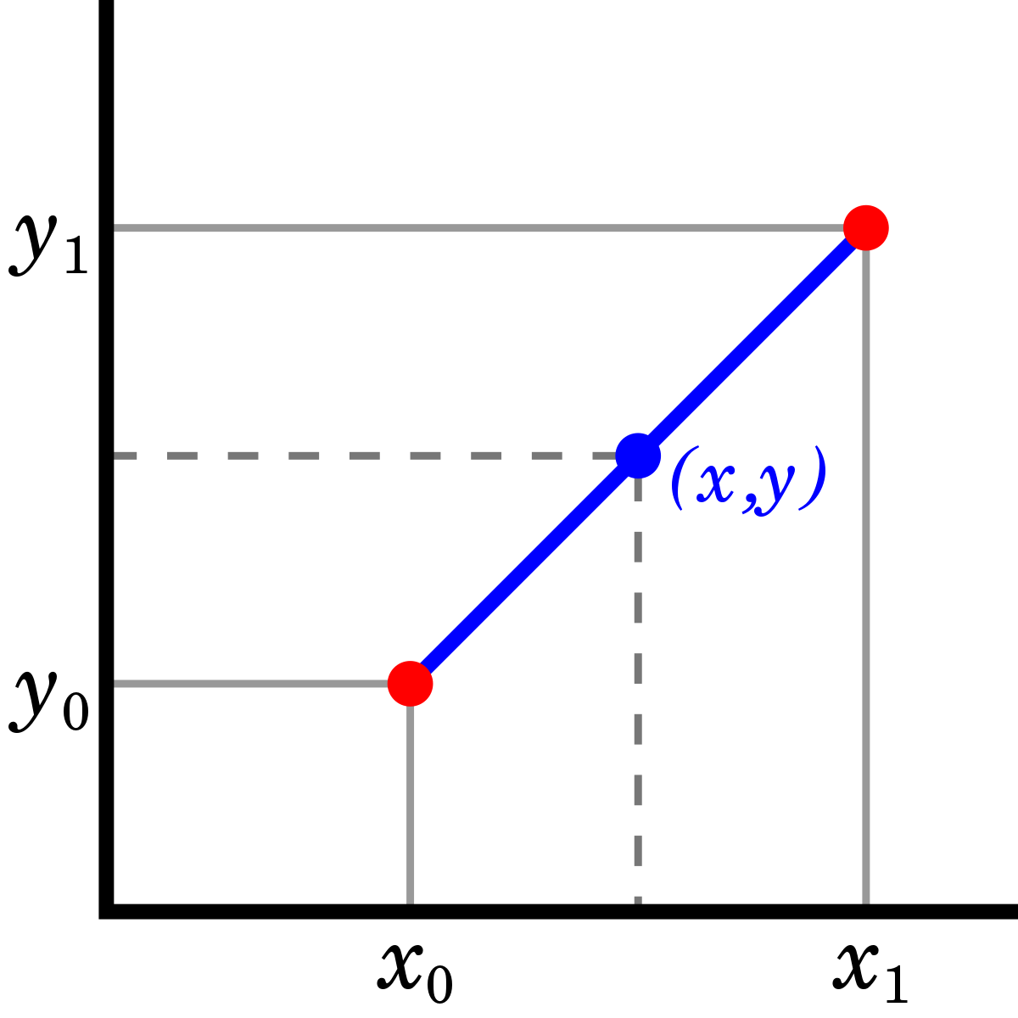
Types of Interpolation
Linear Interpolation Method – This method applies a distinct linear polynomial between each pair of data points for curves, or within the sets of three points for surfaces.
Nearest Neighbour Method – This method inserts the value of an interpolated point to the value of the most adjacent data point. Therefore, this method does not produce any new data points.
Cubic Spline Interpolation Method – This method fits a different cubic polynomial between each pair of data points for curves, or between sets of three points for surfaces.

Slide 7
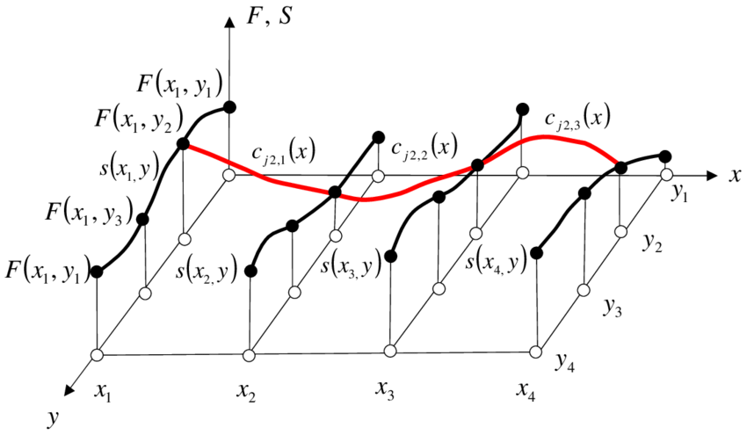
Shape-Preservation Method – This method is also known as Piecewise Cubic Hermite Interpolation (PCHIP). It preserves the monotonicity and the shape of the data. It is for curves only.
Thin-plate Spline Method – This method consists of smooth surfaces that also extrapolate well. It is only for surfaces only.
Biharmonic Interpolation Method – This method is applied to the surfaces only.

Slide 8
Real life applications of interpolation
Interpolation is helpful whenever you have to scale things up or down. Maybe you know how much catering costs for an event with 10 people and also 50 people as well as 100 people, but you need an accurate estimate of how much catering will cost for 25 people or 75.
Interpolation is also used to simplify complicated functions by sampling data points and interpolating them using a simpler function. Polynomials are commonly used for interpolation because they are easier to evaluate, differentiate, and integrate - known as polynomial interpolation.

Slide 9
Portfolio Management
Bankers also manage portfolios on behalf of both the bank and clients. A portfolio is a collection of such investments as stocks, bonds and currencies. How likely the assets are to move up or down in lockstep versus in opposing directions determines the potential performance of the portfolio.
To quantify these moves, bankers use a measure called correlation coefficient, which varies between -1 and 1. If two assets have a correlation coefficient of -1 they always exhibit opposing moves, while a figure of 1 means they mirror each other's moves. Using the correlation coefficient, the banker can calculate the maximum gain and loss in the portfolio.

Slide 10
Why is algebra used in banking?
Banks let you borrow at a certain interest rate. You can also deposit and the bank pays you an interest. variables and cross multiplication is the most common way to find interest.The concept of interest rates is perhaps the most frequently used mathematical concept in banking and finance. Interest rate is simply the cost of money over a specific period of time. Present value is closely related to interest rates and allows the banker to assess the value of a future payment stream.
It’s significance rises even more when a risk is to be assessed for a particular project :
Most future payments involve risk, since some or all of the payment may fail to materialize. To quantify the probability of loss, bankers use mathematical tools such as standard deviation. Standard deviation is a measure of how much the value of a variable tends to vary.
For example, a stock whose price moves up or down by 2 percent per day on average has a higher standard deviation than one whose price fluctuates 1.5 percent per day on average. The higher the standard deviation of an investment, the greater the probability of both a surprise gain as well as a big loss. These tools help bankers make key investment decisions.

Slide 11
Uses of INTERPOLATION in Banking
Determination of internal rate of return of a project.
Finding out the yield to maturity (ytm) of a bond or debenture.
Situations where the time value of money is considered and interpolations have to be made while using the present and future value tables

Slide 12
Application based problem
The cash inflows of a project involving an initial outlay of Rs.22 lakh is as follows:
Year | Rs (in lakhs)
1 | 10
2 | 10
3 | 6
4 | 3

Slide 13
The internal rate of return is the rate at which the total value of discounted cash outflows is exactly equal to the total value of discounted cash inflows. The internal rate of return of a project can be determined only through a process of trial and error.
Present value=Σ(X*v^n) …….(X=amount, n=no. of years, v=discount factor)
At discount rate of 10%(i=10%)
(10 x 0.909) + (10 x 0.826) + (6 x 0.751) + (3 x 0.683) = Rs.23.905 lakh.
At i=12%
(10 x 0.893) + (10 x 0.797) + (6 x 0.712) + (3 x 0.635)=Rs. 23.077 lakh.
At i=14%
(10 x 0.877) + (10 x 0.769) + (6 x 0.675) + (3 x 0.592) = Rs.22.29 lakh.
At i=15%
(10 x 0.870) + (10 x 0.756) + (6 x 0.658) + (3 x 0.572) = Rs.21.93 lakh.

Slide 14
At the discount rate of 15%, the discounted cash inflows are slightly lower than Rs.22 lakh. It can be concluded that the internal rate of return must lie somewhere between 14% and 15%. The technique of interpolation can be used to determine the exact rate of return.
Rate(y) | Discounted Cash flow (Rs. In lakhs)(x)
14% | 22.29
15% | 21.93

Slide 15
To find the discounted cash flow of 22 lakhs, we need to interpolate the discount rate using the linear interpolation method.
Since the discount rate will be higher than 14%
Therefore,
i=14%+((15%-14%)*(22-22.29)/(21.93-22.29))
=0.14805555555
≈14.81%
Thus the interpolated value of discount rate is 14.81% to get the discounted cash flow of 22 lakhs

Slide 16
Reference
https://www.quora.com/unanswered/How-is-interpolation-used-in-banking?q=interpolation%20in%20banking
http://www.expertsmind.com/questions/interpolation-applications-in-financial-analysis-30112021.aspx
https://www.investopedia.com/terms/i/interpolation.asp#:~:text=Interpolation%20is%20a%20simple%20mathematical,by%20using%20related%20known%20values.

Slide 17
Presentation by
Roll no. | Name
69 | Yashvi Shah
70 | Divya Sharma
71 | Poorva Shinde
72 | Manav Shivalkar
73 | Deepika Shorewala

Slide 18
Thank You!

