Slide 1
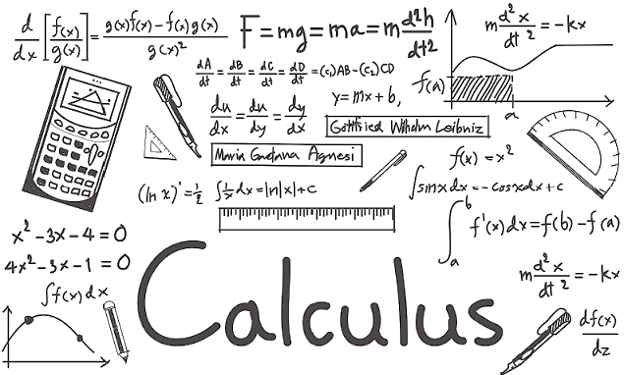

Slide 2
CALCULUS PROJECT
FINANCE:APPLICATION OF CALCULUS BY CREDIT CARD COMPANIES
V V VAISHNAVI
FY SECTION B
ROLL NO: 85

Slide 3
Credit card companies use calculus for the following:
Finding the minimum balance
Finding the available balance
Calculating compound interest
Store credit cards can be used to determine the amount of money a customer spends at a retail store. The expenditure is used to award points every time customers shop. The process of calculating how many points to be awarded to the customers is done through calculus.

Slide 4
MAJOR USE:
To set the minimum payments due on credit card statements at the exact time the statement is processed.

Slide 5
HOW?

Slide 6
Credit card companies use the differential type of calculus to calculate this amount. There are several variables that go into the calculation because it is calculated by the amount of money that is due by a certain time (usually the due date that is listed on the bill). Add on to that the interest rate given and it becomes a complicated task. With all the changing parts, interest rates and available balances, the calculation has to be done simultaneously in order to provide the customer with an accurate minimum balance.
The calculation that is used to determine the minimum payment starts with determining the interest that has accrued since the last payment, or over the month.

Slide 7


