Slide 1
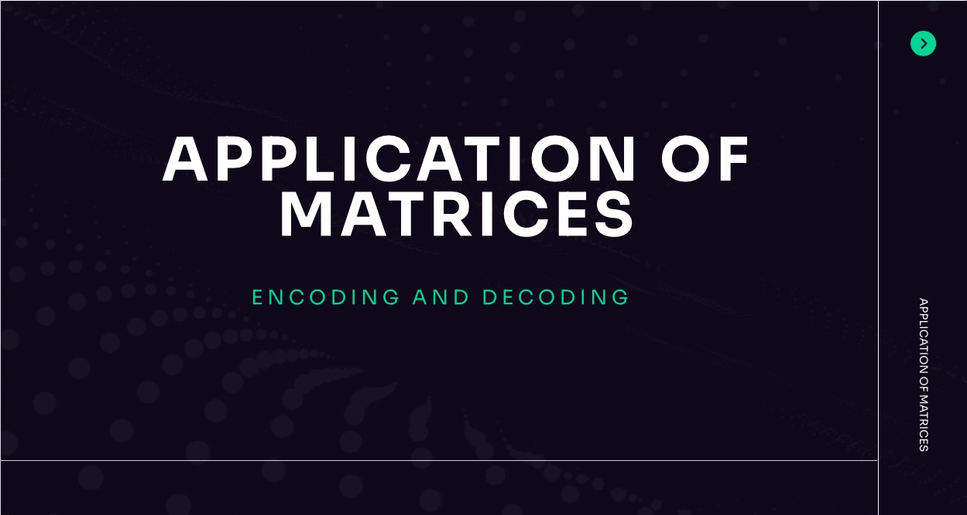

Slide 2
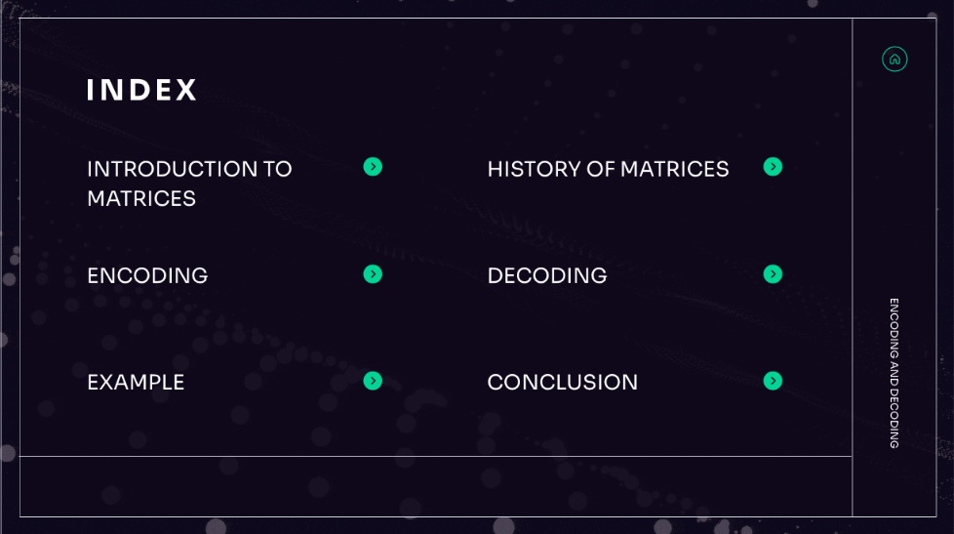

Slide 3
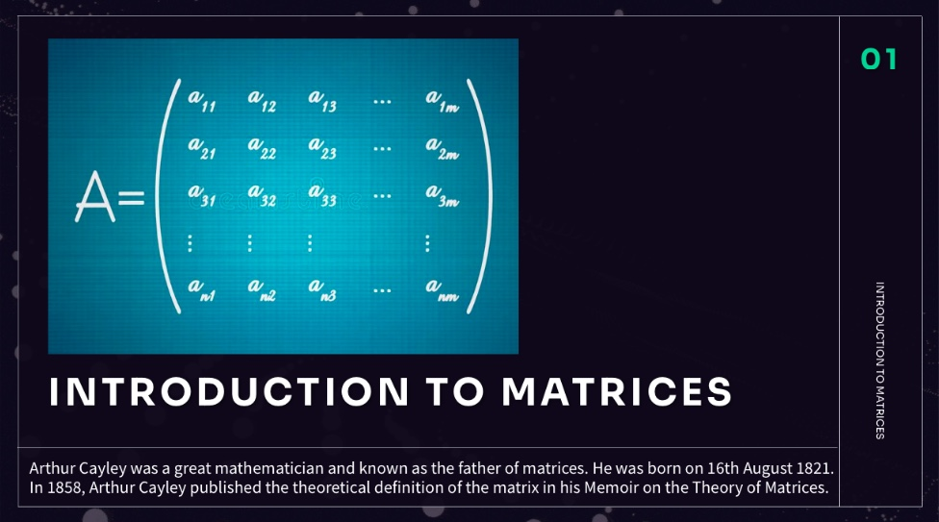

Slide 4
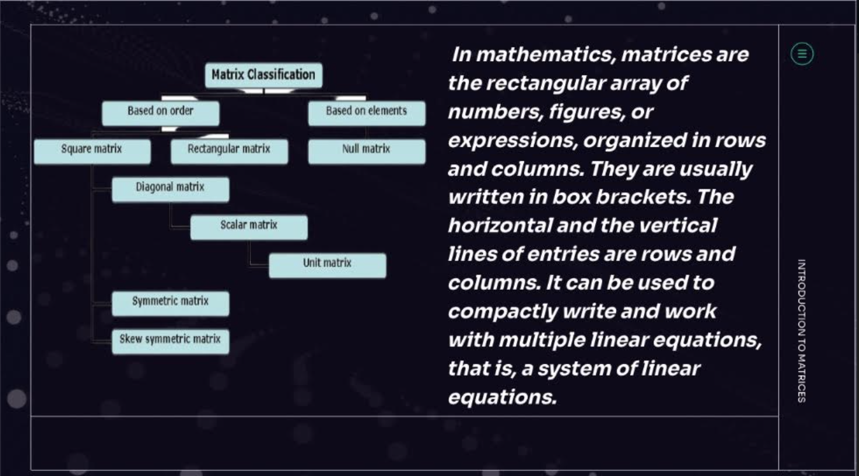

Slide 5
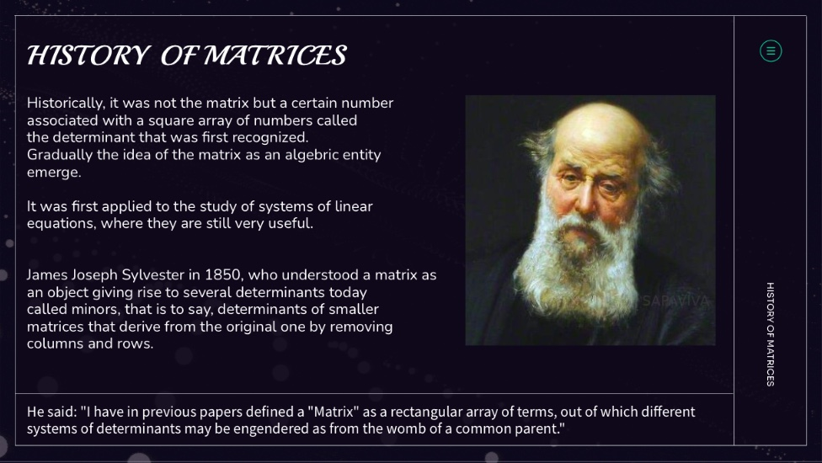

Slide 6
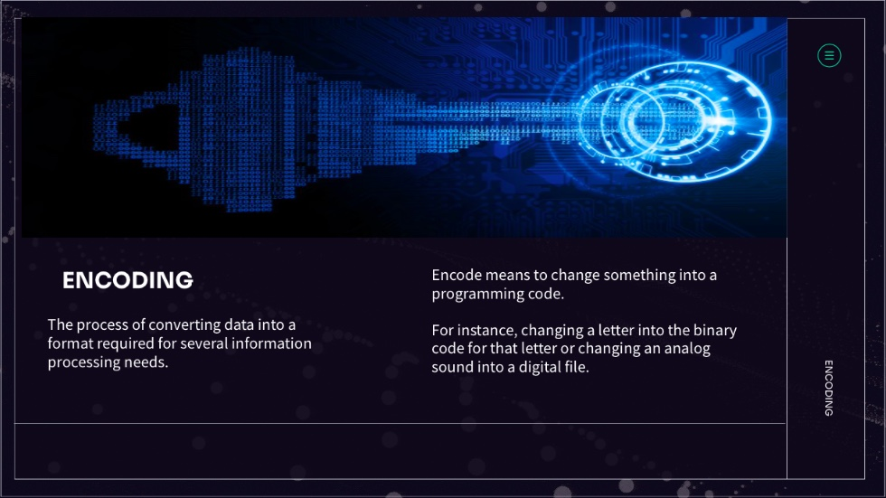

Slide 7
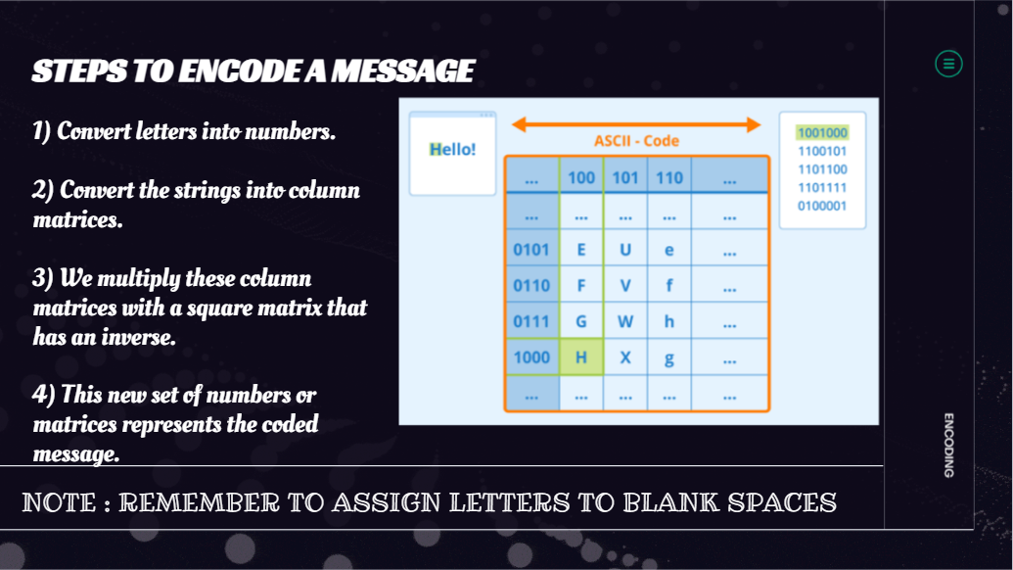

Slide 8
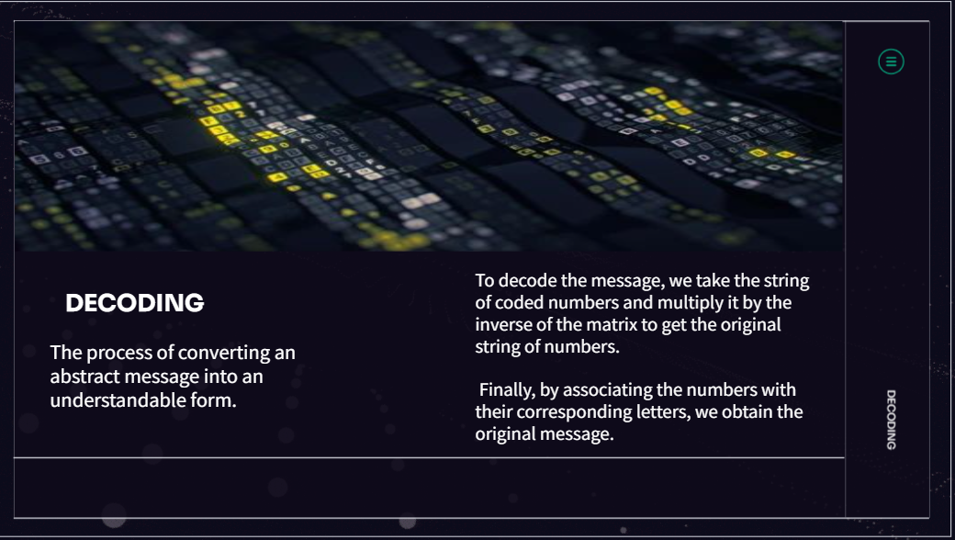

Slide 9
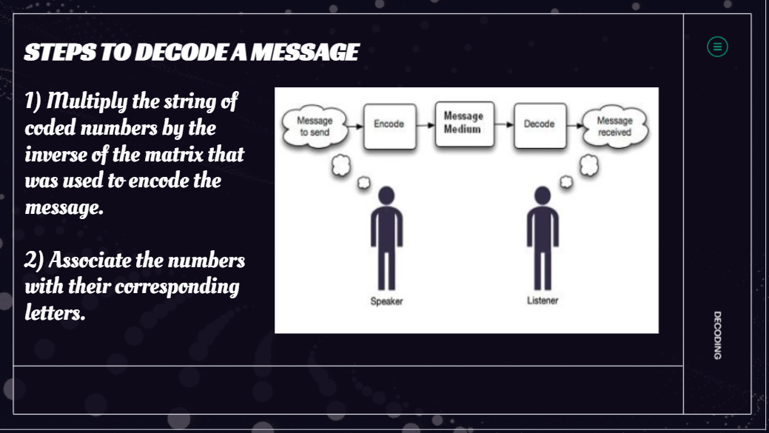

Slide 10

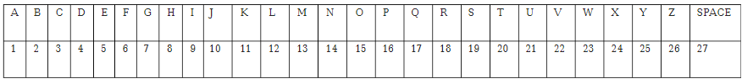
PROCEDURE
Convert alphanumeric messages to numbers
Every alphabet is assigned a number
Space: number 27 and punctuations: ignored
2) Generate matrix from number
The generated matrix will be multiplied by the secret key
So should fulfil the property of matrix multiplication
3) Generate a secret key
A secret key is needed to encrypt and decrypt messages where it I secretly shared btw two communicating parties
It must be communicated through an external mechanism separate from the communication channel over which the encrypted text follows
Using this secret key it’s easy to decrypt the encoded message

Slide 11
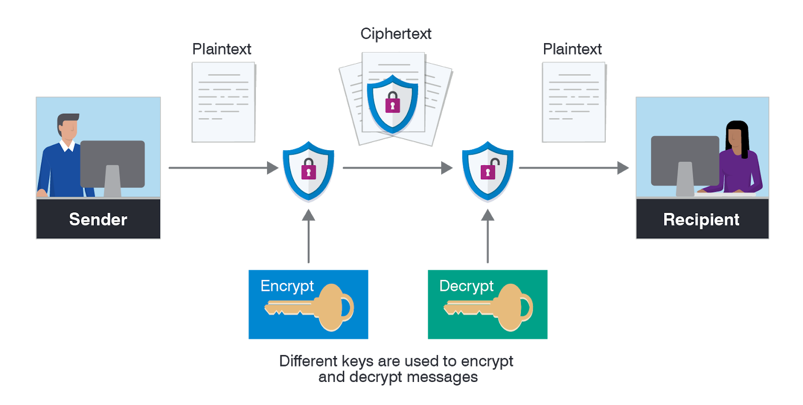


Example:
1) John and Mary agree on a prime number p and a nonzero integer g which is called a generator. These values p and g are made public and can be shared via mail.
2) John picks a secret integer ‘a’ that he does not reveal to anyone, while at the same time Mary picks an integer ‘b’ that she keeps secret
Mary and Erick compute the following,
$$A=g^{a} mod p \left(john\right) B=g^{b} mod p (mary)$$
3) They later exchange A and B i.e., Erick sends A to Mary and Mary sends B to John, since these numbers are sent through mail they cannot be considered secret because they can be cracked by a hacker who is a third party.
4) Finally, John and Mary again use their secret integers to compute :
$$k=B^{a} mod p \left(john\right) k =A^{b} mod p (mary)$$
The resulting figure k is common to Erick and Mary and it is
considered to be the secret key. The generated key must be invertible

Slide 12


Use matrix A =$\begin{matrix}1 & 2 \\ 1 & 3 \end{matrix}$ to encode the message : “ATTACK NOW
We divide the letters of the message into groups of two.
AT TA CK -N OW
We assign the numbers to these letters from the above table and convert each pair of numbers into 2×1 matrices. In the case where a single letter is left over on the end, a space is added to make it into a pair.
$\left[\begin{matrix}A \\ T\end{matrix}\right]= \left[\begin{matrix}1 \\ 20\end{matrix}\right] \left[\begin{aligned}T \\ A\begin{matrix} \\ \end{matrix}\end{aligned}\right]= \left[\begin{aligned}20 \\ 1\begin{matrix} \\ \end{matrix}\end{aligned}\right] \left[\begin{aligned}C \\ K\end{aligned}\right]= \left[\begin{aligned}3 \\ 11\end{aligned}\right]$ $\left[\begin{aligned}− \\ N\end{aligned}\right]= \left[\begin{aligned}27 \\ 14\end{aligned}\right]$ $\left[\begin{aligned}O \\ W\end{aligned}\right]= \left[\begin{aligned}15 \\ 23\end{aligned}\right]$
So at this stage, our message is expressed as 2×1 matrices as follows :
$\left[\begin{aligned}1 \\ 20\end{aligned}\right]$ $\left[\begin{aligned}20 \\ 1\end{aligned}\right]$ $\left[\begin{aligned}3 \\ 11\end{aligned}\right]$ $\left[\begin{aligned}27 \\ 14\end{aligned}\right]$ $\left[\begin{aligned}15 \\ 23\end{aligned}\right]$

Slide 13

Now to encode, we multiply, on the left, each matrix of our message by the matrix A
For example, the product of A with our first matrix is:
$\left[\begin{matrix}1 & 2 \\ 1 & 3\end{matrix}\right]$ $\left[\begin{matrix}1 \\ 20\end{matrix}\right]$ = $\left[\begin{matrix}41 \\ 61\end{matrix}\right]$
And the product of A with our second matrix is:
$\left[\begin{matrix}1 & 2 \\ 1 & 3\end{matrix}\right]$ $\left[\begin{aligned}20 \\ 1\end{aligned}\right]$ = $\left[\begin{aligned}22 \\ 23\end{aligned}\right]$
Multiplying each matrix in (I) by matrix A, in turn, gives the desired coded message:
$\left[\begin{aligned}41 \\ 61\end{aligned}\right]$ $\left[\begin{aligned}22 \\ 23\end{aligned}\right]$ $\left[\begin{aligned}25 \\ 36\end{aligned}\right]$ $\left[\begin{aligned}55 \\ 69\end{aligned}\right]$ $\left[\begin{aligned}61 \\ 84\end{aligned}\right]$

Slide 14
CONCLUSION
Coding and decoding with matrices compress large messages to those occupying less space. So it has reduced both the time involved as well as the size of the messages.
Also these days we see a huge number of cyberattacks, hacking, and unofficial usage of data. With the increase of insecurity in passing sensitive data(like data or messages from national security agencies like RAW, NIA, or from one official of these agencies to the other), the application of matrices in coding and decoding of messages can be used in passing data in a secured manner. So Matrices provide an effective, secure, and efficient way of transferring data like messages, thus reducing the possibility of cybercrimes.
Recommendation
Future research studies should use advanced coding techniques like Data Encryption Standard
(DES). This will help in minimizing cybercrime more so in the hacking of sensitive information passed between two parties(whether they be agencies or persons).

Slide 15
BIBLIOGRAPHY
 | britannica math.libretexts.org https://www.researchgate.net/publication/350640240_Applications_of_Matrices_to_Cryptograph www.britannica.com byjus.com Wikipedia www.vedantu.com news.mit.edu

Slide 16


