Slide 1

CASE STUDY 1
Application of econometric models
Aryan Singh Rajawat Roll no. 27

Slide 2

WHAT IS AN ECONOMETRIC MODEL?
An econometric model specifies the statistical relationship that is believed to hold between the various economic quantities pertaining to a particular economic phenomenon.

Slide 3
Selection and segmentation of variables
Model Sign-Off and implementation
Discussion with the stakeholders
06
01
11
model
Identifying raw data source
Performance testing
07
Ongoing Model Risk Management
02
12
Roadmap to
Initial data collection process
Stattistica testing
03
08
Analyse changes and aggregate data
Stress testing and sensitivity Analysis
04
09
Specifying the model framework
Independent model validation
05
10

Slide 4
Macroeconomic factors
Real GDP Growth
Nominal GDP growth
Real Disposable Income Growth Nominal Disposable Income Unemployment Rate
CPI Inflation Rate 3-month Treasury Rate 5-year Treasury Yield
10-year Treasury Yield BBB Corporate Yield Mortgage Rate
Money Supply
FED Funds Rate VIX CLS
TED Spread
Composite Leader Indicator consumer confidence index Business Confidence Index (USD/euro)
(yen/USD) (USD/pound)
Prime Rate
House Price Index
Commercial Real Estate Price Index
Market Volatility Index

Slide 5
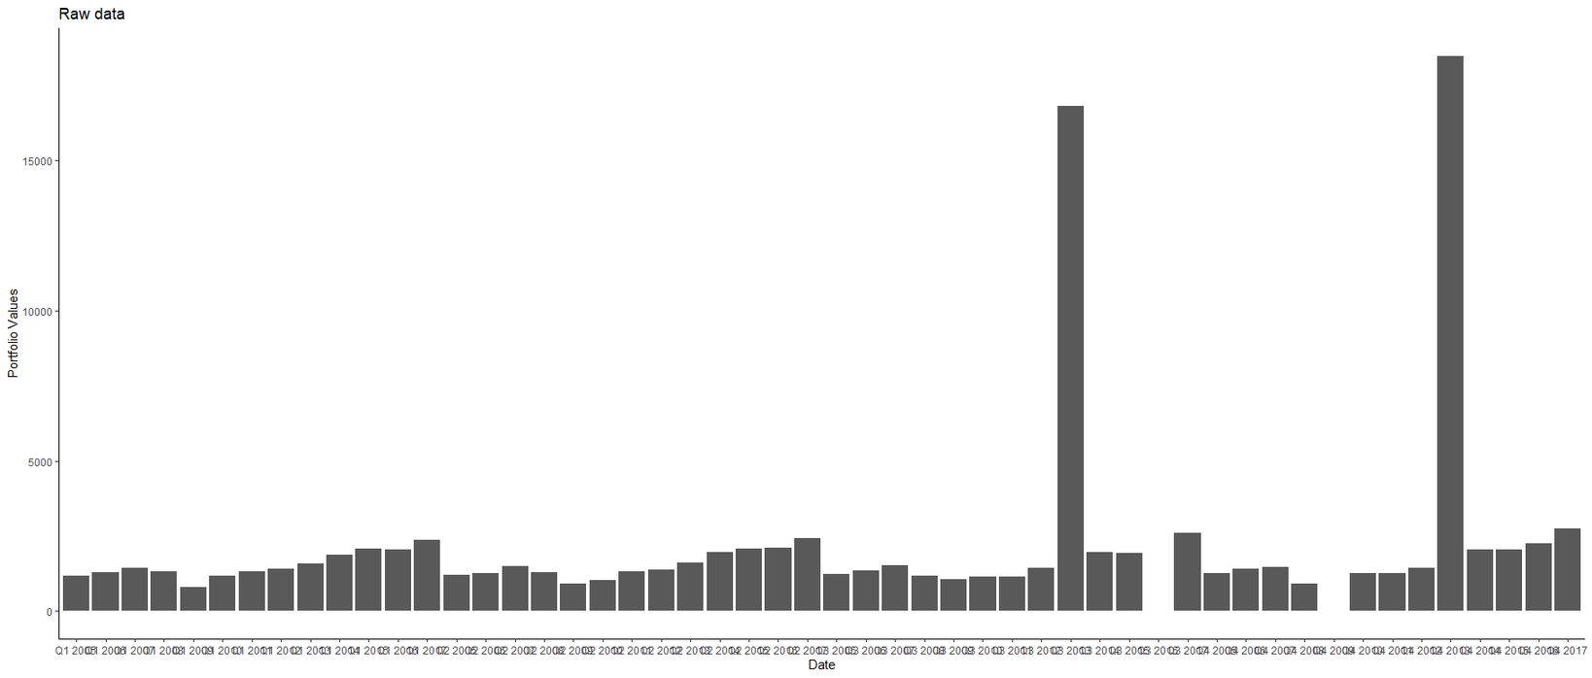
Portfolio value analysis
On visual inspection of the portfolio value graphs, we found out that there were some missing values and outliers in the portfolio data.

Slide 6
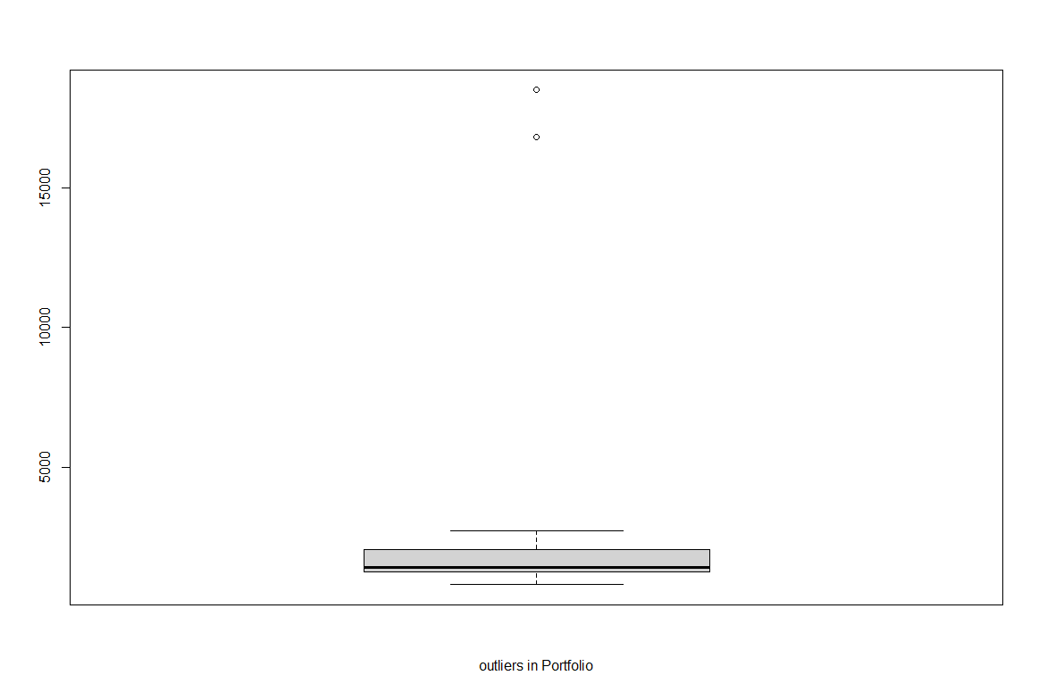
Outlier detection

Slide 7
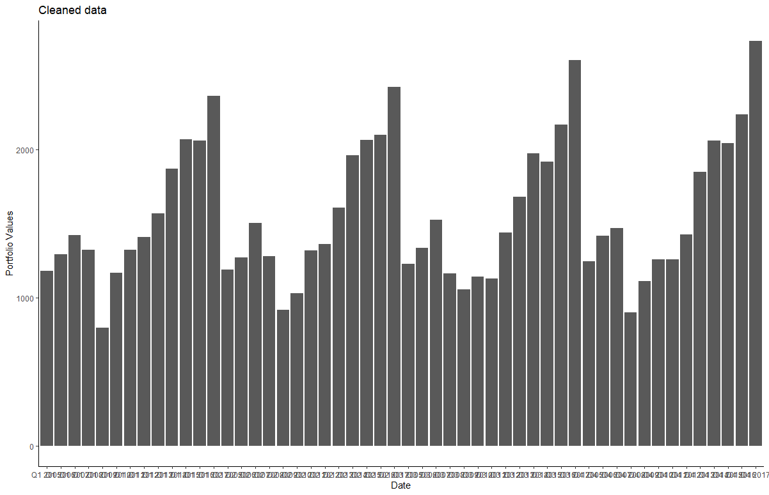
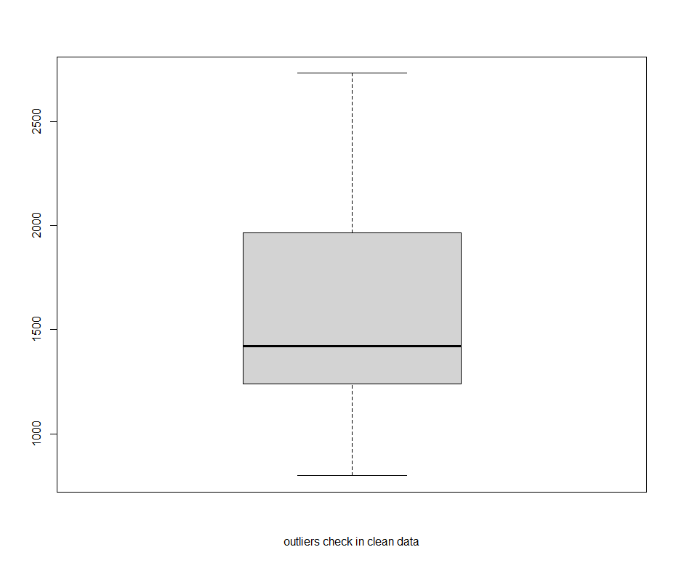
Cleaning raw portfolio data
We will clean the raw data by checking the reasons for the outliers and interpolating the missing values.

Slide 8

Clean Data summary

Slide 9
Correlation test
After cleaning the data we check for the correlation between dependent and independent variables.
We conclude the factor is significant if its correlation coefficient is greater than absolute value of 0.6

Slide 10
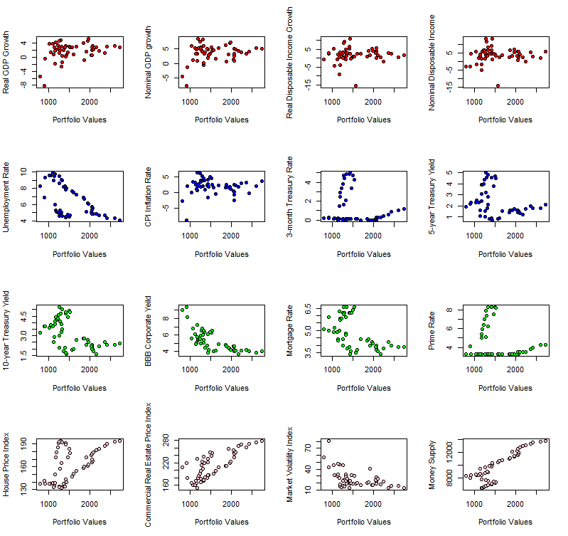
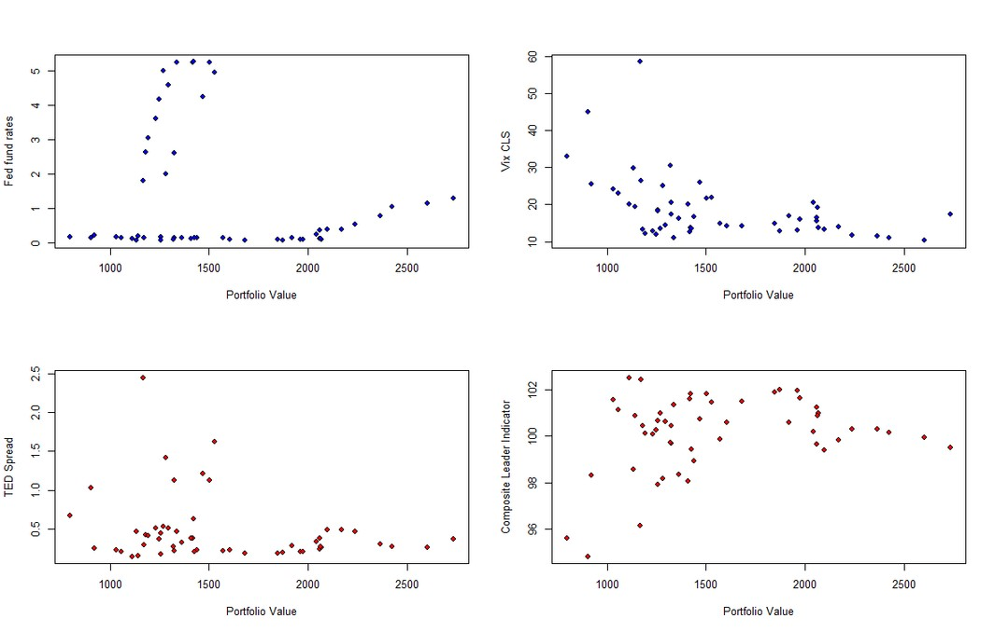
Visual Inspection for correlation

Slide 11
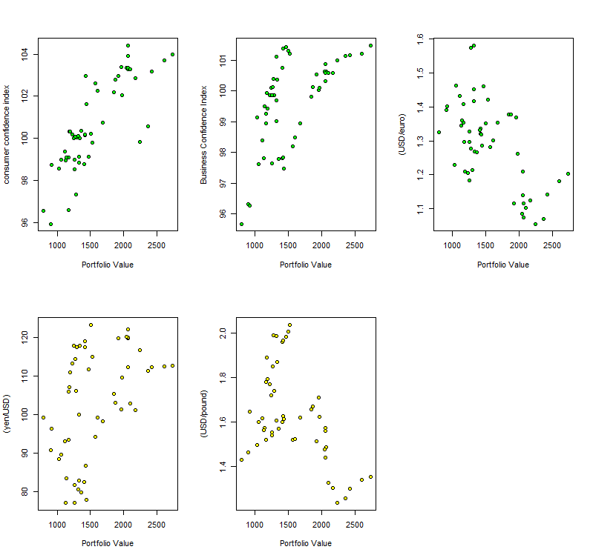
Visual Inspection for correlation
Upon visual inspection we concluded that the Macroeconomic variables like
Nominal Disposable Income, BBB Corparate yield,
Commercial Real Estate Pricing Index, Money supply,
Consumer Confidence Index, Business Confidence Index,
Usd/euro
shows a good correlation with portfolio values. let us inspect the correlation by keeping a threshold of |0.6|

Slide 12
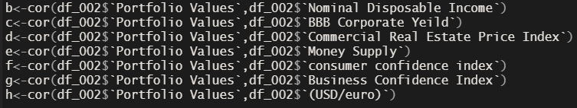
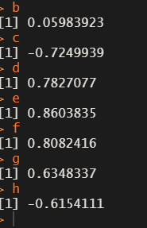
All the variables except b passed the threshold
Which means that all macroeconomic variables except Nominal Disposable income
shows desired correlation with Portfolio Values

Slide 13
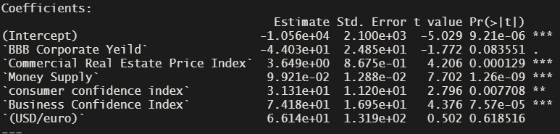
Iteration 1

Slide 14
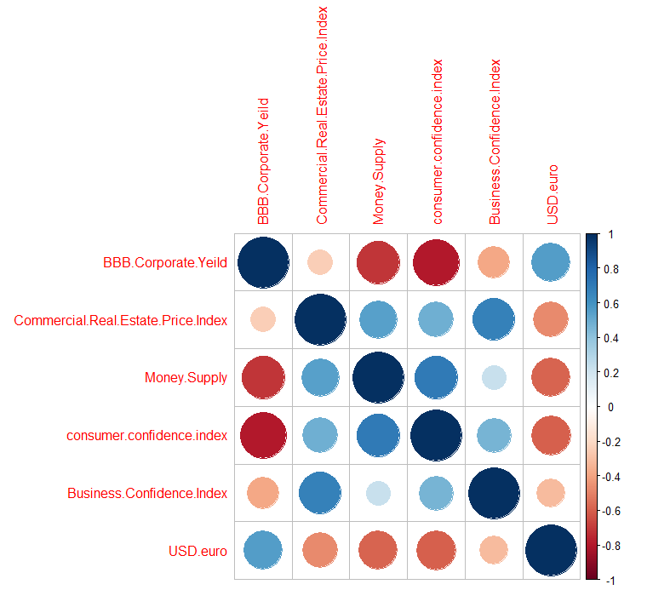
Check for multicol inearity
From the multicorrelation matrix and multicollinearity plot we noticed that there was a very high correlation between
money supply, consumer confidence index and BBBcorparate yield.
so we will eliminate money supply from the model first and then look at the summary

Slide 15
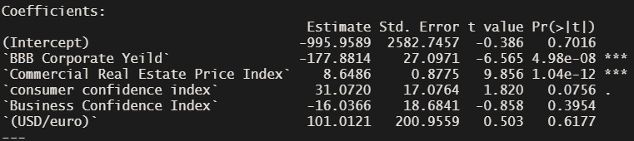
Iteration 2
USD/euro and business confidence index have a very high p-value so they are not significant statistically
therefore we will remove them from the model

Slide 16
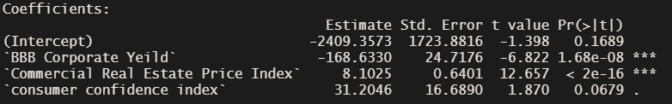
Iteration 3
looking at the summary we were getting an r square value of 92%
let's try eliminating the consumer confidence index and then look at the summary

Slide 17
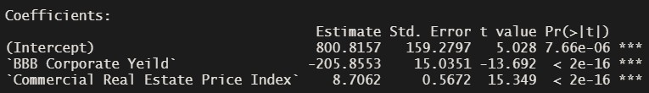
Iteration 4

Slide 18
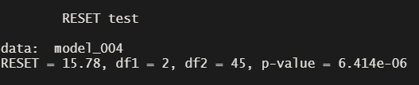

Testing for linearity
We will use the Ramsey testto test for linearity
Apply log Transformation on the portfolio values

Slide 19
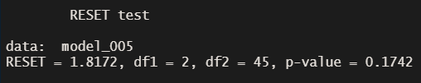
Testing for linearity
Although the p-value is 17% let us transform the dependent variable and see its effect on the p-value

Slide 20
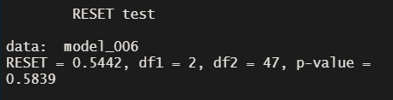
Testing for linearity
The p value in almost 58%

Slide 21
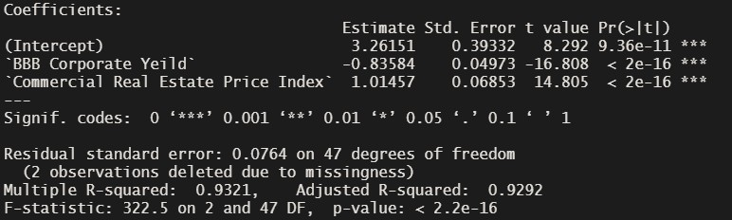
Final model summary

Slide 22
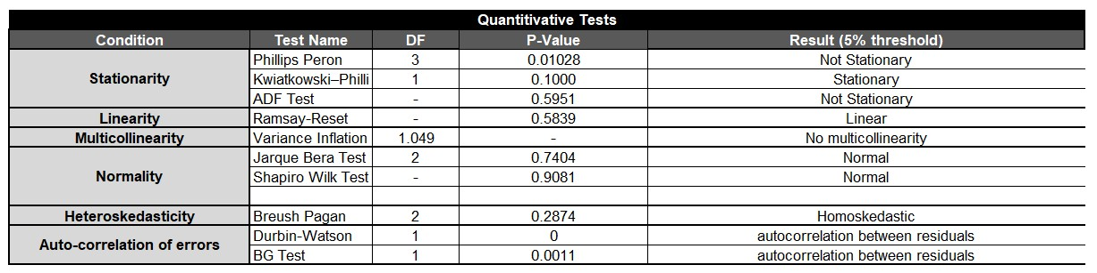
Quantitative test

Slide 23
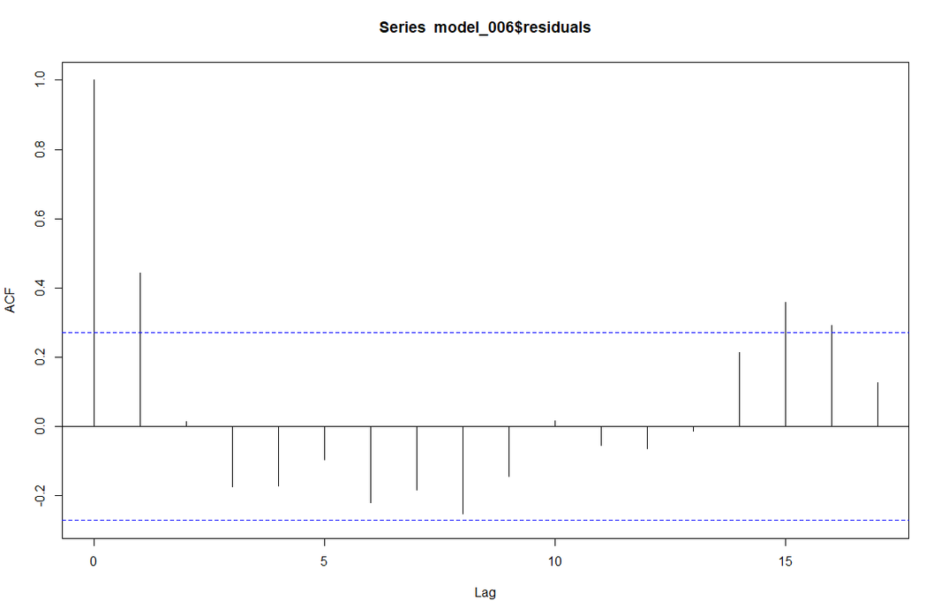
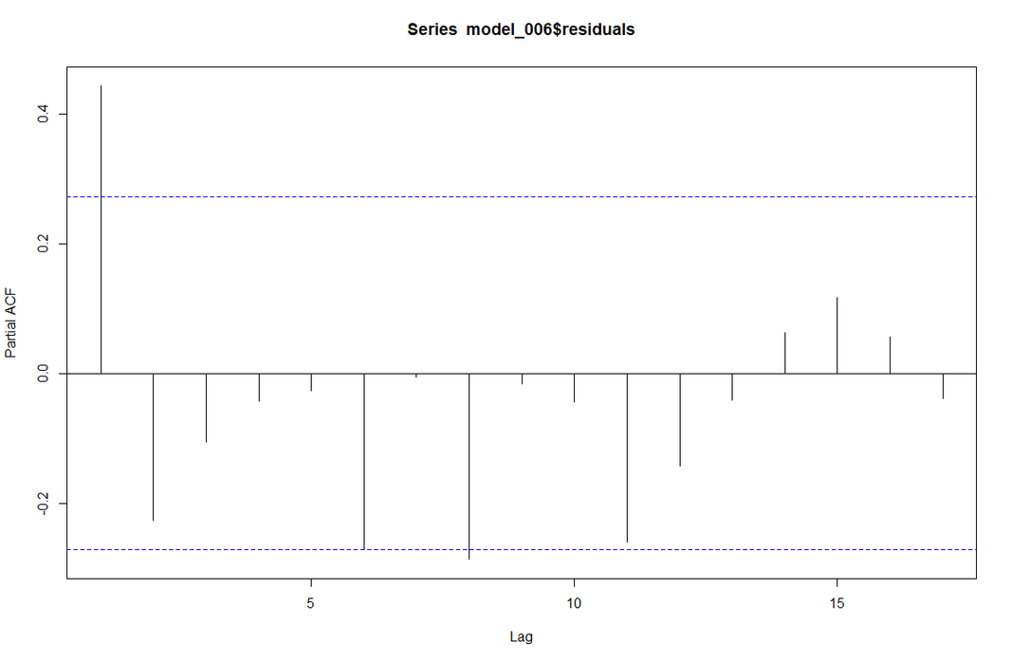
Qualitative Test
ACF values die out at lag 2, PACF values die out at lag 6.

Slide 24
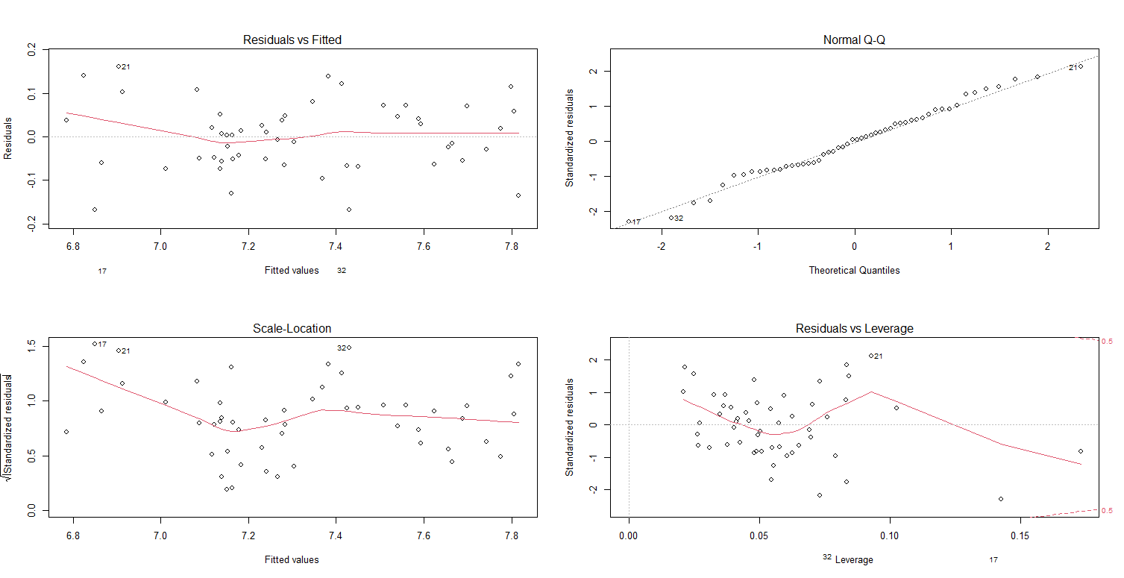
Qualitative Test

Slide 25
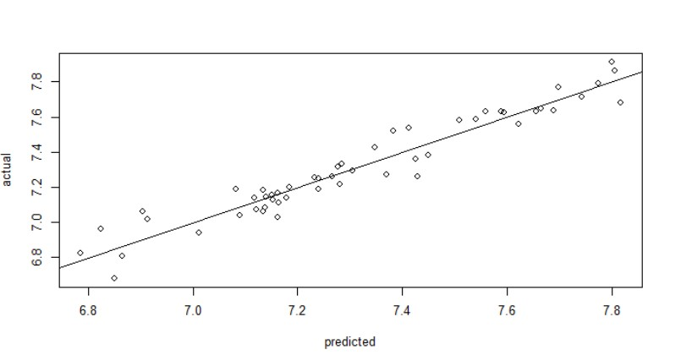



In sample analysis

Slide 26
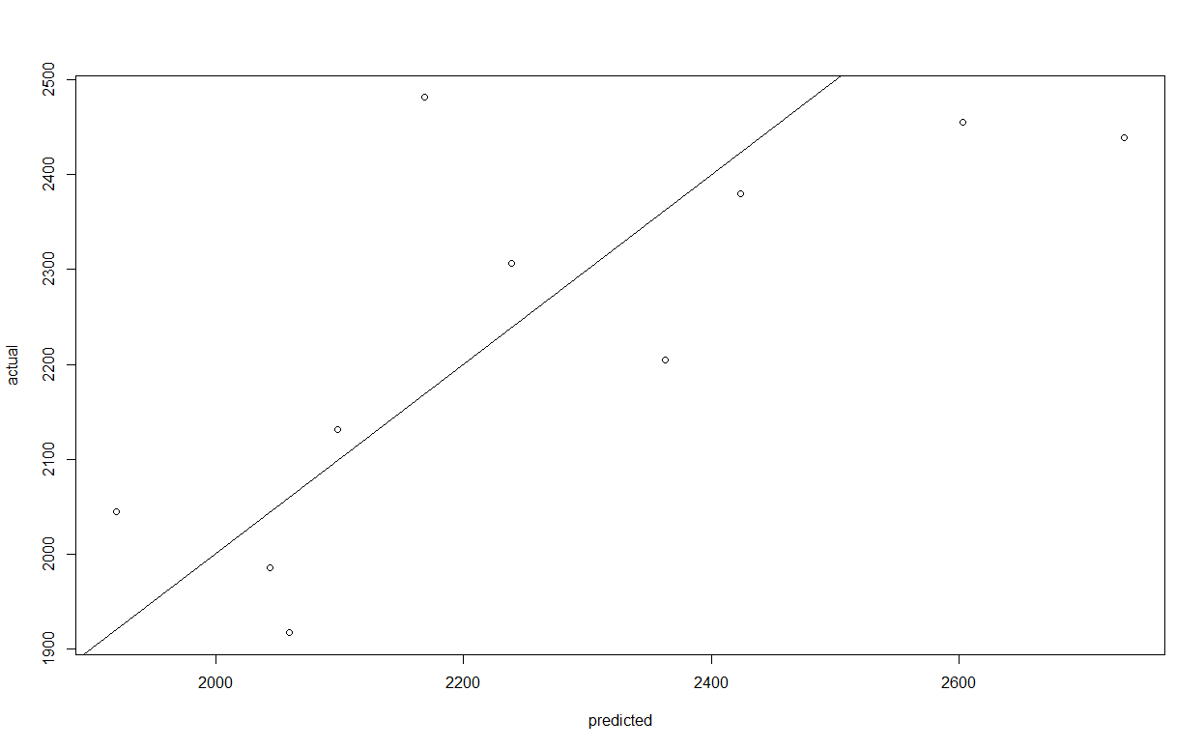



out of sample analysis

Slide 27
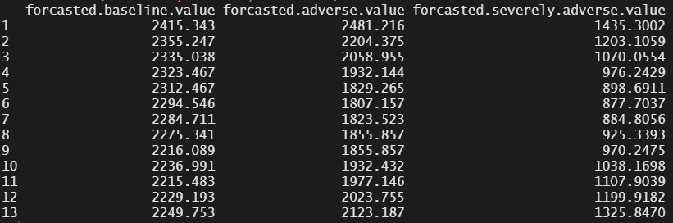
The predicted value for each scenerio

Slide 28
Final Calculations
The capital requirement at a portfolio (CRP) is
166.0697

