Slide 1
FINANCE : APPLICATION OF CALCULUS BY CREDIT CARD COMPANIES
DONE BY-
SAKSHI TRIPATHI
KRISHANGI TRIVEDI

Slide 2
APPLICATION OF CALCULUS IN FINANCE
How is calculus used in finance?
Calculus is used even in the very basic form of Options and Derivatives in Finance. Simply, how would you calculate the rate of change on any of your calls and puts? In risk management, technical and fundamental analysis and all other quantitative financial transaction calculus is used almost every day.
Finance It is used for Portfolio Optimization i.e., how to choose the best stocks. Some of the real life applications of differential calculus are listed below: Statisticians will use calculus to evaluate survey data to help develop business plans. A survey involves many different questions with a range of possible answers, calculus allows a more accurate prediction.

Slide 3
INTRODUCTION
Credit card companies make money by collecting fees. Out of the various fees, interest charges are the primary source of revenue.
When credit card users fail to pay off their bill at the end of the month, the bank is allowed to charge interest on the borrowed amount.
Other fees, such as annual fees and late fees, also contribute, though to a lesser extent. Another major source of income for credit card companies are fees collected from merchants who accept card payments. Calculus is used by the credit card companies in this area.

Slide 4

INTRODUCTION TO USE OF CALCULUS IN THE CREDIT CARD SECTOR
Credit card companies use calculus to set the minimum payments due on credit card statements at the exact time the statement is processed by considering multiple variables such as changing interest rates and a fluctuating available balance.
This Photo by Unknown Author is licensed under CC BY-SA

Slide 5
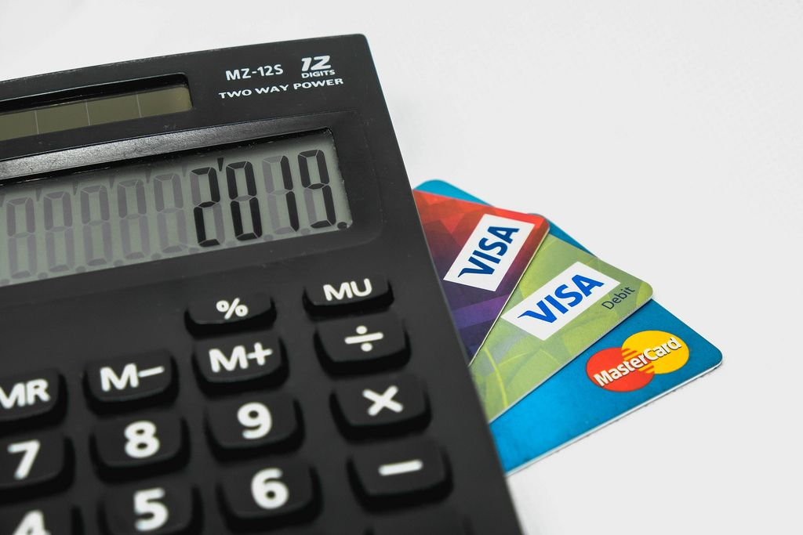
When minimum payments on a credit card needs to be computed, calculus is the method used.
Credit card companies use the differential type of calculus to calculate this amount. There are several variables that go into the calculation because it is calculated by the amount of money that is due by a certain time (usually the due date that is listed on the bill).
Add on to that the interest rate given and it becomes a complicated task.

Slide 6

CALCULATING THE ACCURATE MINIMUM BALANCE
With all the changing parts, interest rates and available balances, the calculation has to be done simultaneously in order to provide the customer with an accurate minimum balance.
The calculation that is used to determine the minimum payment starts with determining the interest that has accrued since the last payment, or over the month.

Slide 7
To calculate the amount of interest, the following calculation is done:
Accrued interest = Beginning balance * (interest rate/12)
The 12 in the calculation represents the number of months in a year. So, if you have a beginning balance of 5,400 and an interest rate of 9.75%, the accrued interest for the month would be $43.88.

Slide 8

Once that amount is calculated, then we can find out what the minimum payment is. After establishing the credit and signing up with the credit card company, a minimum monthly payment was set for what absolutely have to be paid on the card each month even if you used it that month or not. Most of the time, this amount is pretty small; $20 is what is usually set.

Slide 9
The minimum payment that is on the credit card statement is
calculated as such:
=MAX (Minimum month payment, interest + minimum monthly
payment)
This means that if the interested accrued added to the minimum monthly payment is less that the set minimum monthly payment, then the largest amount must be paid.

Slide 10
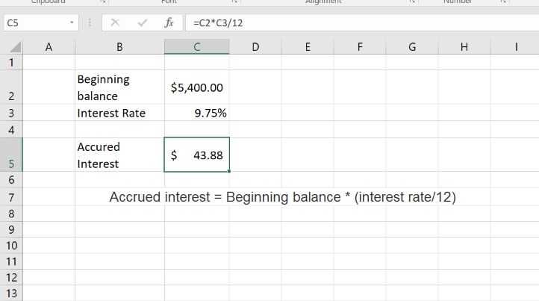
For instance, take the problem above. The minimum payment is $20 and the interest is $43.88;
Those two added together would be $63.88.
Based on this problem, the minimum
payment would be $63.88
because it is the larger amount.
p

Slide 11
CONCLUDING THE IMPACT OF CALCULUS IN THE MORDERN WORLD
In this innovation, differential calculus was used to determine the most accurate and least possible balance of a credit card user. Imagine if calculus hasn’t been discovered, then credit card companies would have a hard time calculating the minimum balance if not impossible. That is why it is essential in the banking and finance sector because it uses the concept of changes most of the time and the values computed are usually high and plenty.
In this innovation, differential calculus was used to determine the most accurate and least possible balance of a credit card user. Imagine if calculus hasn’t been discovered, then credit card companies would have a hard time calculating the minimum balance if not impossible. That is why it is essential in the banking and finance sector because it uses the concept of changes most of the time and the values computed are usually high and plenty.

Slide 12
ACKNOWLEDGEMENT
The Calculus project based on “Finance: Application of calculus in Credit Card Companies" assigned to us by Anurag Gupta sir has been an extremely informative project for each and every person present on the group. Our group members Sakshi Tripathi and Krishangi Trivedi have given their valuable contributions
.
Both the members worked together on the content research and combined their creative skills to understand and put together this presentation.
It has been a pleasure to work together. We thank our teacher for giving us this golden opportunity.

Slide 13
BIBLIOGRAPHY
https://www.quora.com/How-is-calculus-used-in-finance
https://www.embibe.com/exams/real-life-applications-of-calculus/
https://www.sapling.com/4696774/credit-card-companies-use-calculus
https://amsmathcon.wixsite.com/numbersdemystified/post/the-impact-of-calculus-to-the-modern-world

Slide 14
THANKYOU!

