Slide 1
Movie-making
Use of Calculus
Group 2

Slide 2
Introduction
Math isn't everyone's cup of' tea. Lots of people hate it, very, very, very few love it. But you know what, everyone needs it to some degree, at least even filmmakers.
Luckily, working in film doesn't require you to understand advanced calculus or operator algebra, just using a few simple calculations will do just fine.

Slide 3
01
Role Specific Application

Slide 4
Application
Production: Many of the producer's everyday duties require the use of math. Though most of these duties involve creating and adjusting the movie's budget, the constant recalculations require more than a cursory knowledge of accounting practices and math.
Animation: Not surprisingly, animators use math more than anyone else in the industry. While much of this work is sometimes done by a computer, animators are still required to have practical knowledge of many advanced mathematical concepts. Depending on the film's complexity, this can include anything from basic algebra and trigonometry to integral calculus, geometry, and harmonics.
Cinematography and camera: A great deal of math goes into the work of the cinematographer and their cameramen. Much of this work has to do with the video camera itself, which requires the use of math to choose the appropriate aperture speeds, the location of focal points, and to decide on the best camera angles for a given shot.

Slide 5
Movie Equipments and Calculus
02

Slide 6
Movie and Equipment
In a very important sense, almost every aspect of filmmaking is heavily dependent on math. This is because the process of filming a movie involves the use of equipment that is based on different forms of science and technology, which in their turn are founded on the strict application of mathematical principles. In other words, one of the many ways that math is involved in filmmaking is through its equipment.
For instance, can you imagine making even the simplest video camera without a deep understanding of optics, geometry, and trigonometry? How about light meters, sound equipment, and the incredible amounts of electricity required to make a single movie? This is just scratching the surface, but even a little reflection will tell you that none of this equipment would be possible without math.
So right off the bat, before production actually begins, we see one of the many ways that math enters the realm of filmmaking

Slide 7
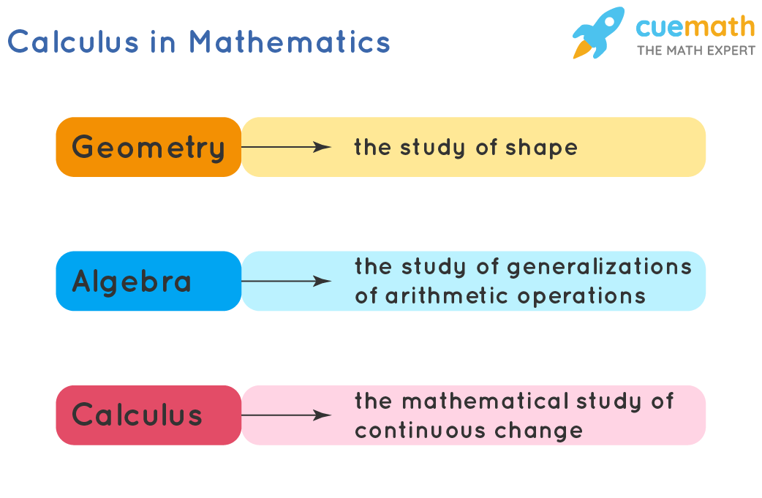
Calculus
Calculus is one of the most important branches of mathematics that deals with continuous change. The two major concepts that calculus is based on are derivatives and integrals. Such concepts are widely used in cinematography.
Calculus is also referred to as infinitesimal calculus or “the calculus of infinitesimals”. Infinitesimal numbers are the quantities that have value nearly equal to zero, but not exactly zero. Generally, classical calculus is the study of continuous change of functions.
Calculus in Mathematics is generally used in mathematical models to obtain optimal solutions and thus helps in understanding the changes between the values related by a function.

Slide 8
03
Movie Math Calculations

Slide 9
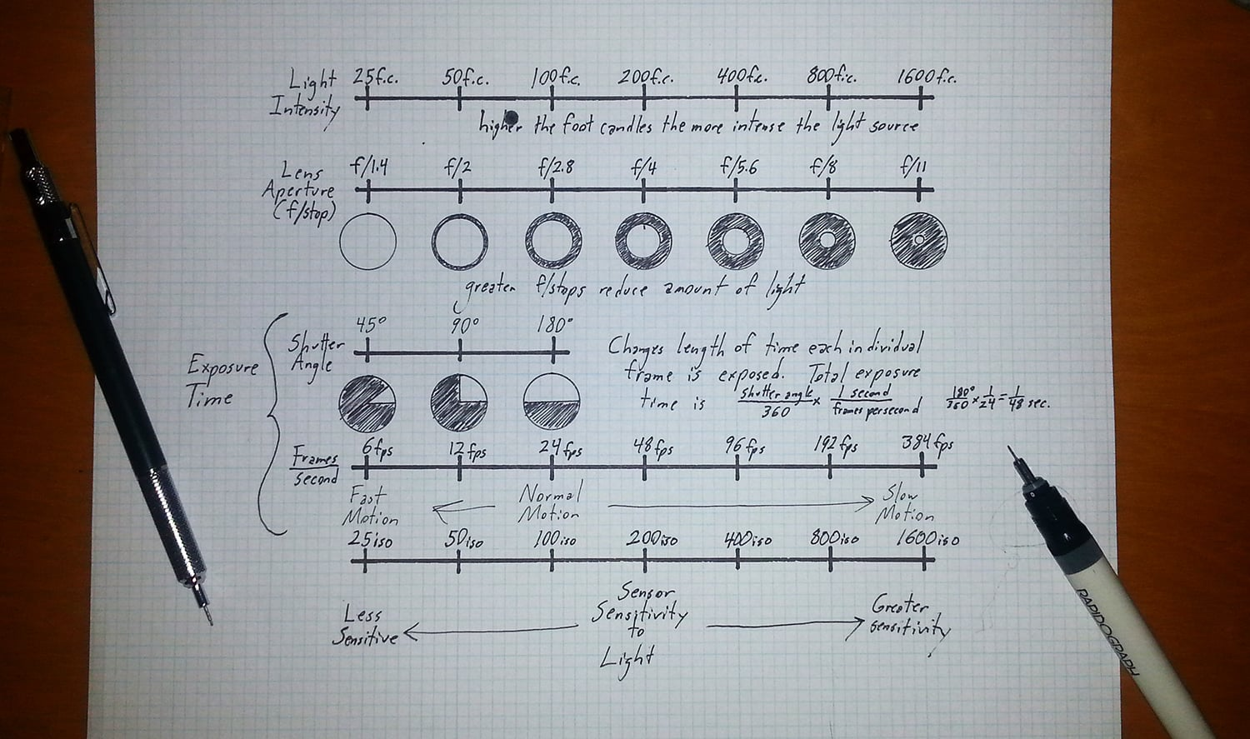
Every-day Use Calculations
The relationship between light intensity, exposure time, sensitivity of the sensor, and the iris of the lens is held in tight reciprocal bonds.
There has been a consistent observation by other cinematography that the understanding and application of these scales purely mentally is more commonly seen in those with an analog background.
The various mathematical calculations which can be used in film making is as below:
1) F stop
2) Shutter angle
3) Avoiding flicker
4) Exposure
5) Optics
6) Photometry
7) Depth of the field

Slide 10
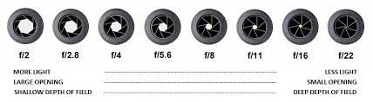
F-stop Scale
F stop is the term used to the aperture measurements on the camera. Aperture controls the amount of light entering through the lens of the camera and is measured in F stop.
If you're going to be shooting a camera, you need to memorize the f-stop scale.
All you need to do is memorize two numbers: 1 and 1.4.
If you can do that, all you have to do is double them to get the next two numbers on the scale: 2 and 2.8.

Slide 11
Shutter Angle
Cinematic motion blur effect is the visual streaking or smearing captured on camera as a result of movement of camera or the subject. The human eye naturally registers motion blur in real life, so a subtle blur often mimics reality better than if it were absent.
In order to get this effect, you will have to know to calculate shutter speed from your frame rate.
The equation for shutter speed is shutter speed= ½* 1/Frame rate

Slide 12
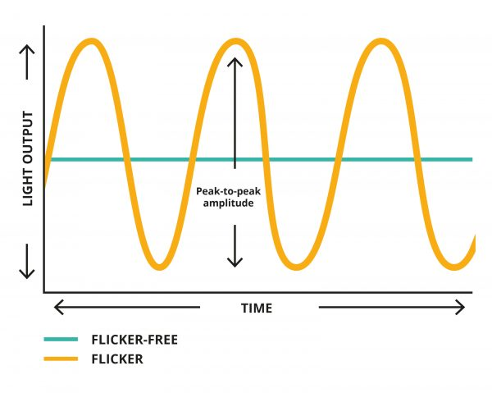
Avoiding Flicker
Flicker is unsteady movement which causes rapid variations in brightness of pictures.
One Way to avoid flicker is by adjusting Frame rate.
Another way of avoiding flicker that doesn’t require you to change frame rate is by adjusting shutter speed to match the sine curve of lighting unit that's causing problem.

Slide 13
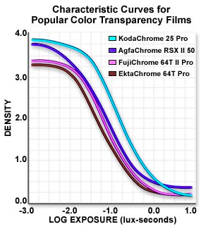
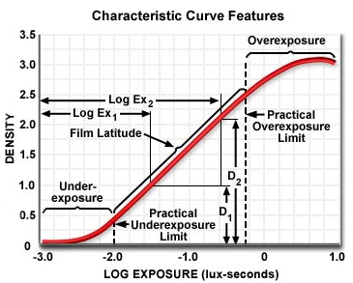
Exposure
The relationship between light intensity, exposure time, sensitivity of the sensor, and the iris of the lens is significant in movie-making.
The understanding and application of these scales, mostly seen in analog backgrounds, requires calculations when the print is projected. The exposure can be achieved visually on a calibrated monitor that requires detail focus on the technical settings.
Exposure of film is given by a relationship between 2 variables: the amount of time the film is exposed to light and the intensity of light. The response of a film emulsion to exposure is plotted as a graph of film density versus the exposure time (or its base 10 logarithm), and is called a characteristic curve.
Characteristic curves and their features for popular color transparency films commonly used in photomicrography are illustrated in the figures.

Slide 14
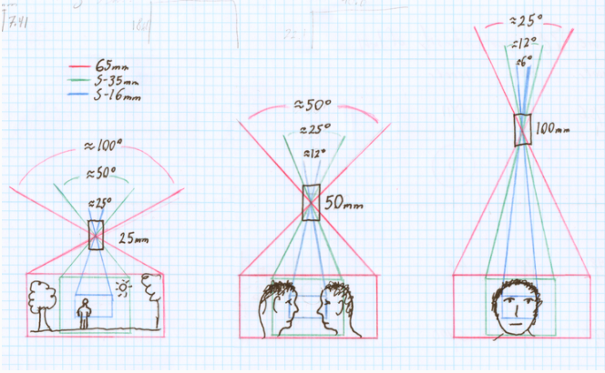
Optics
Calculus, Geometry and trigonometry are prevalent in the science of optics. It helps answer questions like ‘What focal length lens would be required to film an event from one mile away’?
Geometry is used to calculate angular field of view because of its relation to format size and hence the choice of focal length of lens.
At present, there exists constant shifting of format size unlike the analog era. Moving between digital cameras means the problem of picking focal lengths to achieve an equivalent field of view.
The illustration relates field of view to focal length for three different film formats through simple geometry. The location of the lens to the image plane according to its focal length demonstrates the role of this number in its effect on field of view.

Slide 15
Photometry
The measurement of the intensity of brightness of light that can be perceived by the human eye is called photometry.
Photometric instruments measure transmittance, and it is defined as the ratio of the intensity of emergent light to that of the intensity of incident light, mathematically:
Transmittance (T) = Intensity of the emergent (or transmitted) light / Intensity of the incident light
Transmittance is expressed on a range of 0 to 100%.

Slide 16
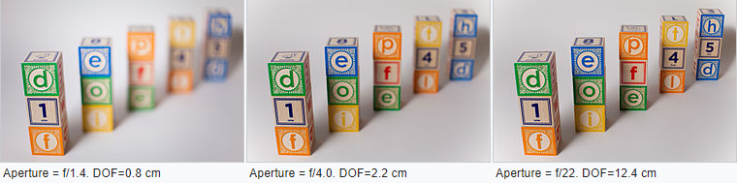
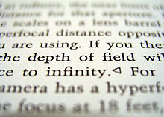

Depth of Field
Depth of field for different values of aperture using 50 mm objective lens and full-frame DSLR camera. Focus point is on the first blocks column.
Depth of Field (DOF) is the distance between the nearest and farthest that are in acceptably sharp focus in an image.
Acceptably sharp focus is defined using a property called circle of confusion (c).
The depth of field can be determined by focal length (f) , distance to subject (u) , the acceptable circle of confusion size and aperture.
The approximate depth of field can be given by where N = f-number.
A particular depth of field may be chosen for technical or artistic purposes.
Its limitations can sometimes be overcome with various techniques/equipments.
A macro photograph illustrating the effect of depth of field on a tilted object.

Slide 17
Conclusion
As pointed out throughout, calculus is indeed an essential stem for cinematographers in the art of movie-making. This can range from projecting angles for cameras on set to setting color patterns using calculus-led approach.
Some widely used areas for calculus are in production, animation and cinematography. Additionally, movie equipments use various principles of calculus to achieve the objective.
Few calculations used prominently in the field of movie-making involve F-stop scale, shutter angle, avoiding flicker, exposure, optics, photometry and the depth of field.
In conclusion, it can be stated that calculus is the most used branch of mathematics in the field of movie-making.

Slide 18
Work Delegation
57 - Muskaan Punjabi
60 - Esha Rane
63 - Nidhish Samajpati
58 - Pulkita Puri
61 - Kris Rodrigues
59 - Davneeka Ranawat
62 - Vikrant Salunke
Introduction (S2) and Role Specific Allocation (S4)
Photometry (S15) and Conclusion (S17)
Shutter Angle (S11) and Avoiding flicker (S12)
Everyday use calculations and F-stop scale (S9,S10)
Movie Equipments and Calculus (S6,S7)
Research and write-up on Exposure (S13) and Optics (S14)
Formatting
Depth of field (S16) and Work Delegation (S18)

Slide 19
Thank You
GROUP 2

