Slide 1
Predictive Modelling – Portfolio Values
Abhinav Iyer
Roll No. 12

Slide 2
Data Cleaning
Step 1 : Having a look at the data
This is the str after merging the two datasets of historic macroeconomic values and historic portfolio values
> str(histdata)
'data.frame': 52 obs. of 27 variables:
$ Date : chr "Q1 2005" "Q1 2006" "Q1 2007" "Q1 2008" ...
$ Real GDP Growth : num 4.3 4.9 0.2 -2.7 -5.4 1.7 -1.5 2.7 2.8 -0.9 ...
$ Nominal GDP growth : num 8.3 8.2 4.8 -0.5 -4.5 3.2 0.2 4.9 4.4 0.7 ...
$ Real Disposable Income Growth : num -3.8 9.5 2.6 2.9 -0.8 0.4 5 6.7 -15.7 4.3 ...
$ Nominal Disposable Income : num -1.8 11.5 6.5 6.5 -3 1.8 8.2 9.2 -14.5 6.5 ...
$ Unemployment Rate : num 5.3 4.7 4.5 5 8.3 9.8 9 8.3 7.7 6.7 ...
$ CPI Inflation Rate : num 2 2.1 4 4.4 -2.7 0.6 4.3 2.3 1.6 2.6 ...
$ 3-month Treasury Rate : num 2.5 4.4 5 2.1 0.2 0.1 0.1 0.1 0.1 0 ...
$ 5-year Treasury Yield : num 3.9 4.6 4.6 2.8 1.9 2.4 2.1 0.9 0.8 1.6 ...
$ 10-year Treasury Yield : num 4.4 4.7 4.8 3.9 3.2 3.9 3.5 2.1 1.9 2.8 ...
$ BBB Corporate Yeild : num 5.4 6 6.1 6.5 9 5.8 5.4 4.7 4 4.6 ...
$ Mortgage Rate : num 5.8 6.2 6.2 5.9 5.1 5 4.8 3.9 3.5 4.4 ...
$ Prime Rate : num 5.4 7.4 8.3 6.2 3.3 3.3 3.3 3.3 3.3 3.3 ...
$ House Price Index : num 172 194 189 165 138 139 133 134 147 160 ...
$ Commercial Real Estate Price Index: num 179 204 230 236 208 152 172 180 190 211 ...
$ Market Volatility Index : num 14.7 14.6 19.6 32.2 56.7 27.3 29.4 23 19 21.4 ...
$ Money Supply : num 6419 6731 7117 7570 8304 ...
$ FED Funds Rate : num 2.63 4.59 5.26 2.61 0.18 0.16 0.14 0.13 0.14 0.08 ...
$ VIX CLS : num 13.4 14.5 13.7 20.7 33 ...
$ TED Spread : num 0.42 0.514 0.628 1.128 0.671 ...
$ Composite Leader Indicator : num 100.4 100.6 101.8 99.7 95.6 ...
$ consumer confidence index : num 100.3 100.1 100.2 98.8 96.6 ...
$ Business Confidence Index : num 99.9 99.9 101.4 101.1 95.7 ...
$ (USD/euro) : num 1.3 1.21 1.34 1.58 1.33 ...
$ (yen/USD) : num 107.2 117.5 117.6 99.9 99.2 ...
$ (USD/pound) : num 1.89 1.74 1.97 1.99 1.43 ...
$ Portfolio Values : chr "1180.5899999999999" "1294.83" "1420.86" "1322.7" ...
Things to do:
Convert portfolio values to numeric
Sort data according to Date
Have a closer look at portfolio values

Slide 3
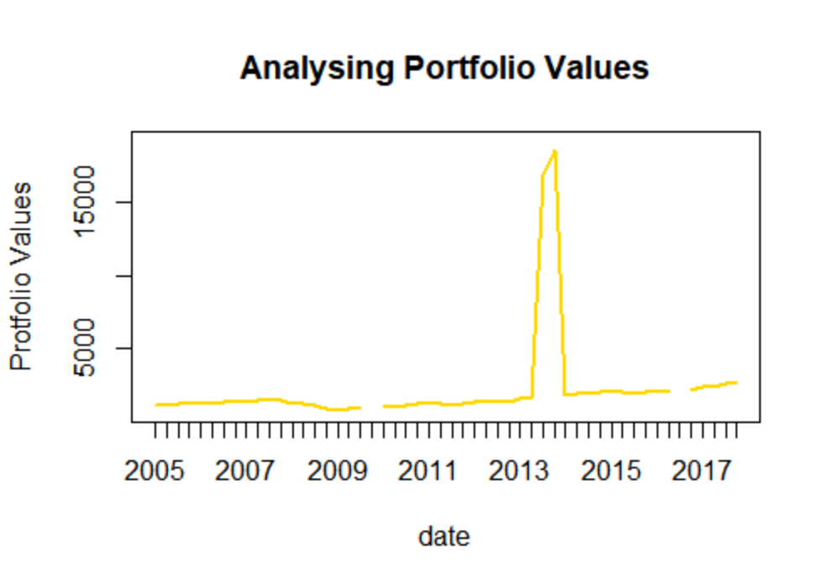
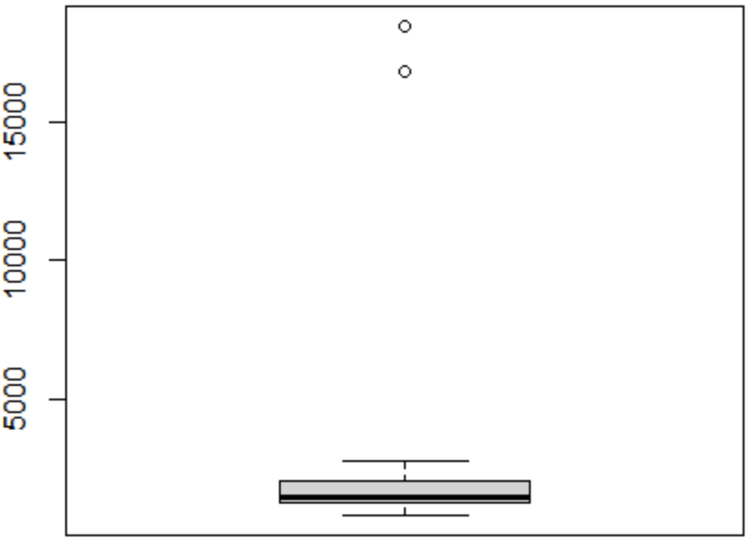
Data Cleaning
Step 2 : Closer look at portfolio values (after first two points in previous slide)
Two outliers and two missing values are to be seen. Boxplot confirms of the outliers present and graph of the missing values.

Slide 4
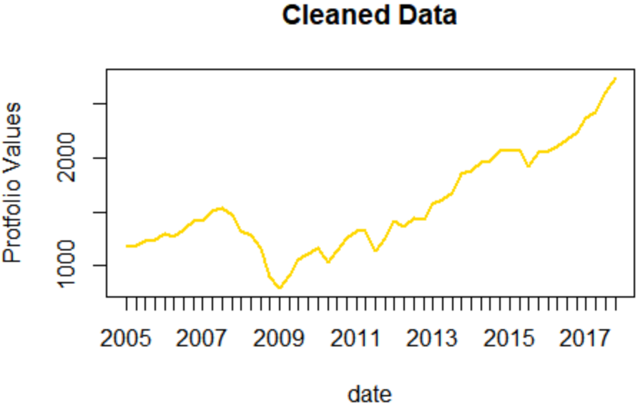
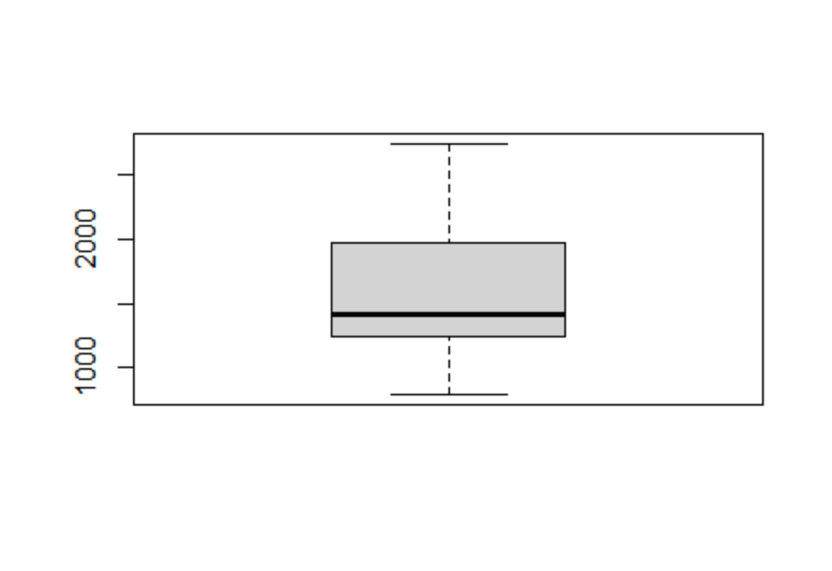
Data Cleaning
Outliers : from the graph, we can see that at Q3 2013 and Q4 2013, the values are 16000 and 18000 approx which does not follow pattern, maybe there might be mistake of decimal places so we shift them to left.
Missing Values: there are two values missing for Q4 2009 and Q3 2016, we perform linear interpolation to fill those portfolio values
Measures of Central Tendency
Mean | 1562.934
Median | 1419.58
Mode | 1180.59
Mean is the better measure of central tendency for this data because there is no outliers present now. The data is now fit for predictive modelling process

Slide 5
EDA of Parameters
1) Correlation Test
 | Portfolio.Values
Real.GDP.Growth | 0.3166432
Nominal.GDP.growth | 0.23755195
Real.Disposable.Income.Growth | 0.06909554
Nominal.Disposable.Income | 0.05983924
Unemployment.Rate | -0.5591771
CPI.Inflation.Rate | -0.01667026
X3.month.Treasury.Rate | -0.20185493
X5.year.Treasury.Yield | -0.31874352
X10.year.Treasury.Yield | -0.54791683
BBB.Corporate.Yeild | -0.72499409
Mortgage.Rate | -0.5573453
Prime.Rate | -0.2038846
House.Price.Index | 0.54392207
Commercial.Real.Estate.Price.Index | 0.78270769
Market.Volatility.Index | -0.5032053
Money.Supply | 0.86038352
FED.Funds.Rate | -0.18693779
VIX.CLS | -0.47259362
TED.Spread | -0.22677664
Composite.Leader.Indicator | 0.26577099
consumer.confidence.index | 0.80824174
Business.Confidence.Index | 0.63483382
X.USD.euro. | -0.61541133
X.yen.USD. | 0.46547555
X.USD.pound. | -0.49147599
Portfolio.Values | 1
We select the Macroeconomic variables whose correlation with Portfolio values is more than 0.6 or less than -0.6.
The Macroeconomic variables satisfying the condition are:
BBB Corporate Yield
Commercial Real Estate Price Index
Money Supply
Consumer Confidence Index
Business Confidence Index
(USD/Euro) rate

Slide 6
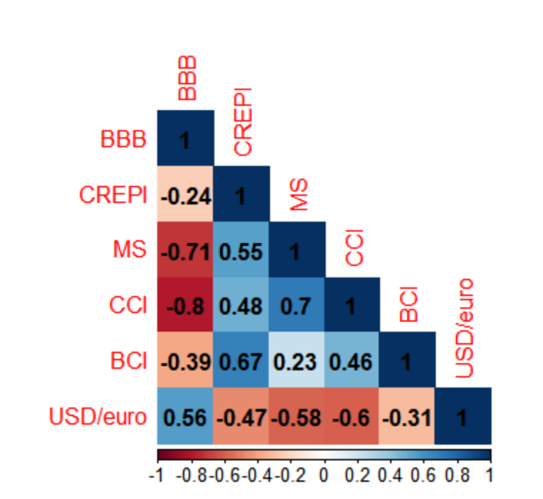
EDA of Parameters
2) Correlation matrix to check multicollinearity
The Correlations with absolute correlation more than 0.6:
BBB Corporate Yield and Money Supply
BBB Corporate Yield and Consumer Confidence Index
Consumer Confidence Index and Money Supply
Commercial Real Estate Price Index Business Confidence Index

Slide 7
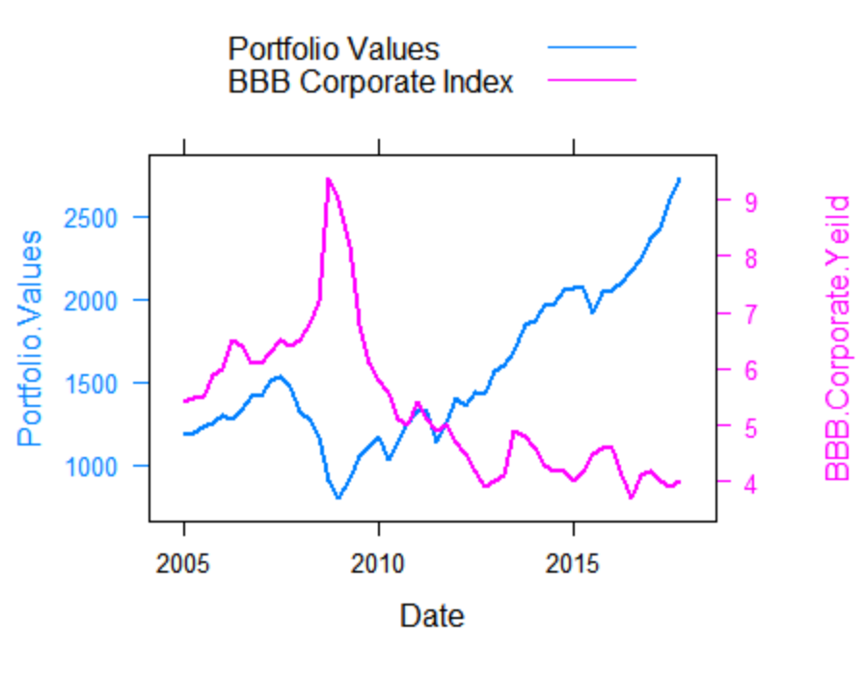
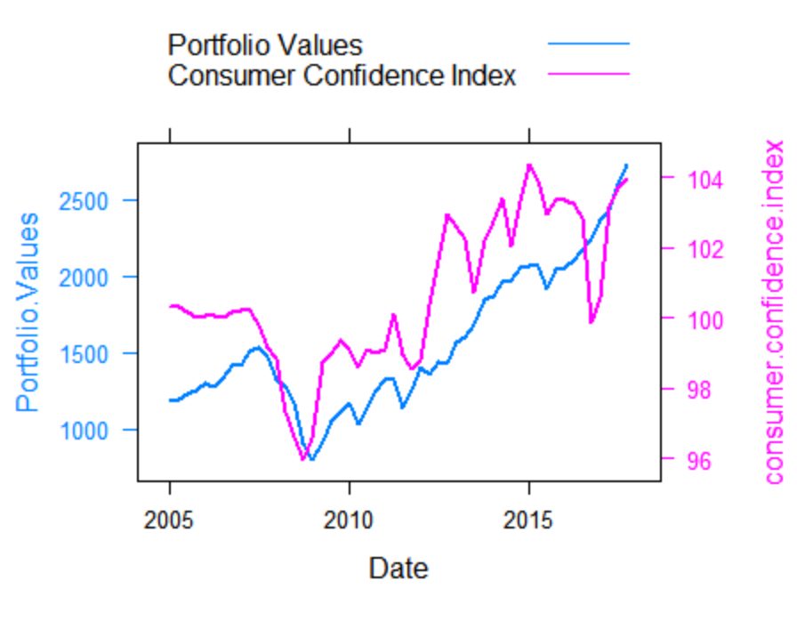
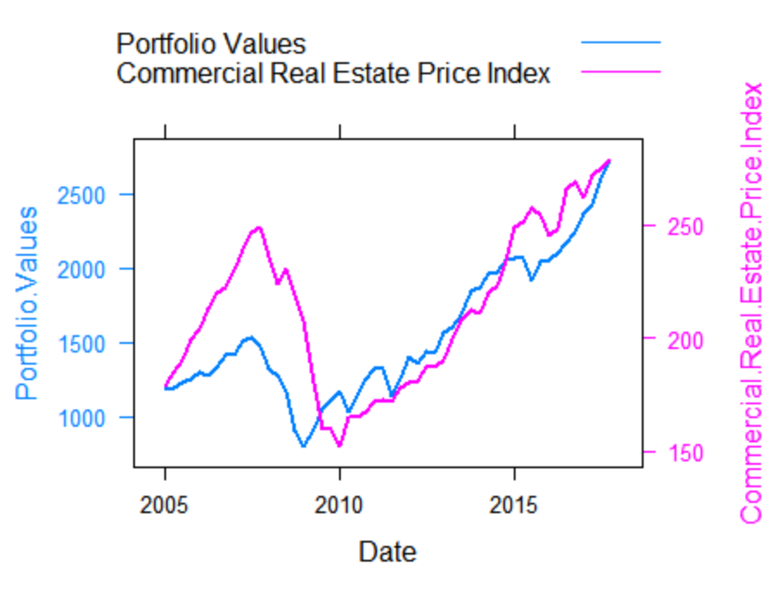
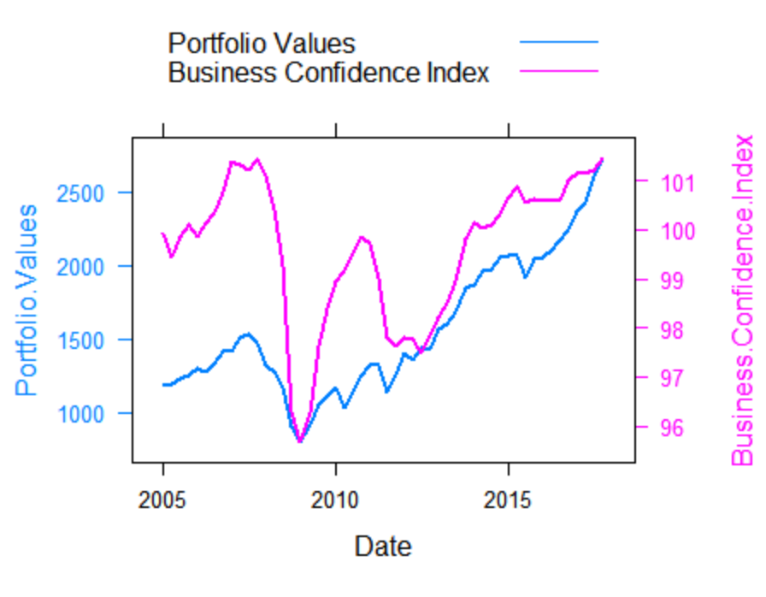
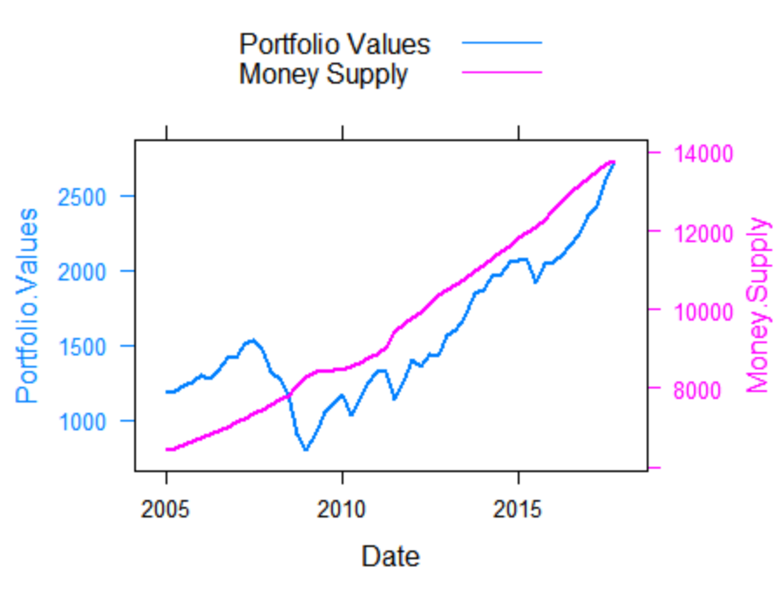
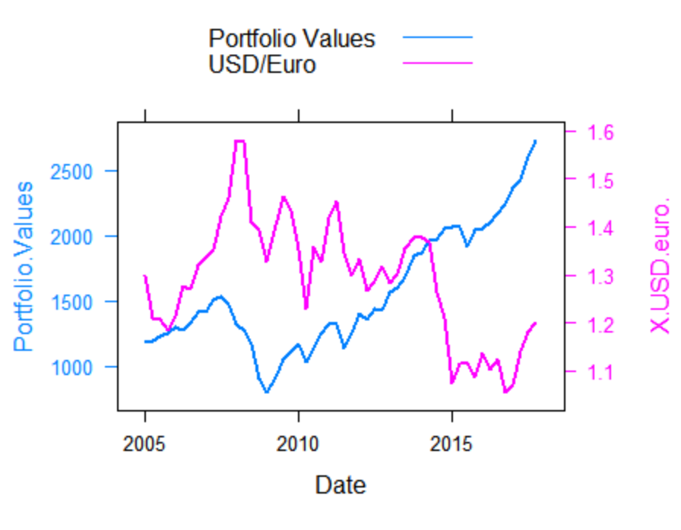
EDA of Parameters
3) Graph Analysis

Slide 8
EDA of Parameters
4) p-value analysis
Parameters | p-value of correlation
BBB Corporate Yield | 1.22E-09
Commercial Real Estate Price Index | 7.16E-12
Money Supply | 2.99E-16
Consumer Confidence Index | 4.35E-13
Business Confidence Index | 4.32E-07
(USD/Euro) | 1.20E-06
All p values are less than 0.05 suggesting the relation being significant and that these parameters can be incorporated into the regression model.

Slide 9
Regression Modelling
Model1 : Not using money supply due to results from EDA
Call:
lm(formula = histdata$Portfolio.Values ~ histdata$BBB.Corporate.Yeild +histdata$Commercial.Real.Estate.Price.Index +
histdata$consumer.confidence.index + histdata$Business.Confidence.Index + histdata$X.USD.euro.)
Residuals:
Min 1Q Median 3Q Max
-267.75 -84.32 -23.11 85.98 320.50
Signif. codes: 0 ‘***’ 0.001 ‘**’ 0.01 ‘*’ 0.05 ‘.’ 0.1 ‘ ’ 1
Residual standard error: 133.6 on 46 degrees of freedom
Multiple R-squared: 0.9251, Adjusted R-squared: 0.917
F-statistic: 113.7 on 5 and 46 DF, p-value: < 2.2e-16
Coefficients:
 | Estimate | Std. Error | t value | Pr(>|t|)
(Intercept) | -1707.4102 | 2563.7332 | -0.666 | 0.5087
histdata$BBB.Corporate.Yeild | -170.3159 | 26.8637 | -6.34 | 8.94e-08 ***
histdata$Commercial.Real.Estate.Price.Index | 8.2727 | 0.8534 | 9.694 | 1.08e-12 ***
histdata$consumer.confidence.index | 34.9014 | 17.0428 | 2.048 | 0.0463 *
histdata$Business.Confidence.Index | -12.6255 | 18.6889 | -0.676 | 0.5027
histdata$X.USD.euro. | 121.0502 | 202.0073 | 0.599 | 0.552
p-values for Business confidence index and USD/Euro is more than 0.05.

Slide 10
Regression Modelling
Model 2: Removing business confidence index and USD/Euro
Call:
lm(formula = histdata$Portfolio.Values ~ histdata$BBB.Corporate.Yeild+histdata$Commercial.Real.Estate.Price.Index + histdata$consumer.confidence.index)
Residuals:
Min 1Q Median 3Q Max
-241.11 -90.60 -32.22 92.43 329.48
Signif. codes: 0 ‘***’ 0.001 ‘**’ 0.01 ‘*’ 0.05 ‘.’ 0.1 ‘ ’ 1
Residual standard error: 131.8 on 48 degrees of freedom
Multiple R-squared: 0.924, Adjusted R-squared: 0.9193
F-statistic: 194.6 on 3 and 48 DF, p-value: < 2.2e-16
Coefficients:
 | Estimate | Std. Error | t value | Pr(>|t|)
(Intercept) | -2710.5398 | 1724.1381 | -1.572 | 0.1225
histdata$BBB.Corporate.Yeild | -161.9066 | 24.4894 | -6.611 | 2.9e-08 ***
histdata$Commercial.Real.Estate.Price.Index | 7.8067 | 0.6169 | 12.656 | < 2e-16 ***
histdata$consumer.confidence.index | 34.4669 | 16.6672 | 2.068 | 0.0441 *
p-value for consumer confidence index is close to 0.05 so we try to remove it in next model to see if it increases accuracy

Slide 11
Regression Modelling
Model 3: Removing consumer confidence index
Call:
lm(formula = histdata$Portfolio.Values ~ histdata$BBB.Corporate.Yeild +
histdata$Commercial.Real.Estate.Price.Index)
Residuals:
Min 1Q Median 3Q Max
-202.08 -81.48 -51.12 98.96 349.27
Coefficients:
Estimate Std. Error t value Pr(>|t|)
(Intercept) 840.583 159.295 5.277 2.97e-06 ***
histdata$BBB.Corporate.Yeild -202.564 15.081 -13.432 < 2e-16 ***
histdata$Commercial.Real.Estate.Price.Index 8.437 0.554 15.230 < 2e-16 ***
Signif. codes: 0 ‘***’ 0.001 ‘**’ 0.01 ‘*’ 0.05 ‘.’ 0.1 ‘ ’ 1
Residual standard error: 136.1 on 49 degrees of freedom
Multiple R-squared: 0.9173, Adjusted R-squared: 0.9139
F-statistic: 271.6 on 2 and 49 DF, p-value: < 2.2e-16
The p values for intercept and parameters have decreased and the dip in r squared is acceptable. Right decision
LINEARITY TEST
PV~ CRE + BBB
RESET test
RESET = 12.574, df1 = 2, df2 = 47, p-value = 4.228e-05
Result : FAILS, i.e. NON LINEAR MODEL

Slide 12
Regression Modelling
Model 4: Using log of dependent and independent variables to see if the model becomes linear
LINEARITY TEST
log(PV)~ log(CRE) + log(BBB)
RESET test
RESET = 0.66685, df1 = 2, df2 = 47, p-value = 0.5181
Result : SUCCESS, i.e. LINEAR MODEL
Call:
lm(formula = log(Portfolio.Values) ~ log(BBB.Corporate.Yeild) +
log(Commercial.Real.Estate.Price.Index), data = histdata)
Residuals:
Min 1Q Median 3Q Max
-0.168414 -0.054586 0.003137 0.048035 0.160566
Coefficients:
Estimate Std. Error t value Pr(>|t|)
(Intercept) 3.44342 0.39744 8.664 1.88e-11 ***
log(BBB.Corporate.Yeild) -0.81726 0.05071 -16.116 < 2e-16 ***
log(Commercial.Real.Estate.Price.Index) 0.97473 0.06851 14.228 < 2e-16 ***
---
Signif. codes: 0 ‘***’ 0.001 ‘**’ 0.01 ‘*’ 0.05 ‘.’ 0.1 ‘ ’ 1
Residual standard error: 0.07909 on 49 degrees of freedom
Multiple R-squared: 0.9281, Adjusted R-squared: 0.9252
F-statistic: 316.3 on 2 and 49 DF, p-value: < 2.2e-16
R squared has increased significantly, so right decision.
Passes linearity test so this is our final model and can proceed towards other statistical tests.

Slide 13
Quantitative Statistical tests
Quantitative Tests
Condition | Test Name |  | P-Value | Result (5% threshold)
Stationarity | Phillips Peron Test | Dickey-Fuller Z(alpha) = -5.442 | 0.7943 | Not Stationary
 | Kwiatkowski–Phillips–Schmidt–Shin (KPSS) test | KPSS level = 0.99699 | 0.0100 | Not Stationary
 | ADF Test | - | 0.5592 | Not Stationary
Linearity | Ramsay-Reset Test | - | 0.5181 | Linear
Multicollinearity | Variance Inflation Factor | vif of parameters = 1.079015 | - | No multicollinearity
Normality | Jarque Bera Test | df = 2 | 0.8392 | Normal
 | Shapiro Wilk Test | - | 0.7 | Normal
 | Kolmogrov-Smirnov Test | - | 0.000000001614 | Not Normal
Heteroskedasticity | Breusch Pagan Test | df = 2 | 0.1130 | Homoscedastic
Auto-correlation of errors | Durbin-Watson Test | D-w statistic = 1.064332 | 0 | autocorrelation between residuals
 | BG Test | df = 1 | 0.0011 | autocorrelation between residuals

Slide 14
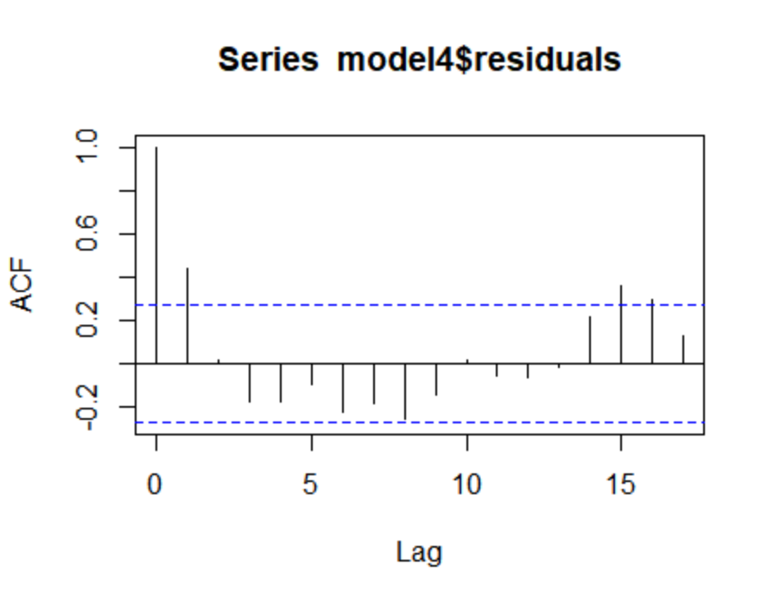
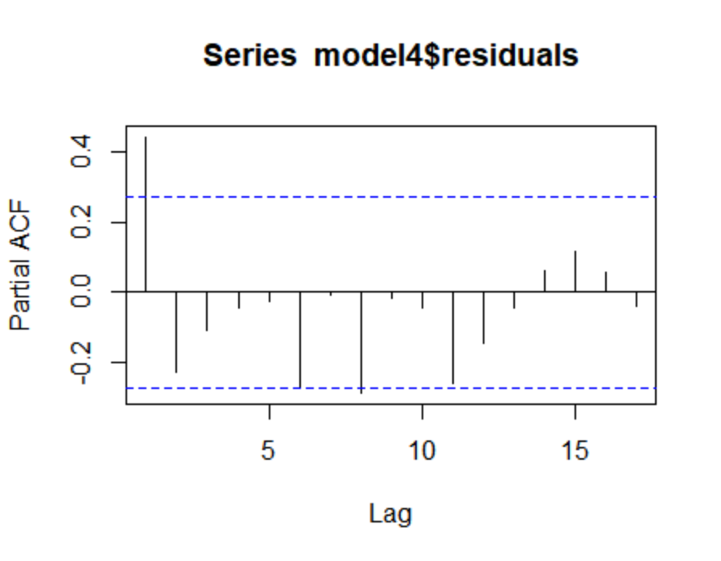
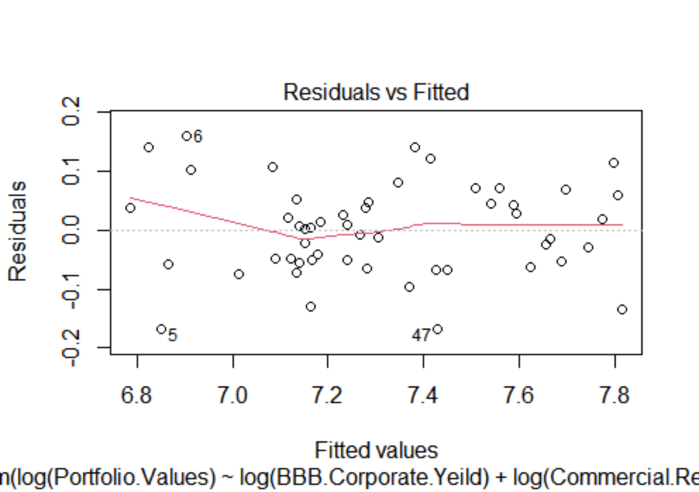
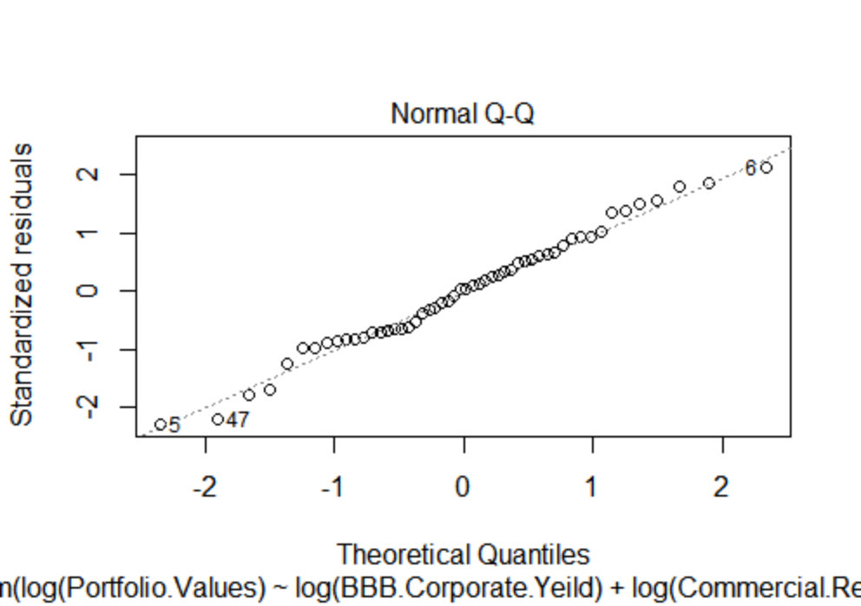
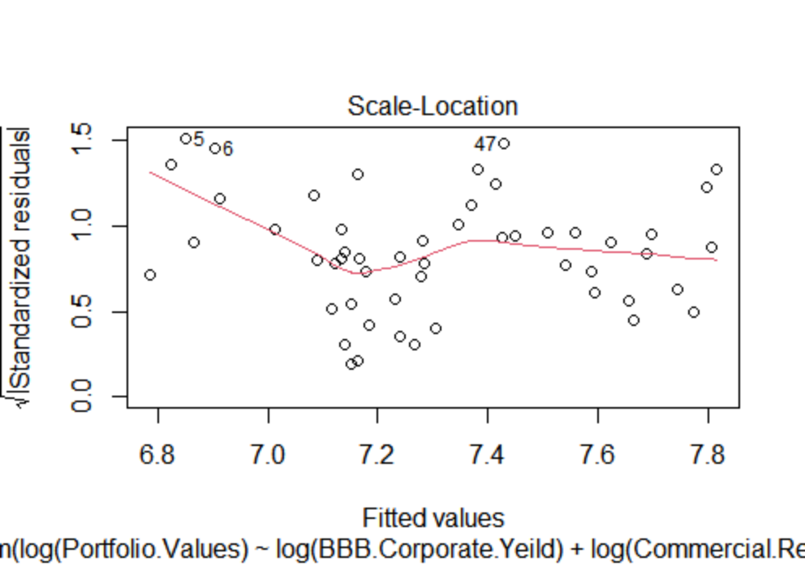
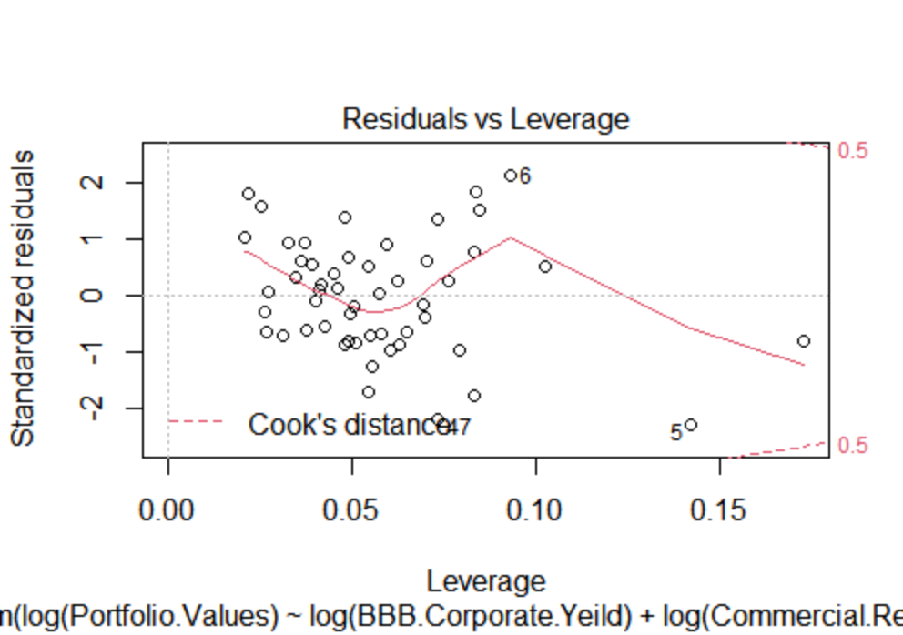
Qualitative Statistical tests
ACF dies out at lag 2
PACF dies out at lag 6
Residues pass the normality test
Relationship between fitted values and residuals is largely a straight line
Plot shows presence of heteroskedasticity
No significant outlier present

Slide 15
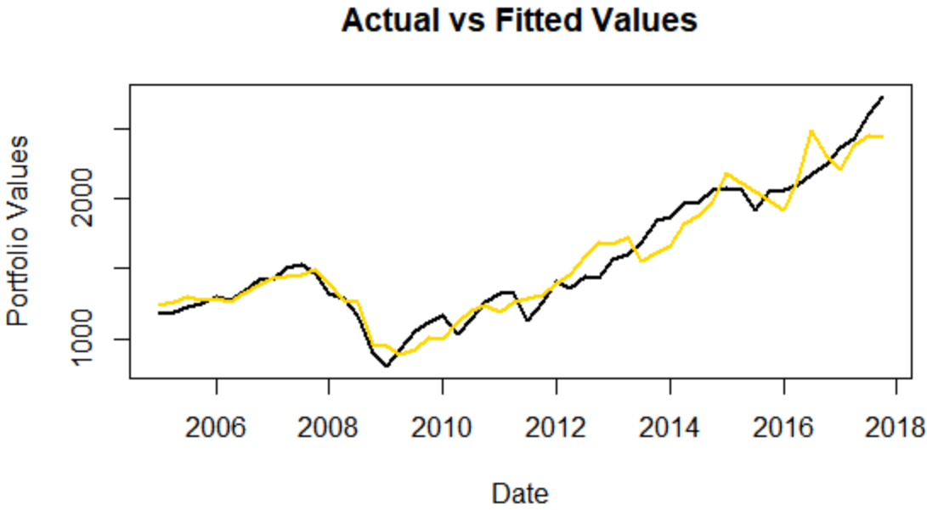
In Sample Analysis
Residual Analysis
MSE | 14491.13
RMSE | 120.3791
MAPE | 6.28%
The Chart above shows close approximation of the movements in Portfolio Values. The major upward and downward movements of the fitted values is moving along with general trend of the actual data. Additionally the MAPE is less than 10%. This indicates an acceptable in-sample fit

Slide 16
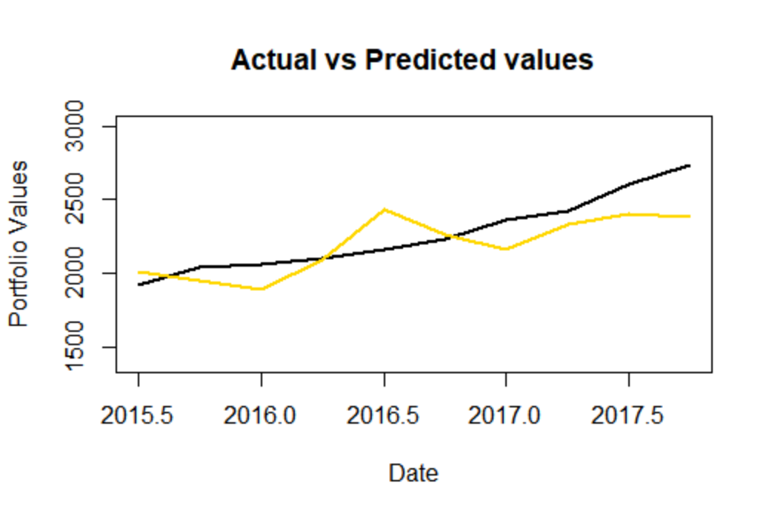
Out Sample Analysis
Residual Analysis
MSE | 32281.65
RMSE | 179.671
MAPE | 6.32%
The chart above shows that on an average the fitted value revolves around the actual portfolio value indicating that the model is able to predict the actual value closely and will in general predict the value correctly. Additionally the MAPE is below 10%. Hence the out sample analysis also looks to be acceptable

Slide 17
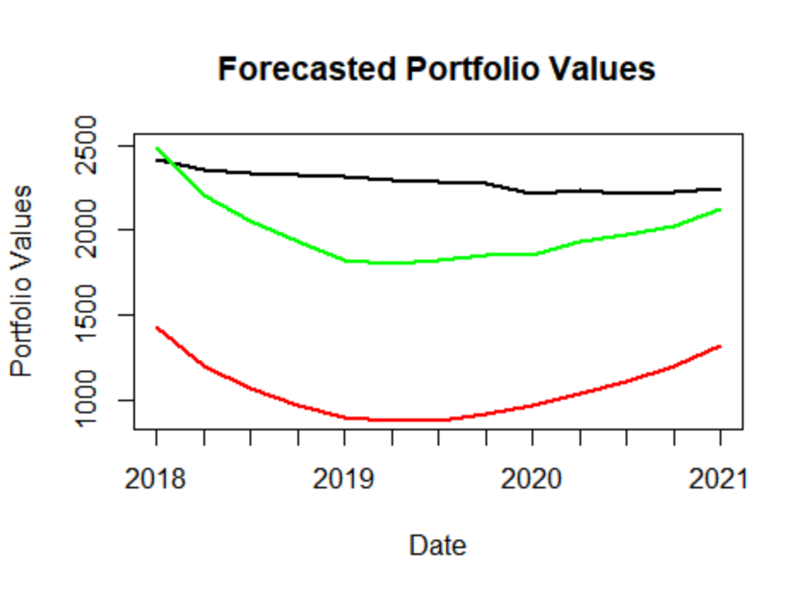
Forecast
 | Portfolio Values
Date | Baseline | Adverse | Severely Adverse
2018 Q1 | 2415.34 | 2481.22 | 1435.30
2018 Q2 | 2355.25 | 2204.37 | 1203.11
2018 Q3 | 2335.04 | 2058.95 | 1070.06
2018 Q4 | 2323.47 | 1932.14 | 976.24
2019 Q1 | 2312.47 | 1829.26 | 898.69
2019 Q2 | 2294.55 | 1807.16 | 877.70
2019 Q3 | 2284.71 | 1823.52 | 884.81
2019 Q4 | 2275.34 | 1855.86 | 925.34
2020 Q1 | 2216.09 | 1855.86 | 970.25
2020 Q2 | 2236.99 | 1932.43 | 1038.17
2020 Q3 | 2215.48 | 1977.15 | 1107.90
2020 Q4 | 2229.19 | 2023.76 | 1199.92
2021 Q1 | 2249.75 | 2123.19 | 1325.85
 | 9 Quarter loss in value
Portfolio value in Q4 2017 | Baseline | Adverse | Severely Adverse
2733.48 | 517.391 | 877.624 | 1763.232
 | Baseline
 | Adverse
 | Severely Adverse
Required Capital for portfolio Investment = 148.43

Slide 18
THANK YOU

