Slide 1
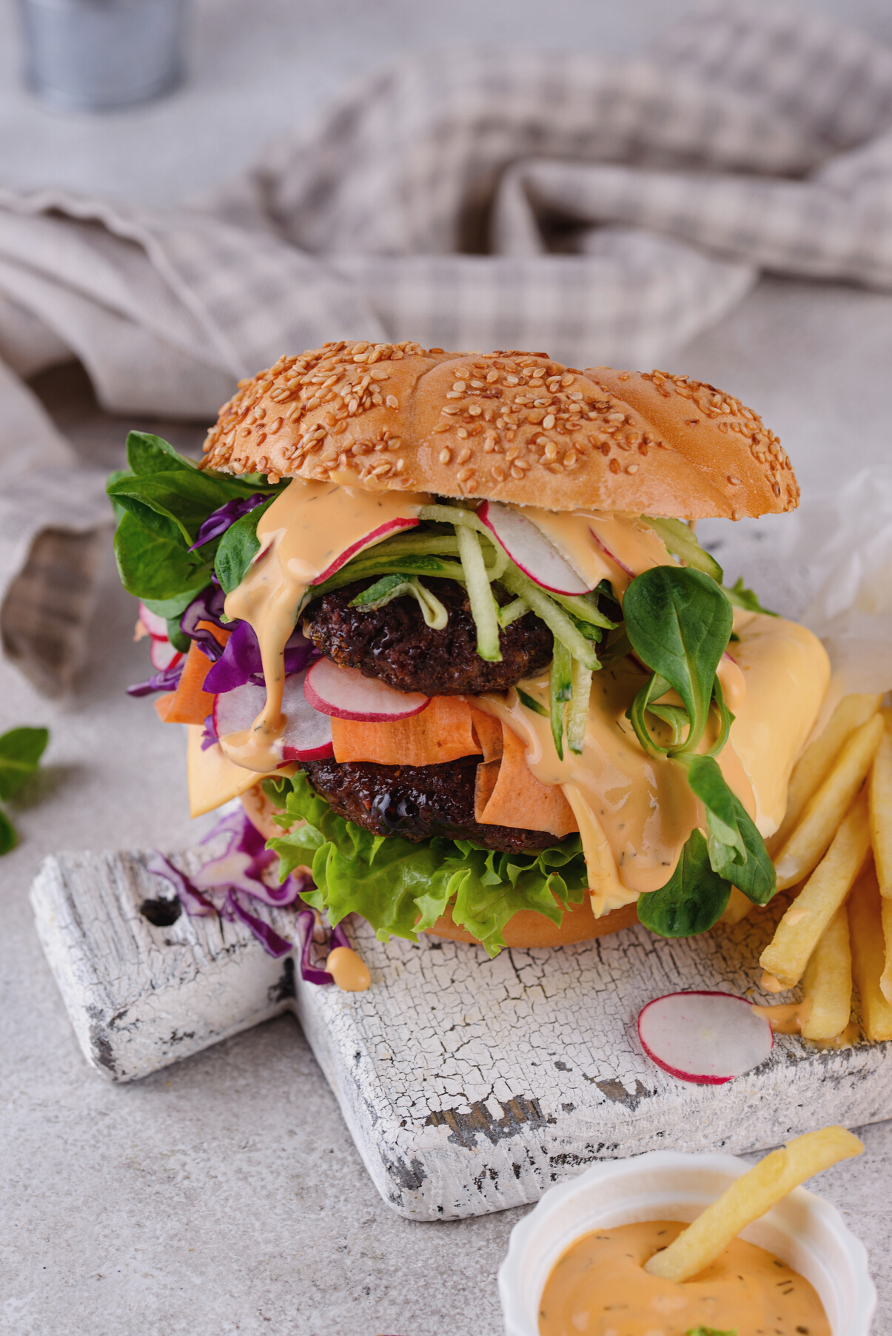
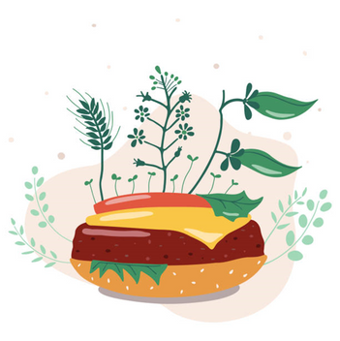
Project
PlantNation
Revolutionizing your Diet!
Privileged and Confidential.

Slide 2






Balanced scorecard slide 7
MEET THE TEAM
Aryan Tripathi
Khushi Morzaria
Devika Jyotish
Krunal Modi
Dharini Shah

Slide 3

Balanced scorecard slide 7
TABLE OF CONTENTS
The Problem
Survey Analysis
About the Company
Revenue Model
Marketing Approach
For educational purposes only. Privileged & Confidential

Slide 4

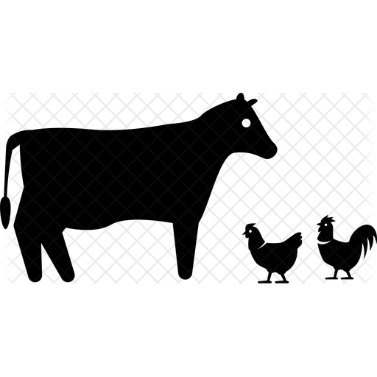








THE PROBLEM
4
What’s wrong with the Meat Industry today?
50 Bn land animals slaughtered for food annually
Livestock farming contributes 18% of human produced greenhouse gas emissions worldwide
To produce 1kg of beef requires 25 kgs of grain – to feed the animal – and ~15,000L of water
Around 30% of the earth’s land surface is currently used for livestock farming
If all grain were fed to humans instead of animals, we could feed an extra 3.5 Bn people
80% of all antibiotics are consumed by the livestock industry in the US
More than 23,000 people are estimated to die every year in the US alone from resistant bacteria
Avg. daily meat intake for someone living in a high-income country is 200-250g; UN recommends 80-90g
For educational purposes only. Privileged & Confidential
Sources: US National Library of Medicine National Institutes of Health, FAO, The Conversation, UN Water, Global Agriculture, FDA, NY Times, The Lancet, PNAS

Slide 5
5
SURVEY RESULTS
SAMPLE SIZE : 68
POPULATION
HAVE YOU HEARD ABOUT PLANT-BASED MEAT BEFORE?
HOW DOES THE IDEA SOUND?
IF GIVEN AN OPTION, WOULD YOU TRY IT?
For educational purposes only. Privileged & Confidential

Slide 6


6
WHAT IS PlantNation
At PlantNation, we believe there is a better way to feed the planet.
Who Are We?
Our mission is to create The Future of Protein® – delicious plant-based burgers, beef, sausage, crumbles, and more.
Our Mission
To address four growing global issues: human health, climate change, constraints on natural resources, and animal welfare.
To be the go to alternative
Our Goal
For educational purposes only. Privileged & Confidential

Slide 7
7
OUR PRODUCTS
Varieties
How are they made?
Simple process of heating, cooling, and pressure to create the fibrous texture of meat and layer in plant-based
fats, binders, flavors, and colors
Leafy Burger
Leafy Beef
Leafy Sausages
Kinds of Proteins used
Leafy Meatballs
By using a variety of plant proteins including pea, rice mung bran, and faba bean
Leafy Chicken Tender
For educational purposes only. Privileged & Confidential

Slide 8
Balanced scorecard slide 7
Food Component
Taste?
A CLOSER LOOK
Plant based
Without GMOs
Synthetically produced
Higher protein levels
No cholesterol
No antibiotics
No hormones
Is it healthy?
Replicated taste
Replicated texture
Juicy
Tender
Succulent
Proteins
Fats
Minerals
Flavors and colors
Carbohydrates

Slide 9









9
REVENUE MODEL (I) – UNDERSTANDING THE MARKET
Market Characteristics
Target Audience
4.3 USD Billion market in 2020
Flexitarians
Vegetarians & Vegans
8.3 USD Billion projected market by 2025
Health conscious
Compound Annual Growth rate of 14%
Explorers
Growth attributed to increasing awareness about health benefits
Environment conscious
For educational purposes only. Privileged & Confidential

Slide 10

10
REVENUE MODEL (II) – SOURCES OF REVENUE
Revenue Streams
Ways to increase Profits
Restaurants and Food-service Outlets
Efficient Supply Chain
Retail Outlets
Controlled Production Cost
Direct to Customers
Controlled Ingredient Cost
Subscription Based
Franchising Outlets
Inculcate Taste
For educational purposes only. Privileged & Confidential

Slide 11




11
SOURCES OF FUNDING
Venture Capital
Crowdfunding
Bootstrapping
Loans
For educational purposes only. Privileged & Confidential

Slide 12












12
OUR APPROACH TO MARKETING
Inclusivity
Indirect Marketing
Advertisement
Consumer Trends
Brand Endorsement
Offers and Rewards
For educational purposes only. Privileged & Confidential
© Privileged & Confidential. All rights reserved |

Slide 13

Balanced scorecard slide 10
THANK YOU

