Slide 1
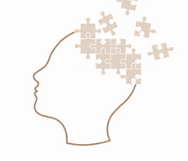
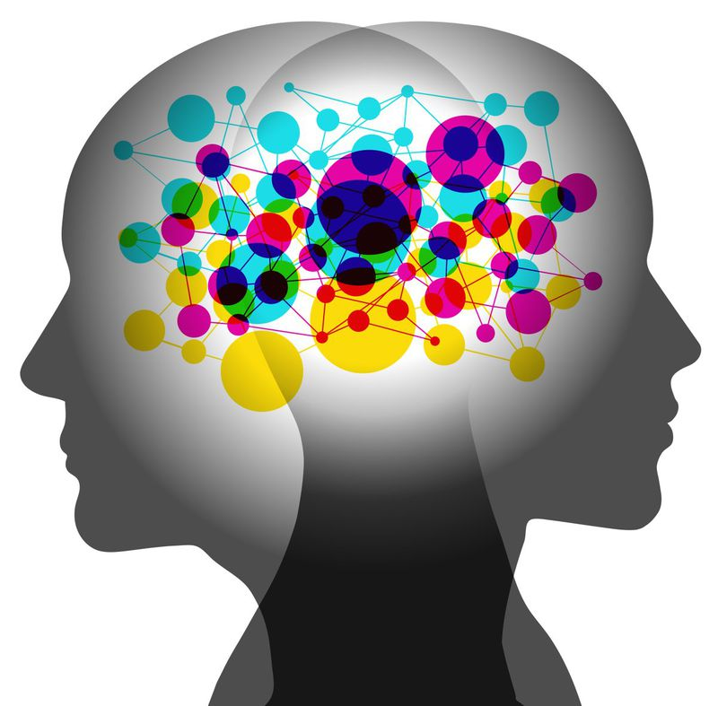
JAMES LANGE - THEORY OF EMOTIONS

Slide 2
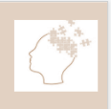
INDEX
What are emotions
Emotions and changes across body
Theories of emotion
Historical approach
What is James - Lange theory of Emotions
Examples
Support of James Lange Theory
Criticism of James Lange theory
Conclusion

Slide 3
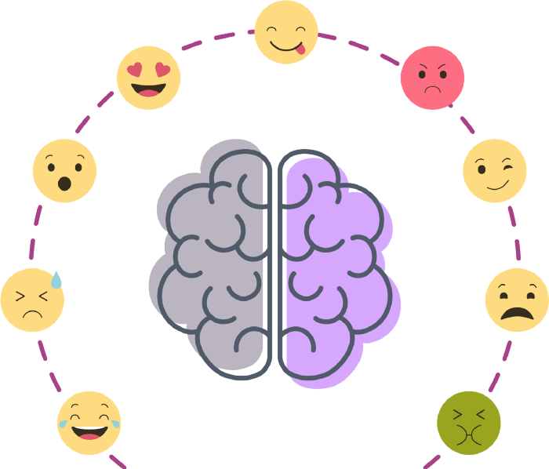
WHAT ARE EMOTIONS ?
An emotion is a conscious mental reaction subjectively experienced as strong feeling usually directed toward an object.
An emotion is a particular kind of active state.
Functions of emotion:
-Intrapersonal
-Interpersonal
-Social and cultural

Slide 4
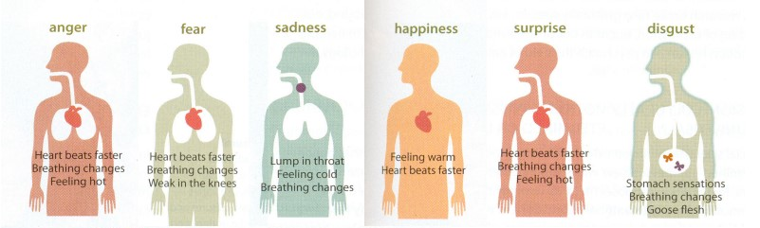
Emotion and changes across the body
The most fundamental emotions, known as the basic emotions, are those of anger, disgust, fear, happiness, sadness, and surprise.
Basic emotions are expressed universally in the human faces.

Slide 5
THEORIES OF EMOTION
James-Lange theory
Cannon-Bard theory
Two-Factor theory
Heart pounding
Heart pounding
Fear (emotion)
Heart pounding
Cognitive label
Fear (emotion)
Fear (emotion)

Slide 6
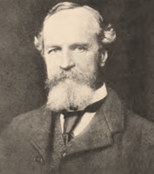
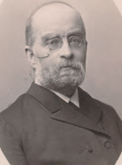
Historical approach!
WILLIAM SMITH (1842-1910)
Psychologist who believed our awareness of physiological responses leads to our experience of emotion.
CARL LANGE (1834-1900)
Danish physiologist who proposed a theory of emotion similar to and at about the same time as James’ theory – the awareness of physiological responses leads to experiences of emotion.

Slide 7
WHAT IS JAMES LANGE - THEORY OF EMOTIONS ?
According to the James-Lange theory of emotion, emotions arise as a result of physical reactions to experiences (physiological responses to stimuli directly cause subjective feelings).
Our natural way of thinking about these basic emotions is that the mental awareness of some truth stimulates the mental fondness known as the emotion, and that this latter state of mind generates the bodily expression.

Slide 8
WHAT IS JAMES LANGE - THEORY OF EMOTIONS ?
The common course of perception is that we first feel the emotions and then react to it. When we see a bear, we get terrified and flee; and when we are insulted by a rival, we are infuriate and strike.
However, James theory states that this is an incorrect order. The person’s mental state is not immediately induced by the environment, before the emotions develop the body starts to react to the environment which helps in understanding what the person’s feeling.

Slide 9
CASE STUDY

Slide 10
APPLE
PETITION
Apple announced that from September 2019, its employees should return to working from its offices. Thousands of employees have signed a letter of protest in reaction to Cook's back-to-office announcement, claiming that they were not consulted and demanding that they be allowed to continue working in a distributed way.
Action
Response
Result
Boss has told the employee to come to work at office regularly now.
The employee feels unmotivated and discomfort to go to work.
This makes the employee realise that he/she is in a comfort zone and may not be productive at office.
Reference : https://www.forbes.com/sites/enriquedans/2021/06/07/back-to-the-office-nothanks/?sh=5fe5ed05fb23

Slide 11
INTERVIEW & PRESENTATION
Person is nervous for his interview / presentation
01
Initial Stage
He is very agitated and anxious. He becomes fidgety and might be feeling sweaty.
02
Reaction
The person overcomes nervousness and the employer helps him calm down by talking in general aspect for the first few minutes
03
Option 1
Whereas on the other hand, he could still be nervous and he could flunk his interview by either blabbering or stuttering
04
Option 2

Slide 12

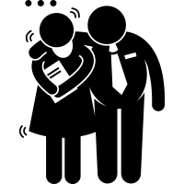


WORKPLACE DISCRIMINATION
In an origanisation, there are various biasness and discrimination done and these are 4 sample issues from all over the world.
1)Amazon
2)McDonalds
3)Disney
1.
2.
1)Goldman Sachs
2)Bloomberg
3) Johnson & Johnson cases.
Race, color and gender
Sexual Harrasment
Nepotism
Age Discriminnation
1)JPMorgan Chase & co
2)The Trump Organisation
3)Rolling Stone
1)LA Times
2)PWC
3)GNC Financial Group
3.
4.

Slide 13
Support of the James- Lange Theory
People display slight differences in their psychological reactions when they were asked to make facial expressions for different emotions.
Basic emotions showcase distinct patterns of activity in neural networks in the brain
Perception Causes Bodily Changes Without Trigger the Emotion

Slide 14
Criticisms of the James- Lange Theory
The theory was mostly just the result of introspection and correlational research.
Application of the stimulation to the same site does not lead to the same emotions every time.
James and Lange have not distinguished between Emotion-Producing and Unproductive Physical Changes.

Slide 15
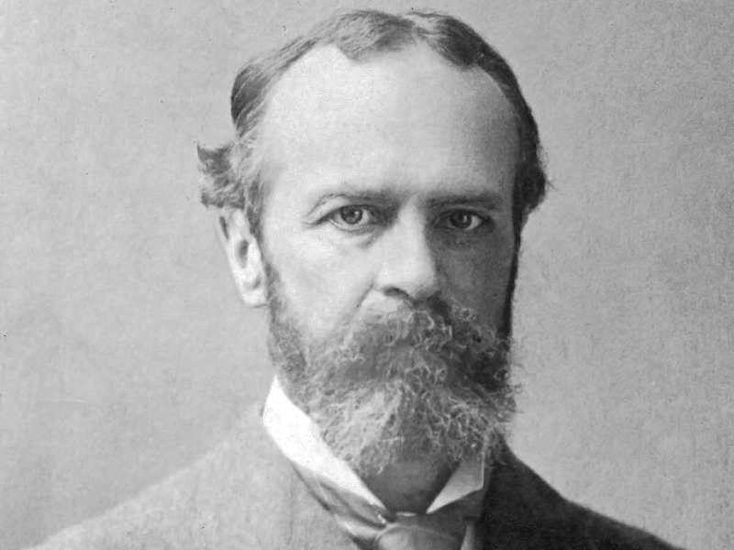
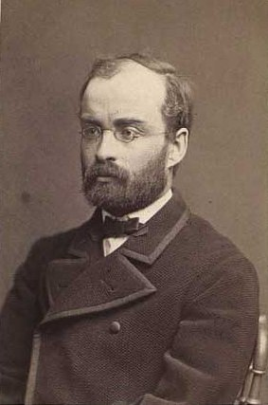
OVERVIEW
Emotion is often defined as a complex state of feeling that results in physical and psychological changes that influence thought and behavior.
Emotionality is associated with a range of psychological phenomena, including temperament, personality, mood, and motivation.
Many came forward with various theories of emotions. James and Carl Lange were one of them.
William James and Carl Lange devised two physiological theories of emotion independently. These theories had different emphases, and some scholars argue that the James-Lange theory of emotion is a distortion of both scientists’ work.

Slide 16
KEY TAKEAWAYS
Key Takeaways: James-Lange Theory
The James-Lange theory suggests that emotions are the result of physical changes in the body.
When we see something emotional, changes occur in the body—and these changes make up our emotional experience.
Although the James-Lange theory has been challenged by other theorists, it has been incredibly influential in the study of human emotions
Emotion stimulus
Physiological Response Pattern
Affective Experience

Slide 17
Conclusion
Prior to the James-Lange theory, the standard line of thought was that people the first reaction to perception was cognitive.
The James-Lange approach instead suggested that these physiological responses occur first
For example, a person may experience a physiological reaction such as becoming ill in public place, which then leads to an emotional response such as feeling anxious.
If an association is formed between the situation and the emotional state, the individual might begin avoiding anything that might then trigger that particular emotion.
Examples
Developing Phobias
Developing a panic disorder

Slide 18

THANK YOU !!!
Presented by :
Drishti Chulani
Jill Morakhiya
Saloni Bera
Richa Rane
Sandowen Ramasawmy

