Slide 1

Econometric model for banking Industry - deploying CCAR
By ~ Priyanshu Mehta
Roll No - 432

Slide 2
Steps we follow for Developing a model:-
Collect data from various sources consisting of the macroeconomic variables which have significant impact on Large AAA financial institutions.
Load the Data and run Exploratory Data Analysis to obtain a brief glimpse of what the data tries to resonates.
Furthermore, we analyse, clean and aggregate the datasets imported with giving it a meaningful form.
Then, we build a model which follows certain rounds of iterations until preferred precision isnt met.
Robust Statistical tests like Quantitative and Qualitative tests run to know if the fit of the model is as desired according to our objectives.
Forecasts and predictions are made to know if the model would stand up to expectations and level of accuracy in real world scenarios.

Slide 3

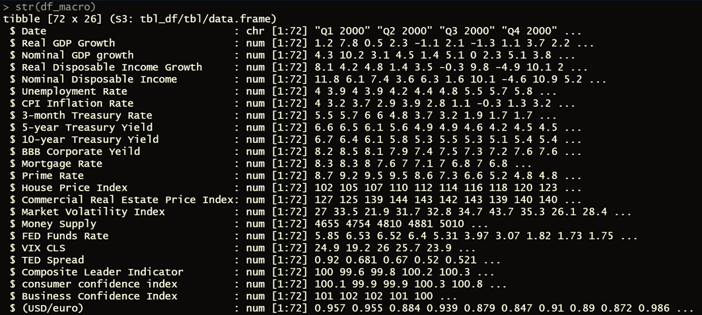
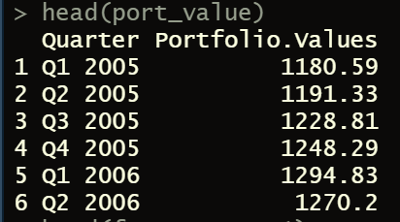
Loading datasets and running eda
Datasets used:-
Bank'sEquityPortfolio
HistoricalMacroeconomicData
ForecastsforMacroeconomicVariables
Common EDA codes used for analysis are:-
Head()
Str()
Dim()
Furthermore sorting and filtering was undertaken to bring all the datasets in common terms

Slide 4
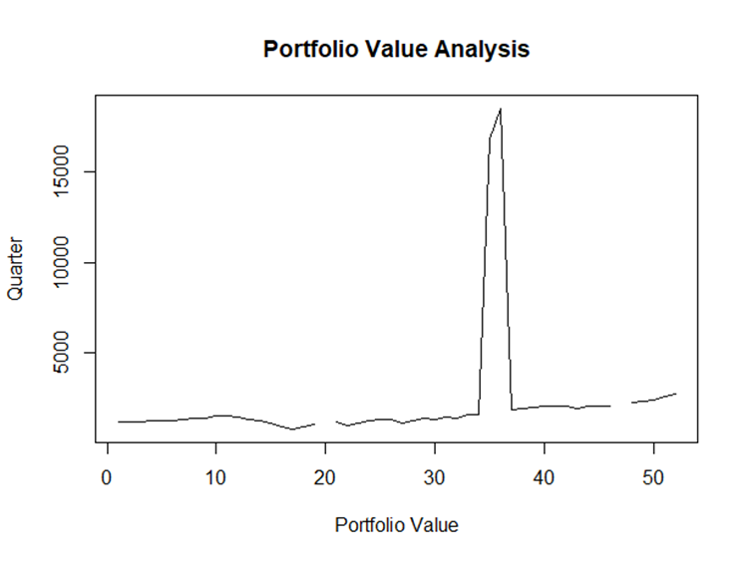
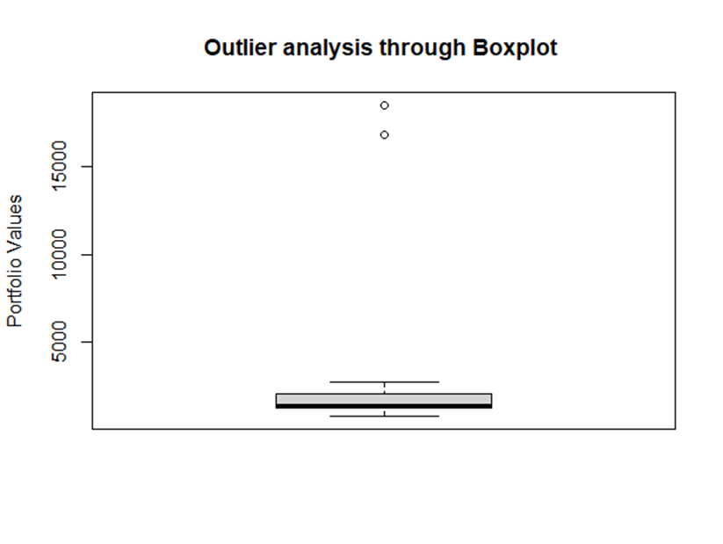
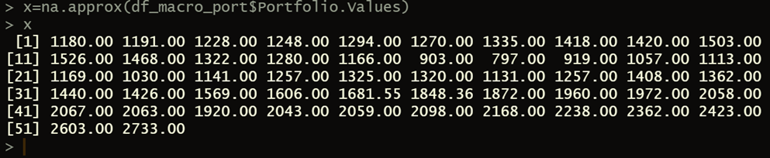




Analysis of portfolio values using Graphical representations
The blank spaces above around 20 and 47th quarters represent the missing values whereas the sudden erratic rise in portfolio value at 35th and 36th quarter represent the presence of outliers.
We can perhaps easily interpret that there are 2 outliers whose value lies above 15000. On Portfolio value analysis, it was found that there was a data input error which resulted into the decimal points getting shifted by 1dp.
Above mentioned is the vector consisting of portfolio values along with the interpolated values according to time series

Slide 5
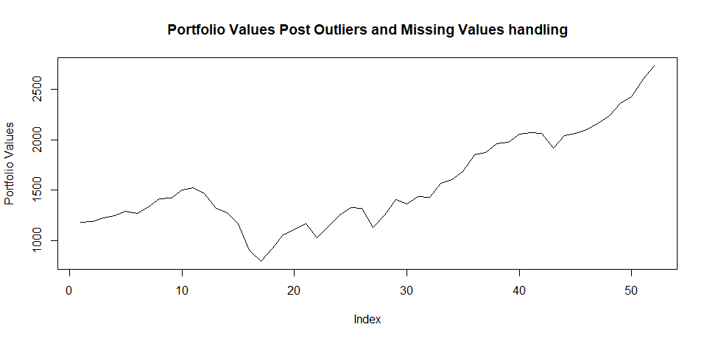
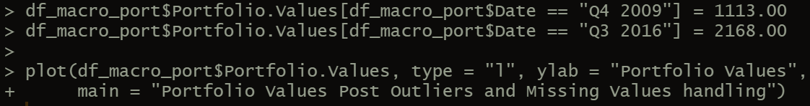
Handled Missing and outlier values!

Slide 6
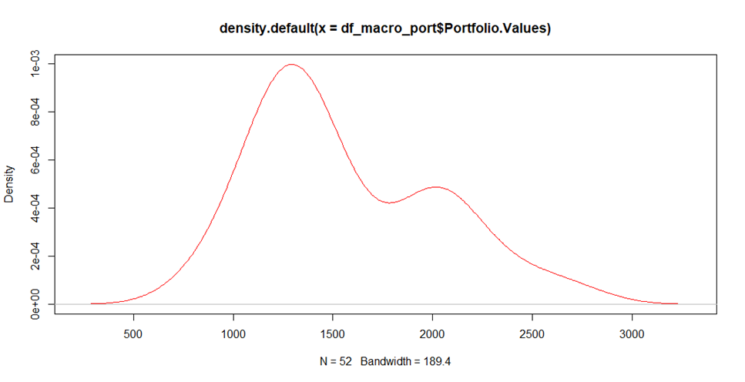
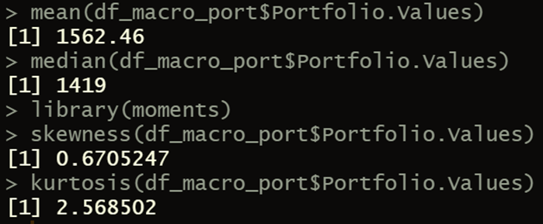
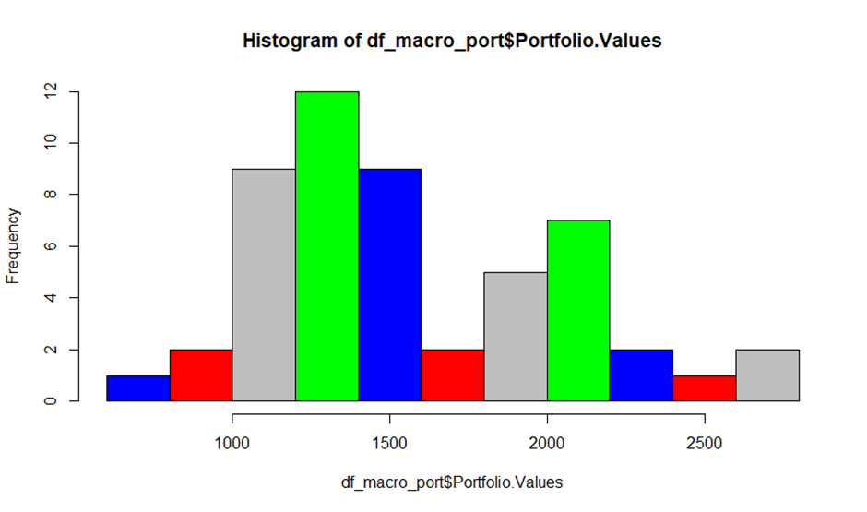
Analysis of historical portfolio values
Central tendency values around historical portfolio

Slide 7
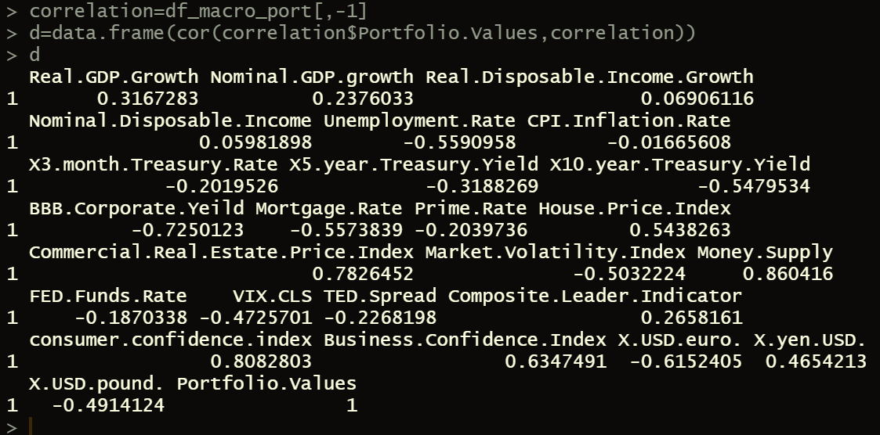
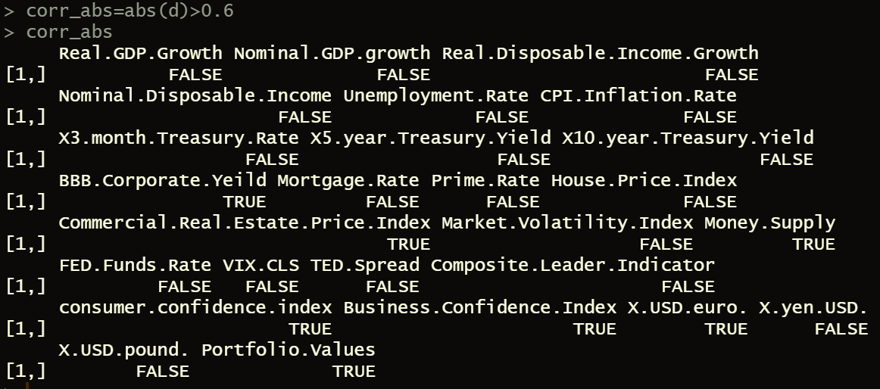
Correlation analysis
Correlation between dependent and independent values: -
All the true values below represent absolute correlation > 0.6

Slide 8
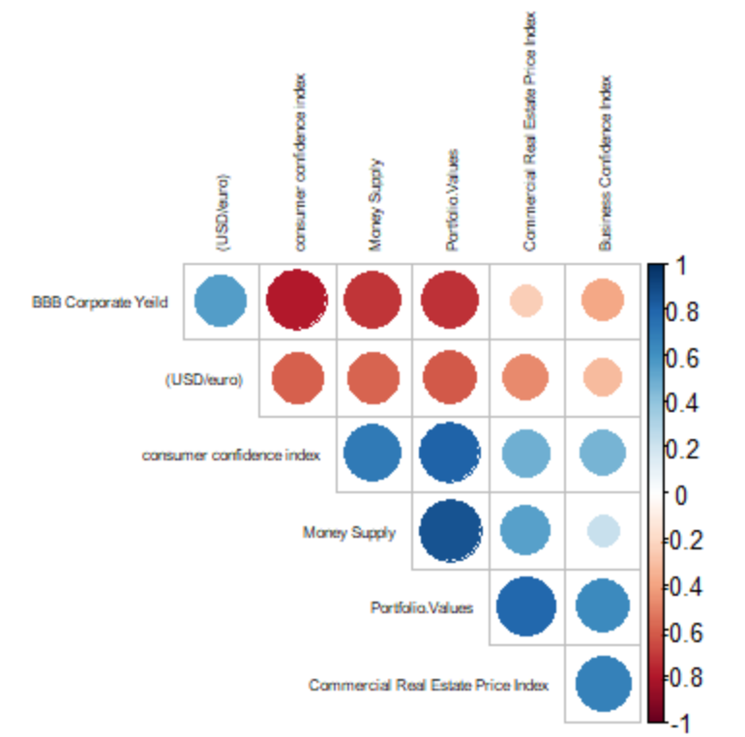
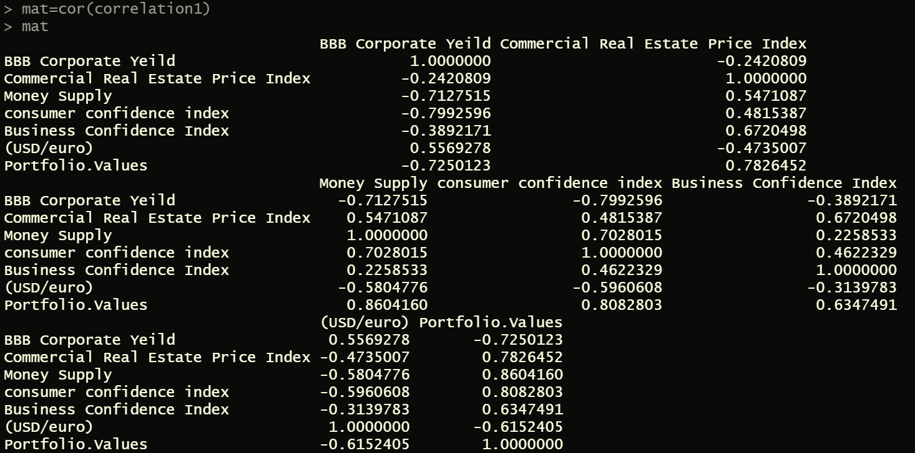
Correlation matrix
Perhaps from the matrix and it’s plot, we ascertain that money supply has highest multicollinearity with several other variables. Thus, we remove it from the analysis considering it to be a non - reliable variable.
We then analyse the chosen variables by plotting it against Bank Portfolio too for better visual clarity.

Slide 9
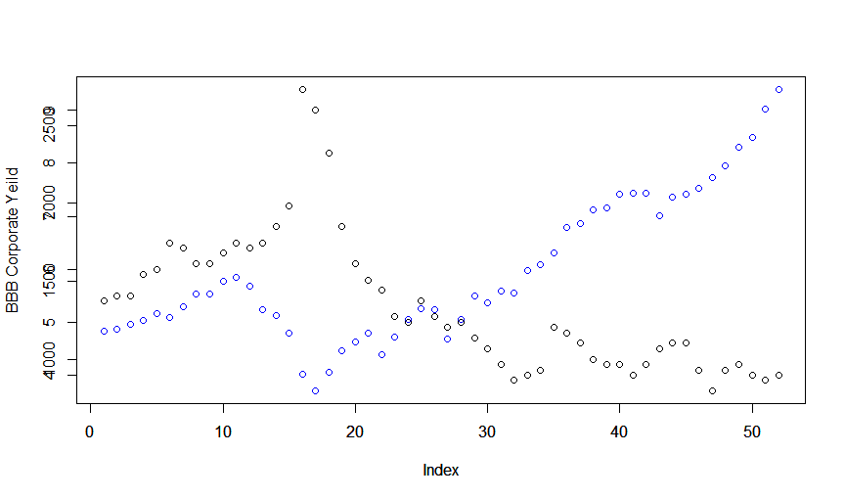
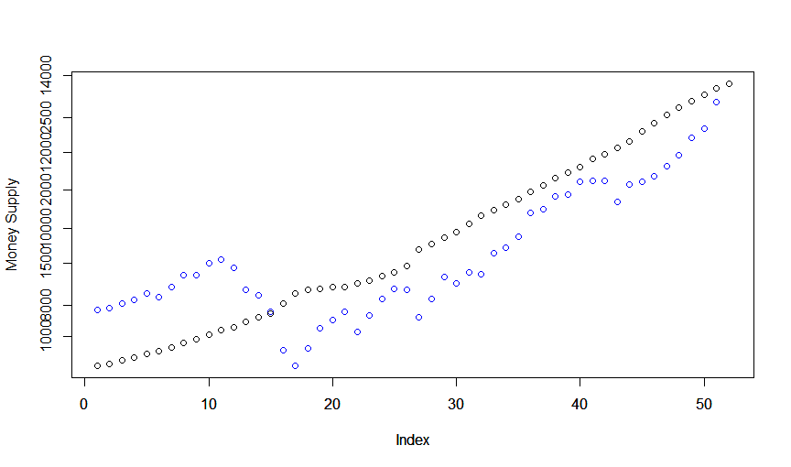
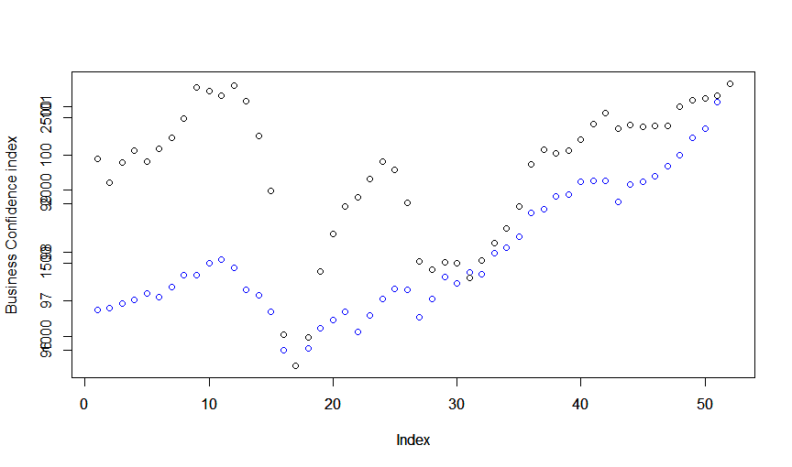
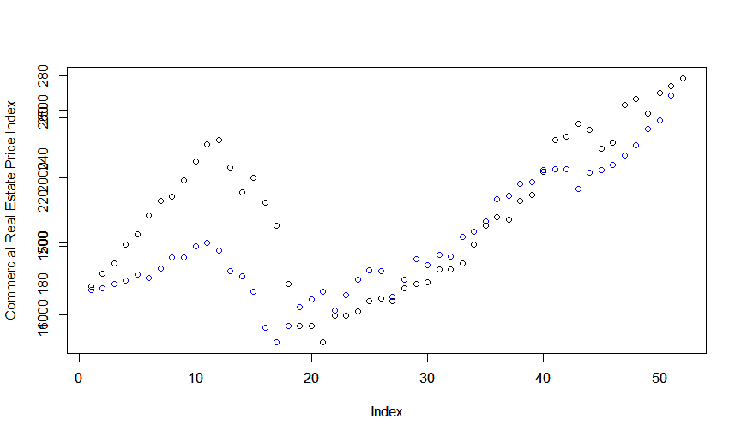
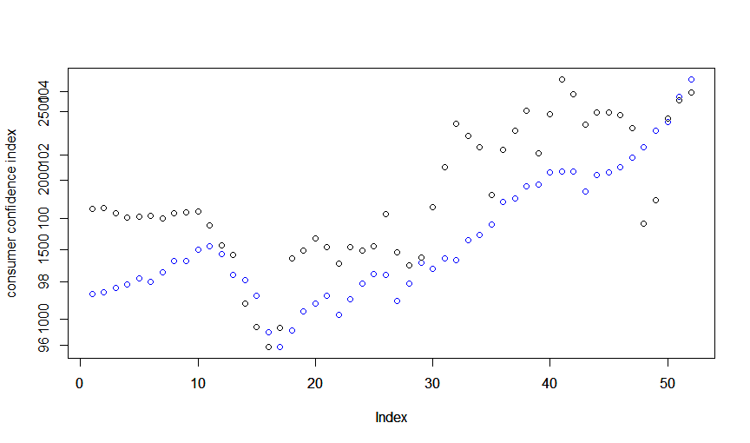
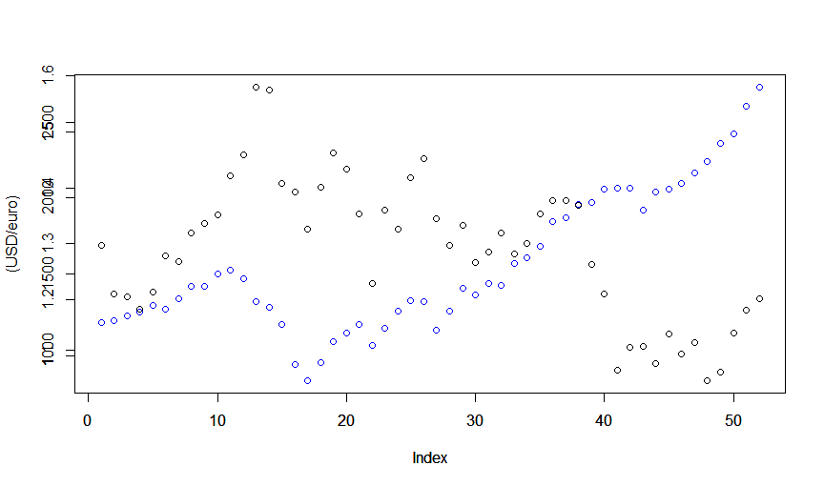
Scatter plots for :- dependent v/s independent variables
Other than “Money Supply”, all other variables provide a pretty good intuition for the Portfolio Values

Slide 10
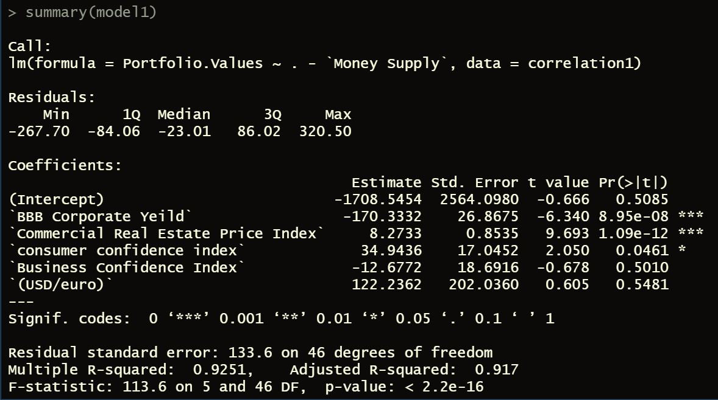
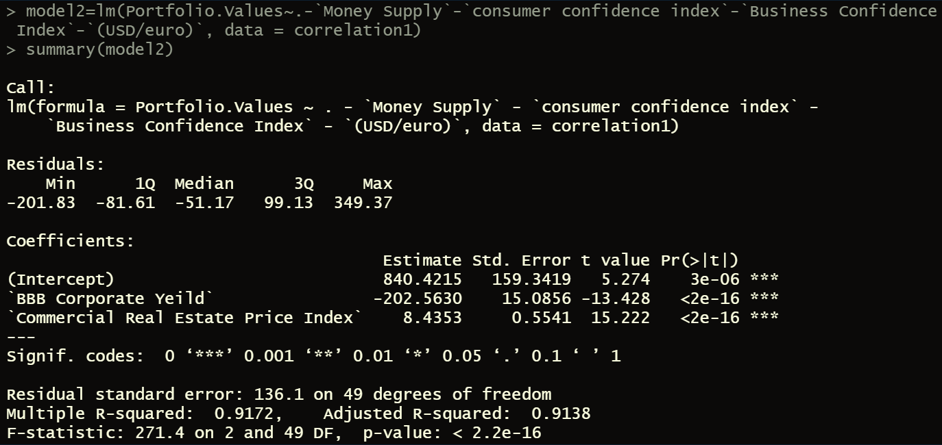
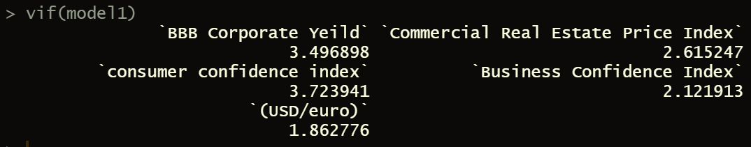
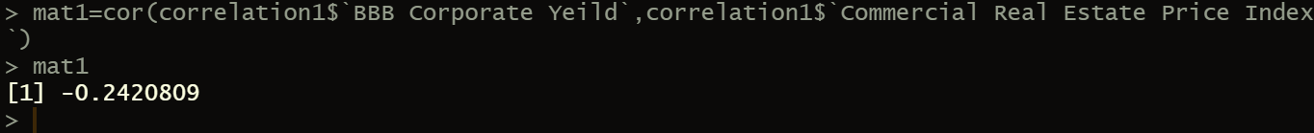
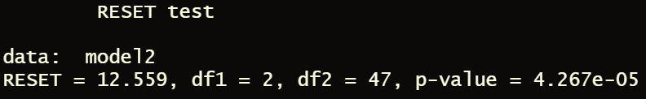
Multiple rounds of Model iterations
Variables with p-value > 0.05 are removed since they fall in the H0 region. Consumer Confidence index too was removed due to having the highest p-value.
The Variance Inflation factor means that the remaining variables aren’t multicollinear since their value is < 10.
The model failed the test!

Slide 11
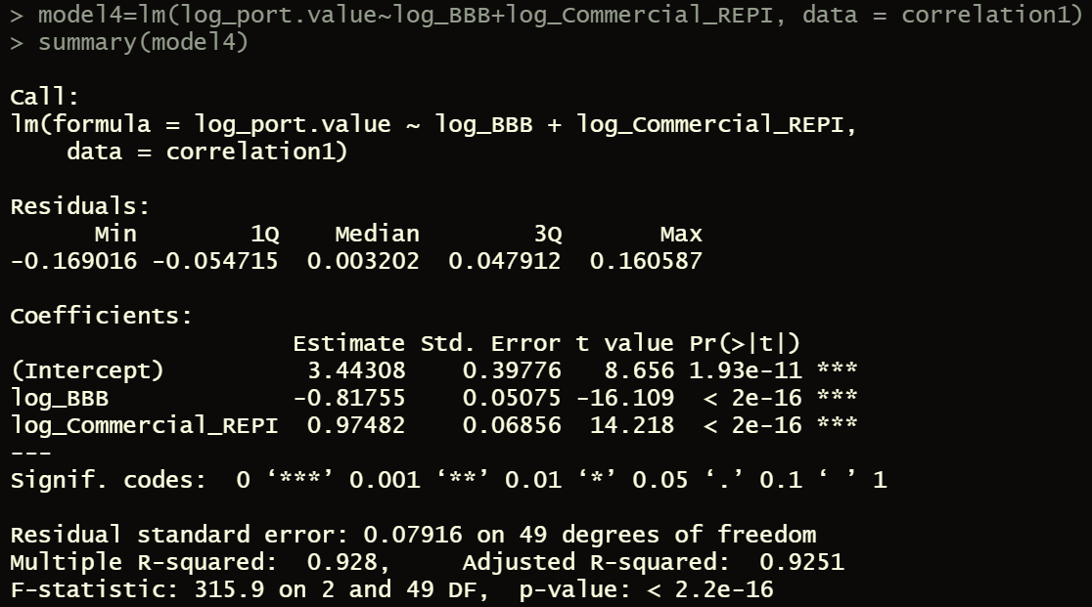
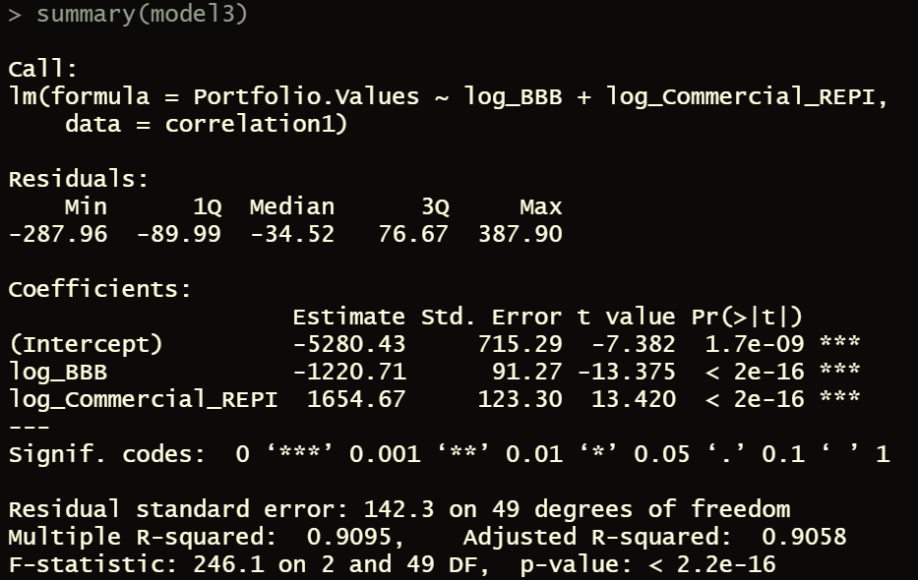
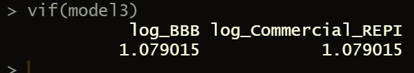
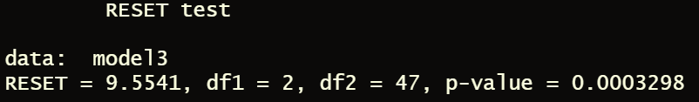

Final model
The final model consisting of log values
The model failed the test!

Slide 12
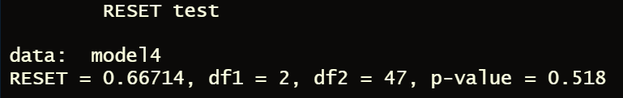
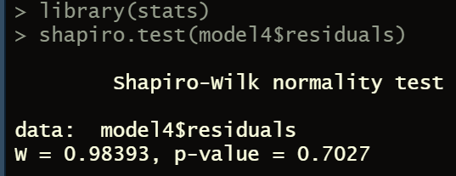
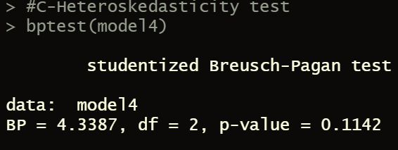
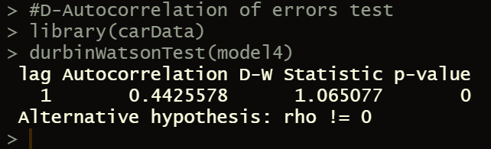
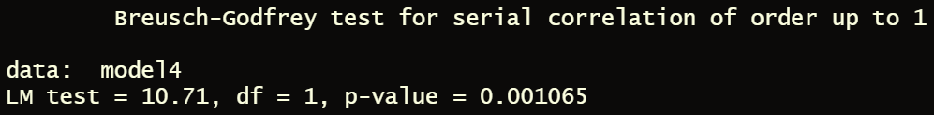
Statistical tests - Quantitative tests
TESTS | INFERENCE
Ramsay reset [Linearity test] | Linear since p-value>0.05
VIF [Multicollinearity] | No multicollinearity since <10
Shapiro – Wilk [Normality test] | Normal since p-value>0.05
Breusch Pagan Test [Heteroscedasticity] | Homoscedastic since p-value>0.05
Durbin-Watson Test | Auto correlation since p-value<0.05
Breusch Godfrey Test | Auto correlation since p-value<0.05

Slide 13
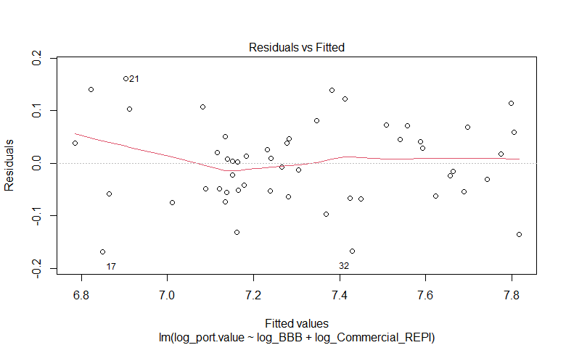
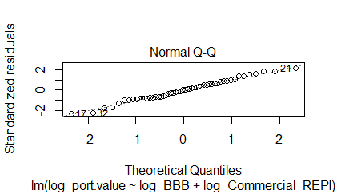
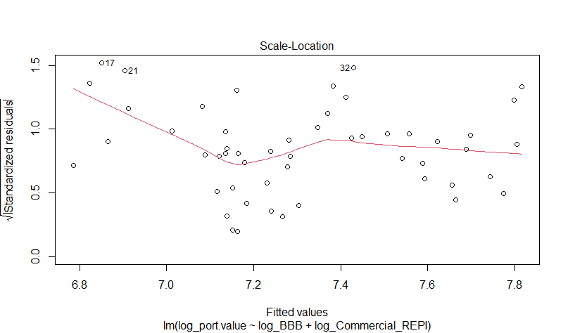
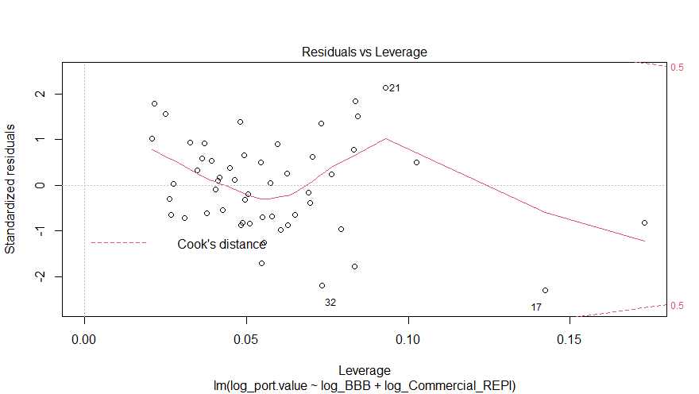
Statistical tests - Qualitative tests
As we can witness that the first output we get is a Residuals v/s Fitted plot wherein x-axis has the fitted values and y-axis Residuals. Since the red dotted line here is almost horizontal without any significant deviations, we can conclude that there is presence of Linearity in our model.
since the residuals pretty much fall on the plotted line which consists of the fitted values, we can conclude that the residuals are normally distributed
At left we have Scale-Location or Spread-Location plot. Since the values in future smoothen out, we can say that homoscedasticity exists.
In right, since no value crosses cook’s distance, we conclude that outliers don’t significantly impact our regression model

Slide 14
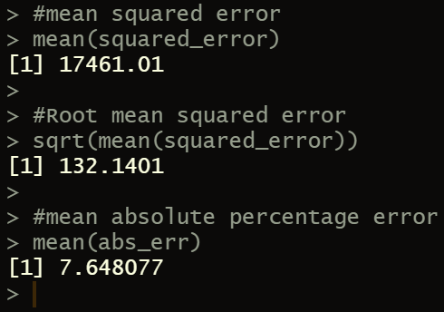
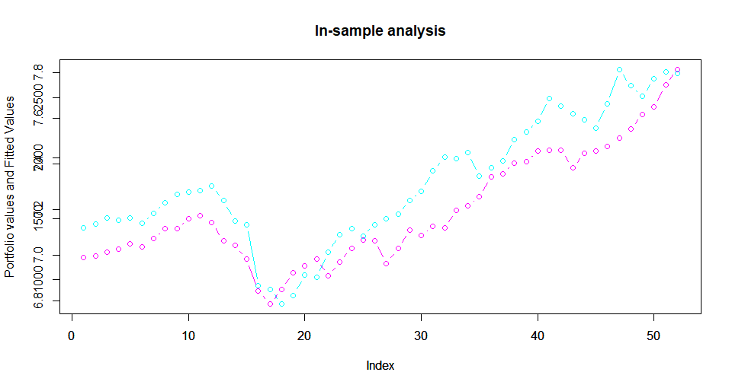


Sample analysis – In sample analysis
Perhaps since the mean absolute percentage error i.e. MAPE is less than 10%, it indicates an acceptable in-sample fit.

Slide 15
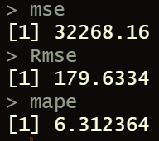
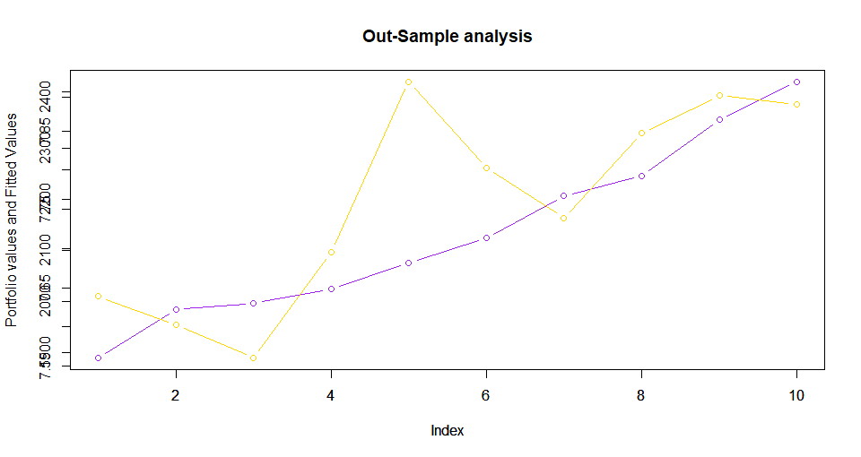
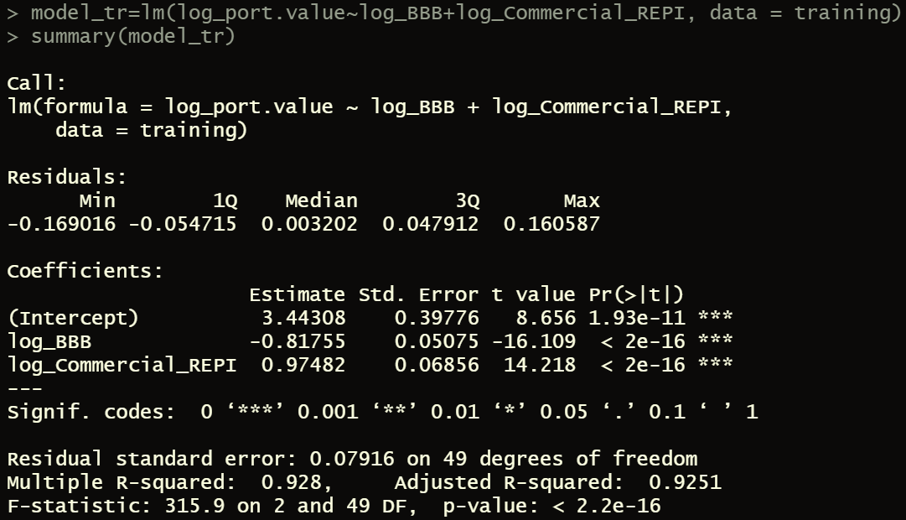


Sample analysis – out sample analysis
Perhaps since the mean absolute percentage error i.e. MAPE is less than 10%, it indicates an acceptable in-sample fit.

Slide 16
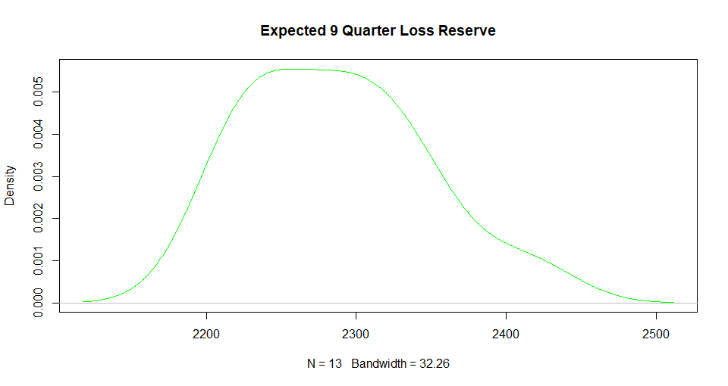
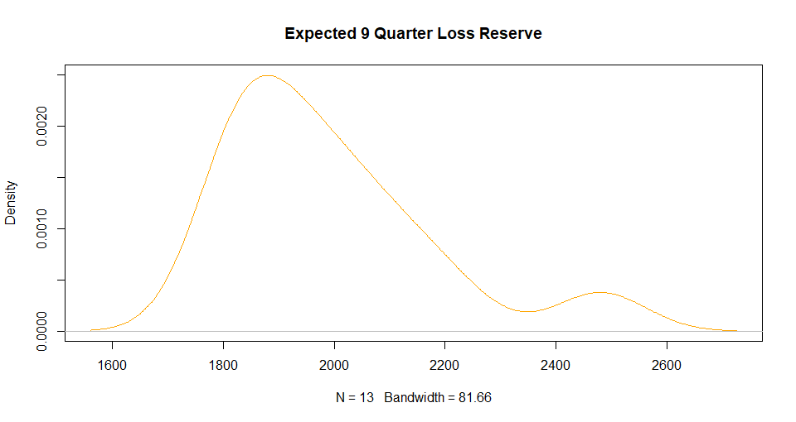
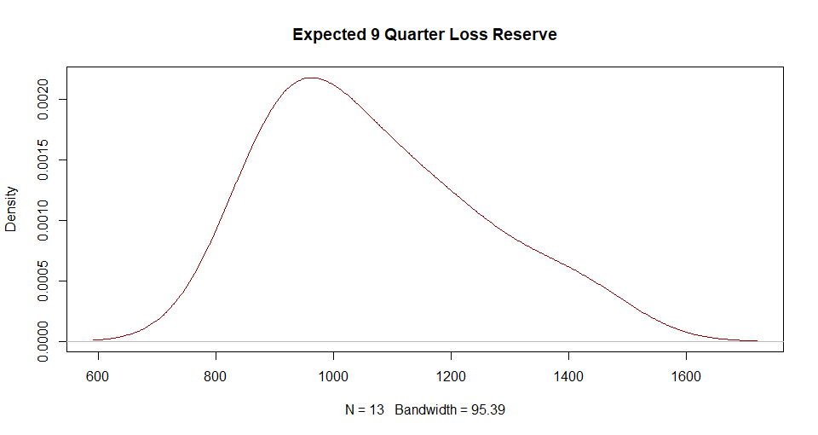




Final Comprehensive Capital Analysis and Review value
Expected 9Q Loss Under Each Scenario
Baseline | Adverse | Severely Adverse | Initial Portfolio Value (Q4 2017)
$517.5414 million | $877.6618 million | $1763.163 million | $2733 million

