Slide 1
Application of Vector Algebra in Civil Structure
Group 58-63

Slide 2
58 - Pulkita Puri | Application Of Curvature Beam in Civil Structure
60 - Esha Rane | APPLICATION OF LINEAR ALGEBRA IN CIVIL ENGINEERING
61- Kris Rodrigues
63 - Nidhish Samajpati | Application of vectors in arch bridges

Slide 3
Application Of Curvature Beam in Civil Structure

Slide 4
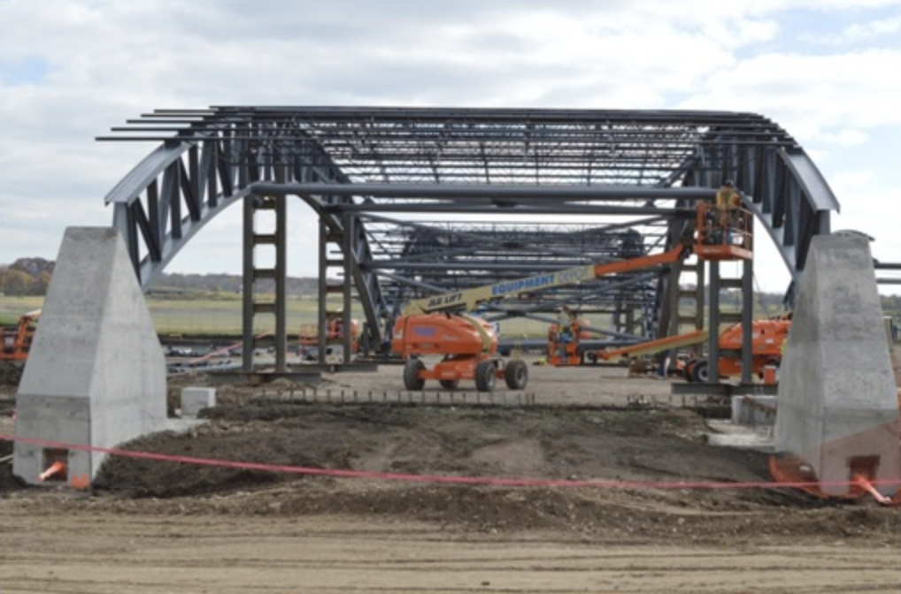
Application of Curvature Beam in Civil Structure
Pulkita Puri (58)
A curved beam is defined as a beam in which the neutral axis in unloaded condition is curved instead of straight.

Slide 5
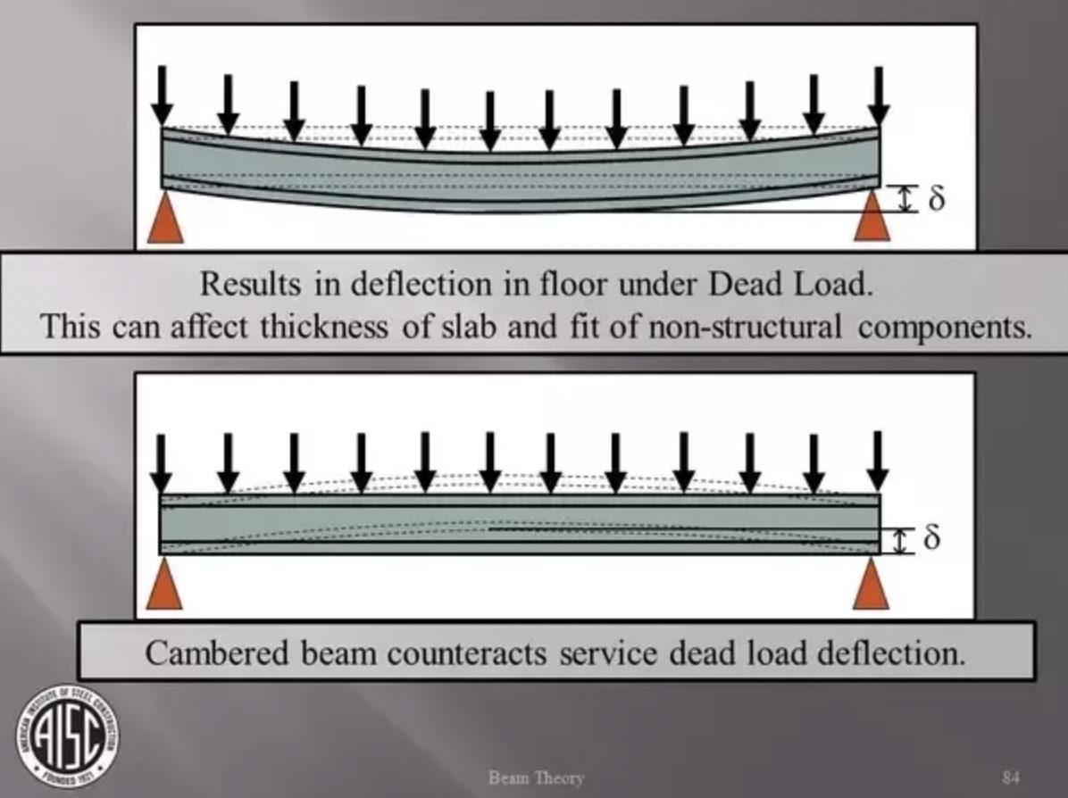
Curved Beams
Pulkita Puri (58)
Curved beams are known to be more efficient in transfer of loads than straight beams. The transfer in the curved beam is affected by means of bending, shear and membrane action.

Slide 6
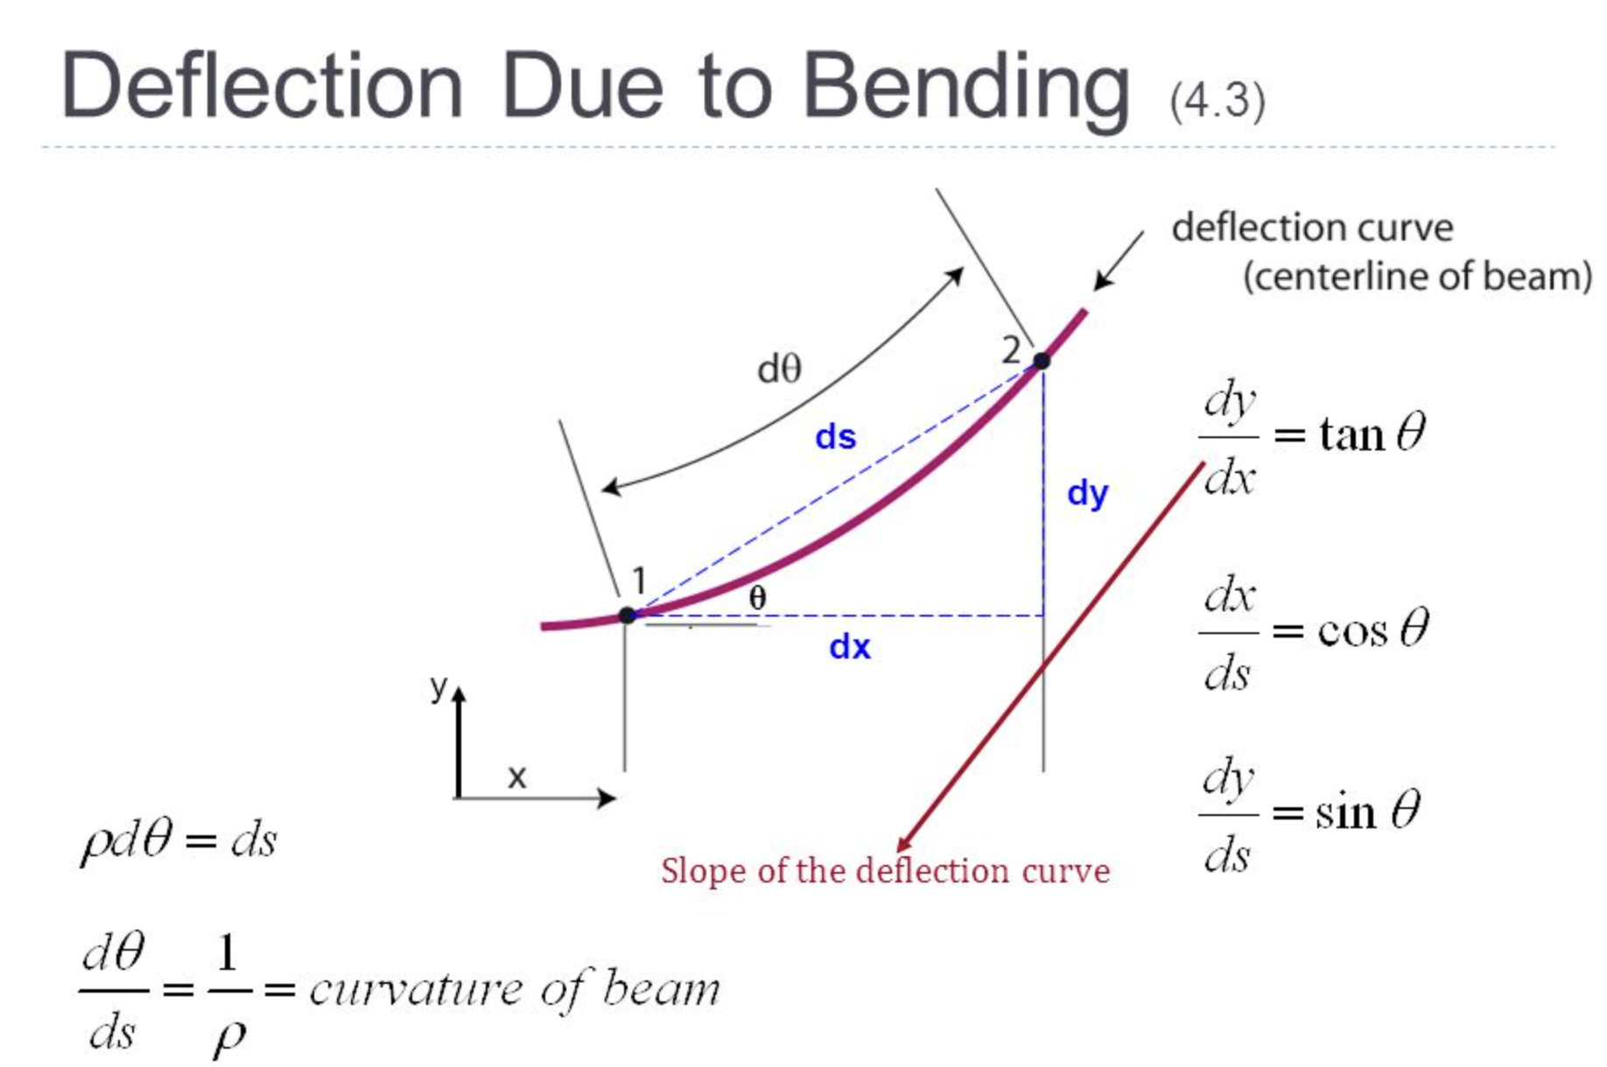
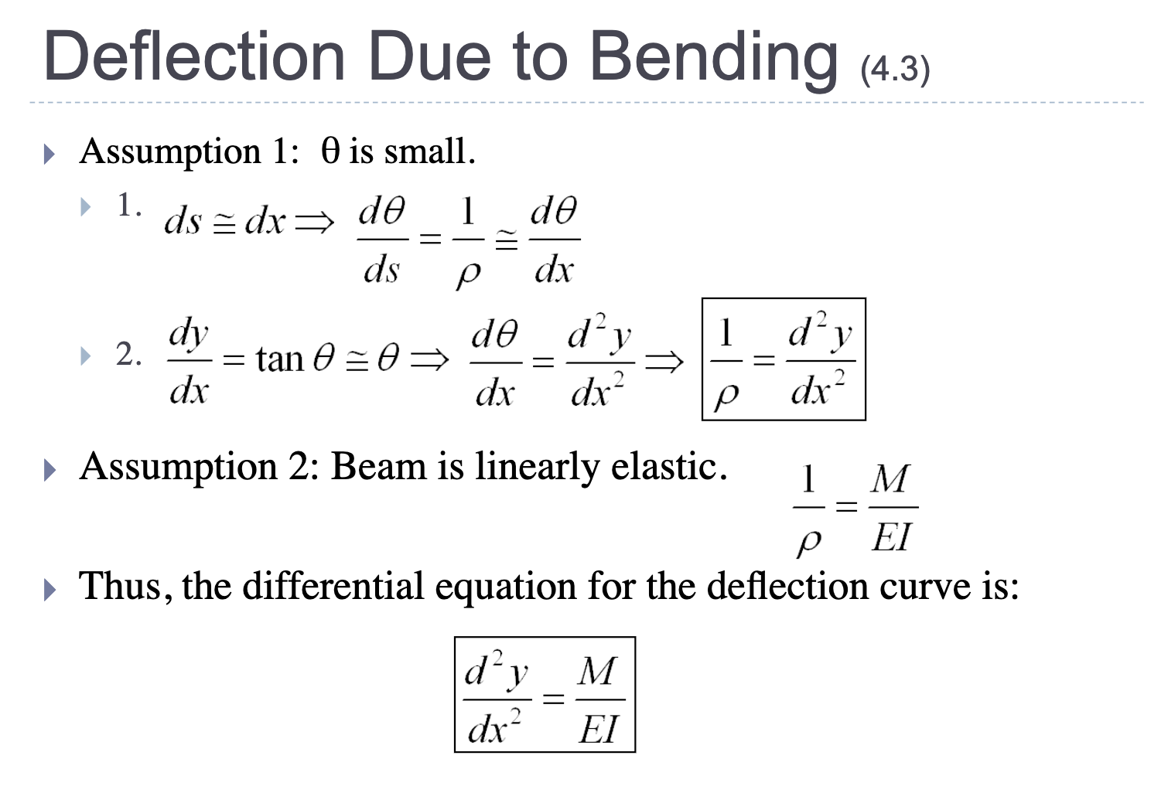
Curved Beam Formula and it’s Illustration
Pulkita Puri (58)

Slide 7
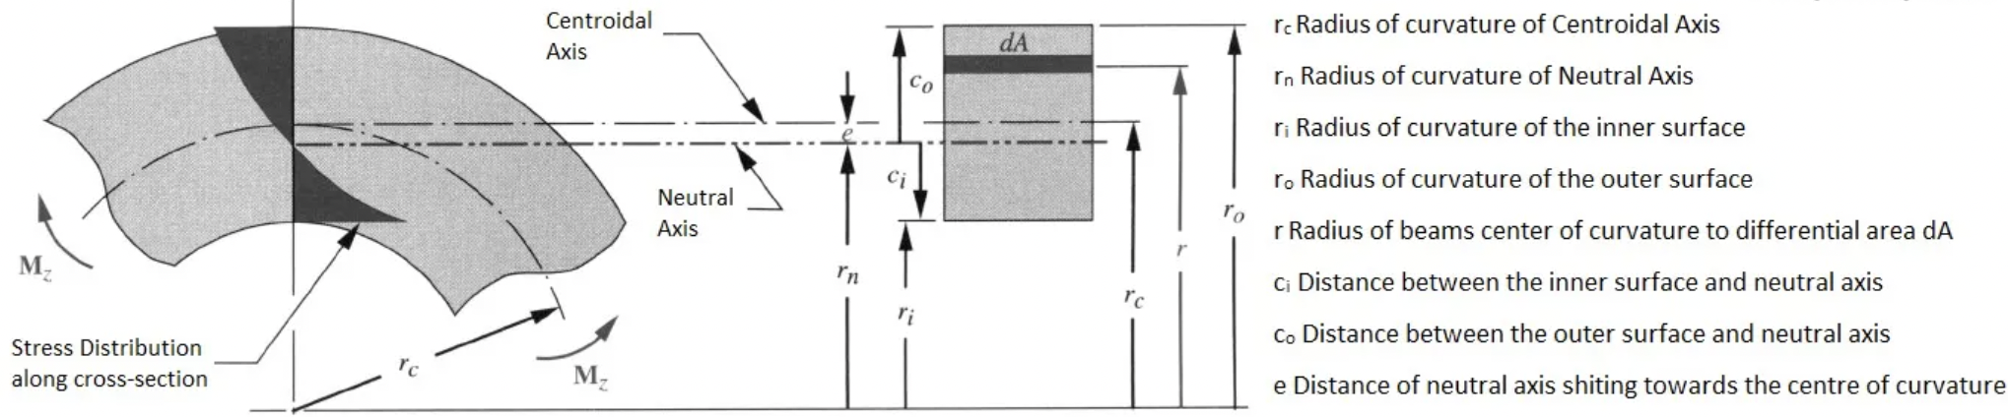
Shifting of Neutral Axis
Pulkita Puri (58)

Slide 8
Bibliography
Pulkita (58):
Curved Beam Design Procedure - The Chicago Curve (cmrp.com)
Finite element analysis on curved beams of various sections | IEEE Conference Publication | IEEE Xplore
What is curved beam? - Online Interview Questions
Beam Deflection Review ( ) - ppt video online download (slideplayer.com)

Slide 9
Application of vectors in arch bridges

Slide 10

Arch Bridge History
The ancient romans were the first to recognize
the potential of arch bridges for construction.
Roman arc bridges were usually constructed using
semi-circulars sarcs, although some used arcs less than
a semi-circle.

Slide 11
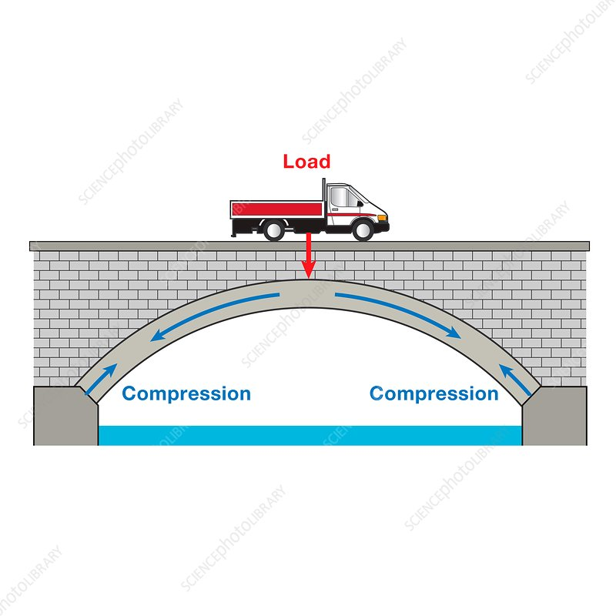
Working of an Arch Bridge
Arch bridge construction centers on the idea that the
arch distributes the force of gravity acting on the bridge
(i.e., the thrust) through the curve of the arch and into
the column beneath it, which are called base columns.
The force vectors for each stone push downward in a
direction perpendicular to the joint between the stones
and the force vectors are assumed to have the same
magnitude(except for the keystone).

Slide 12
Important Formulae of the Arch
Elastic Energy , U (s, t ) = EaAa/2∫ [ ∂va (s, t )/∂s − w(s, t )/R]^2ds + EaIa/2∫ [ ∂2wa(s, t )/∂s2 + ∂v(s, t )/R∂s]^2ds
Kinetic Energy ,T (s, t ) = μ(s)/2∫ {[ ∂va (s, t )/∂t ]^2 + [ ∂wa (s, t)/∂t]^2}ds
where μ(s) and μ(x) denote the masses per unit length of arch and beam, respectively. Eic (i = 1, 2, . . .), Aic (i = 1, 2, …..)Lic (i = 1, 2, . . .) denote the Young’s modulus, area and length of the ith hanger, respectively.
n denotes the number of the segments.
R denotes the radius of the arch, wa, va and wb are the arch’s normal displacement, tangential displacement and the beam’s transverse displacement, respectively.
The location Si (i = 1, 2, . . .) of the ith hanger on arch depends on φi (i = 1, 2, . . .) and Xi (i = 1, 2, . . .).
Correspondingly, wai, vai and wbi are the displacements of the ith hanger’s end points.
Additionally, ki (i = 1, 2, . . .) denotes the spring constant.

Slide 13
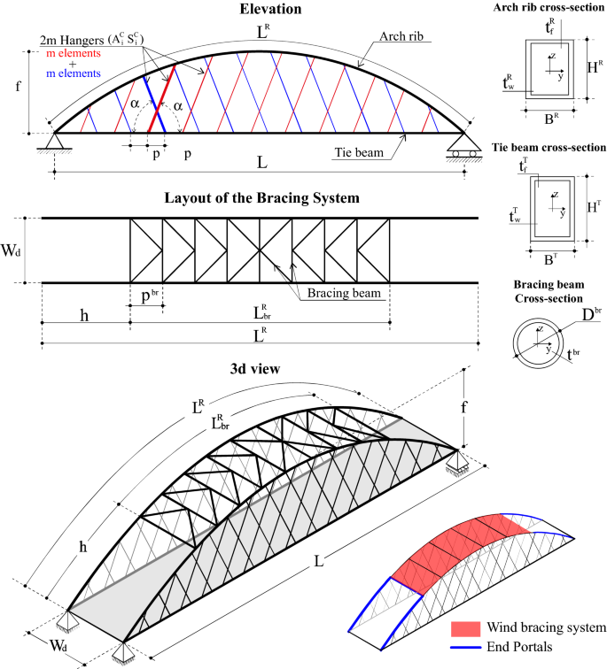
Design of network Arch Bridge (Diagram)
Abbreviations
m : Number of cables
mbr : Number of arch cross-beam
p : Spacing step of the cables
pbr : Step of the arch cross-beam along the
arch rib
AC : Cable cross-section
[Abbreviations are continued in next page]

Slide 14
Design of network Arch Bridges(Abbreviation)
L: Bridge span length LR : Arch rib length
LRbr : Wind bracing system length Wd : Bridge width
f : Arch rise h : Height of the end portal
α : Cable slope DL : Dead Load
LL : Live Load HR : Height of the arch rib cross-section
BR : Width of the arch rib cross-section tRw : Web thickness of the arch rib
cross-section
tRf : Flange thickness of the arch rib HT : Height of the tie girder cross-section
cross-section tTw : Web thickness of the tie girder
BT : Width of the tie girder cross-section cross-section
tTf : Flange thickness of the tie girder Dbr : External diameter of the arch cross beam
cross-section tbr : Pipe thickness of the arch cross beam

Slide 15
Bibliography
Nidhish (63):
https://link.springer.com/article/10.1007/s13296-019-00282-8
file:///C:/Users/Admin/Downloads/precalculus-m2-topic-d-lesson-20-teacher%20(1).pdf

Slide 16
APPLICATION OF LINEAR ALBEBRA IN CIVIL ENGINEERING
ESHA RANE 60

Slide 17
Esha rane 60
Civil engineers use linear algebra to design and analyze load-bearing structures such as bridges. Mechanical engineers use linear algebra to design and analyze suspension systems, and electrical engineers use it to design and analyze electrical circuits.

Slide 18
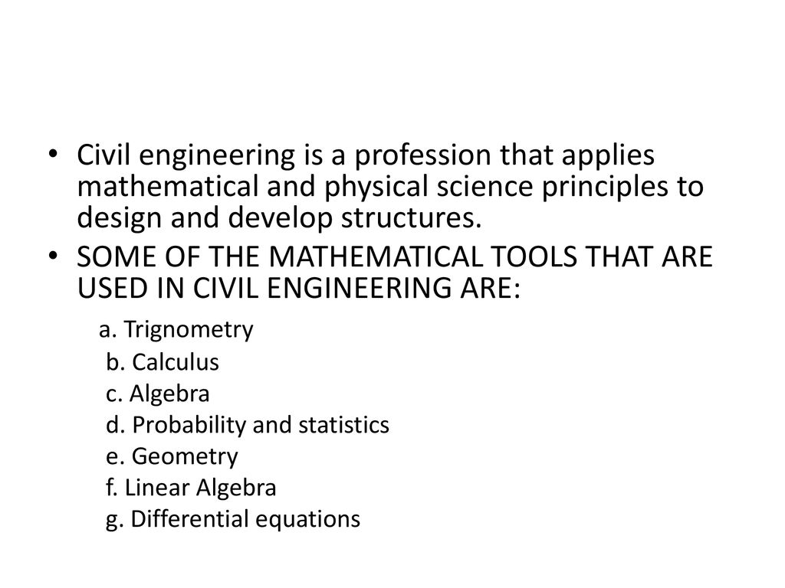
ESHA RANE 60

Slide 19
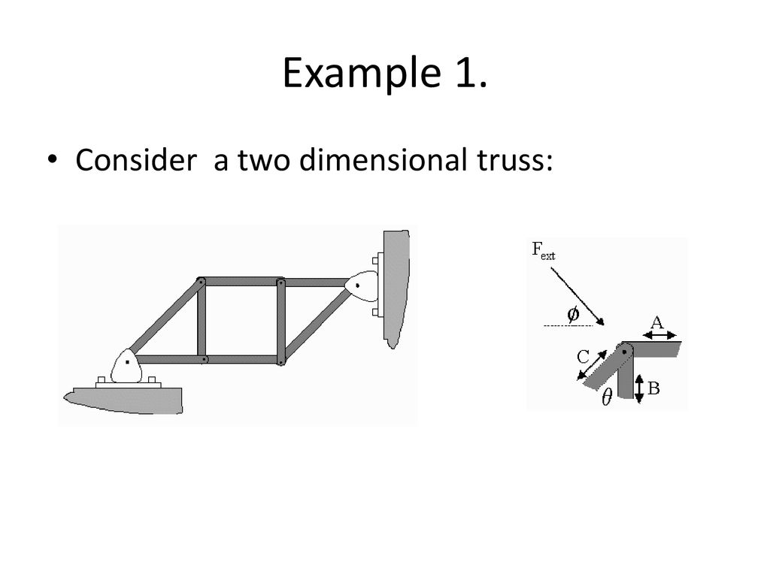
ESHA RANE 60

Slide 20
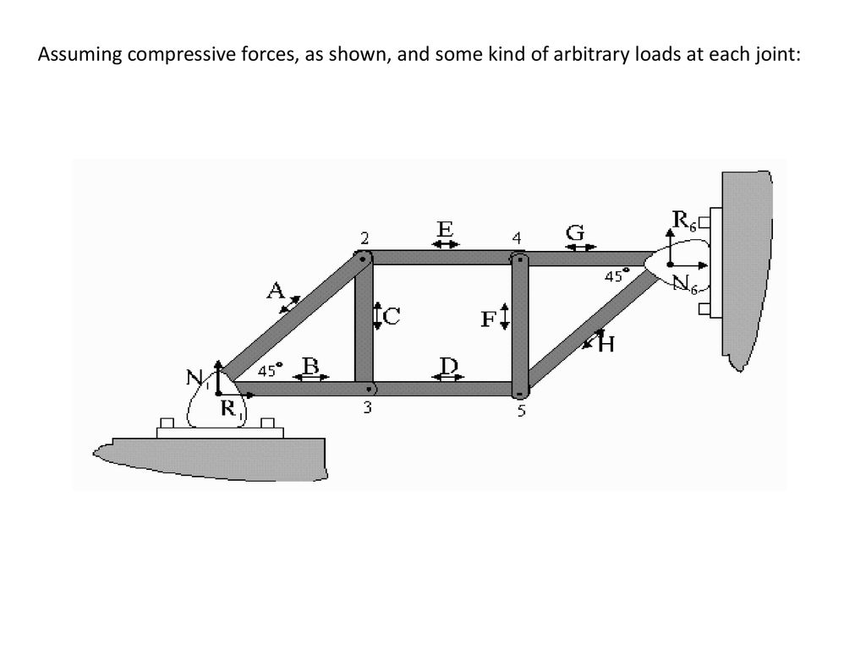
ESHA RANE 60

Slide 21
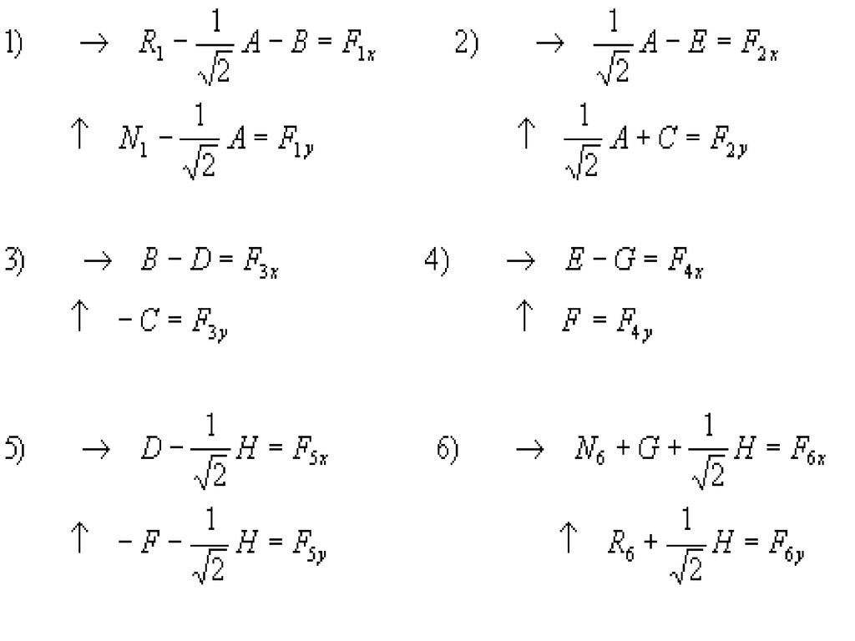

Slide 22
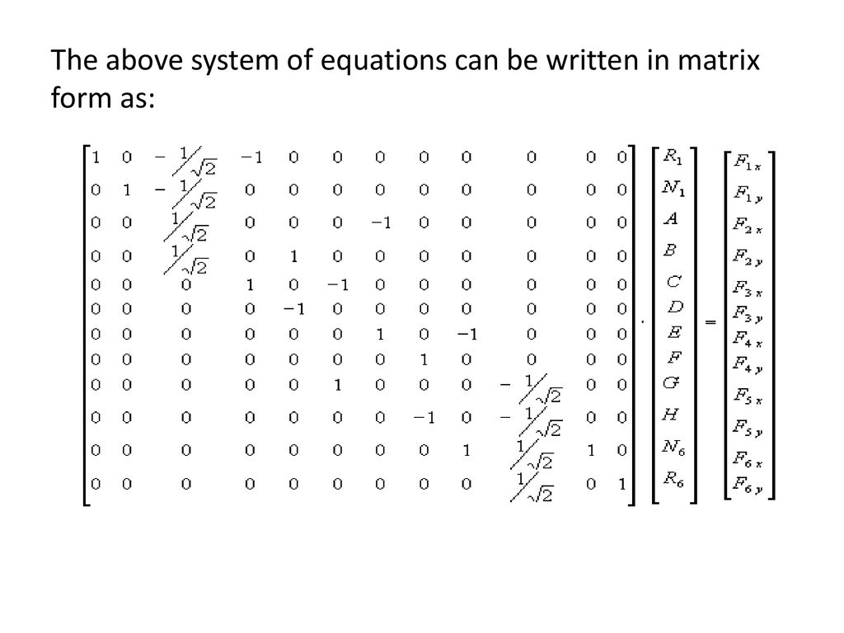

Slide 23
