Slide 1
Application of matrix algebra and inverse in encoding and decoding of messages
ROLL NO: 51 TO 57

Slide 2
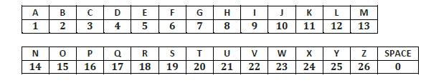
Cryptography and use of matrices
Roll No. 56
Cryptography is the study of secure communications techniques that allow only the sender and intended recipient of a message to view its contents. The term is derived from the Greek word kryptos, which means hidden. It is closely associated to encryption, which is the act of scrambling ordinary text into what's known as ciphertext and then back again upon arrival.
The Hill Algorithm, was created by Lester Hill, a mathematics professor who was involved with military encryption.
It is relatively easy to break with modern technology.
It involves arbitrarily assigning numbers to each letter.

Slide 3
Method of encoding messages
Roll no. 52
Divide the letters of the message into groups of two or three.
Convert each group into a string of numbers by assigning a number to each letter of the message. Remember to assign letters to blank spaces.
Convert each group of numbers into column matrices.
Convert these column matrices into a new set of column matrices by multiplying them with a compatible square matrix of your choice that has an inverse. This new set of numbers or matrices represents the coded message.

Slide 4
Method of Decoding Messages
Roll.No 54
The receiver of the message decodes the encrypted message using inverse matrix concept
The inverse of encoding matrix is called as decoding matrix
The decoding of the message is done by
Step1: Finding Decoding Matrix (Inverse of the encoding matrix)
Step2:Multiplying the Encrypted message matrix with the Decoding Matrix using matrix multiplication.

Slide 5
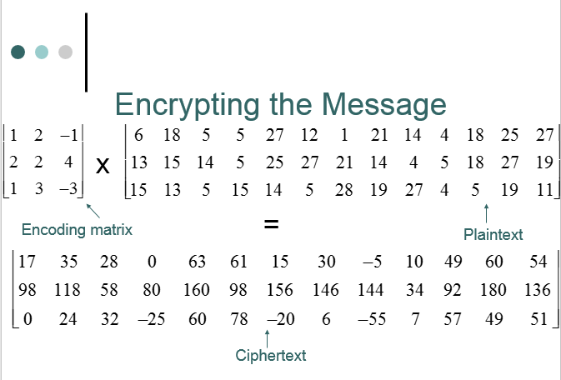
Example of Encoding Message 1
Roll.No 51

Slide 6
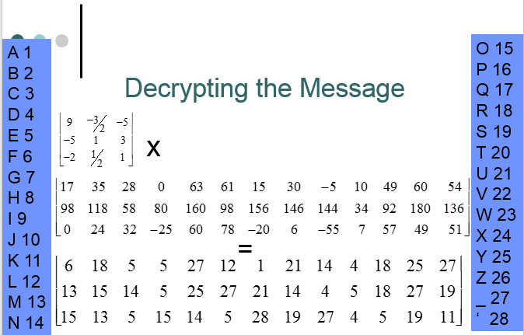
Example of Decoding Message 1
Roll.No 51

Slide 7
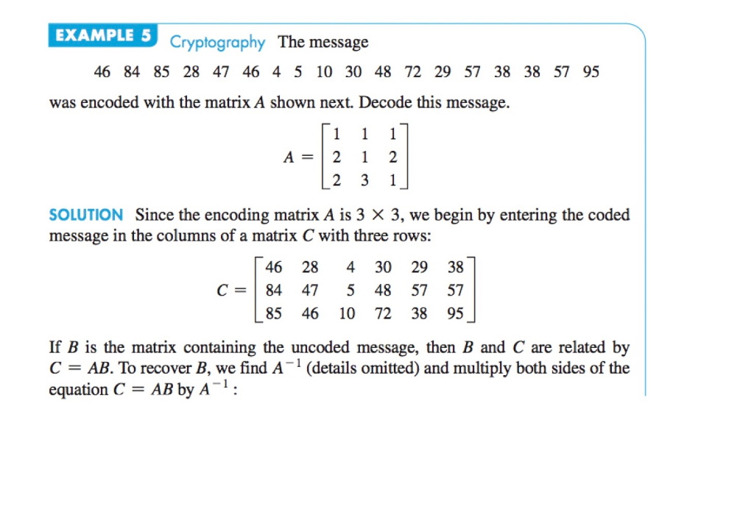
Example of Encoding Message 2
Roll.No 52

Slide 8
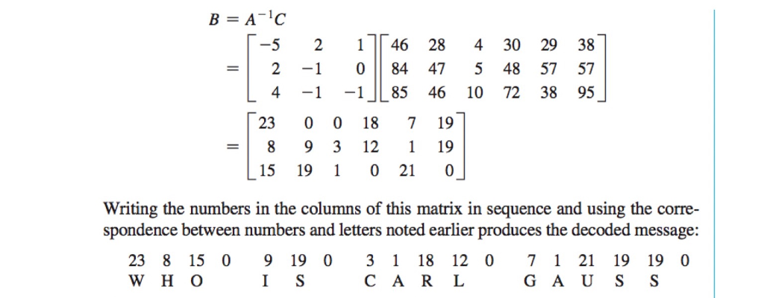
Example of Decoding Message 2
Roll.No 52

Slide 9
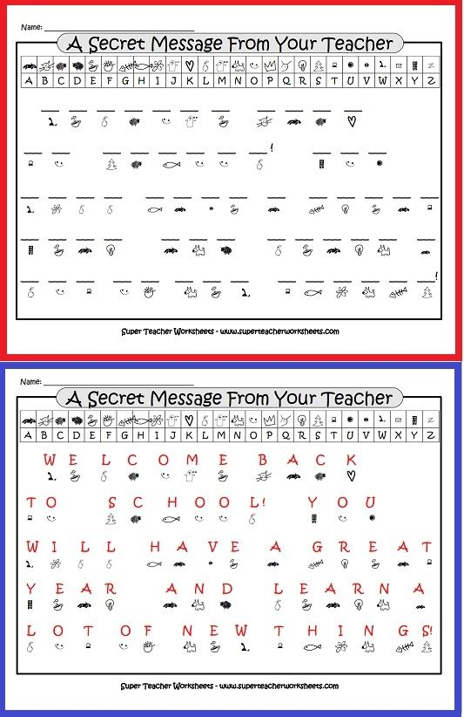
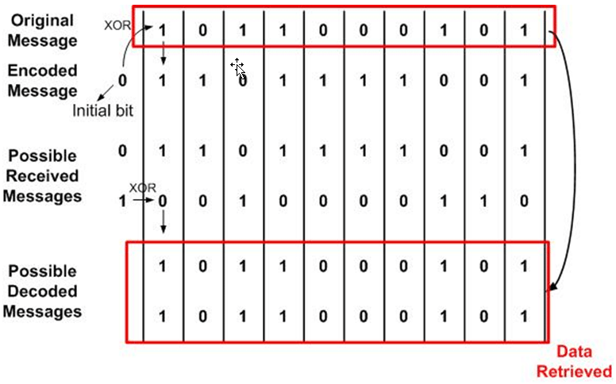
Example of Encoding Message 3
Roll.No 53

Slide 10
Example of Decoding Message 3
Roll.No 53

Slide 11
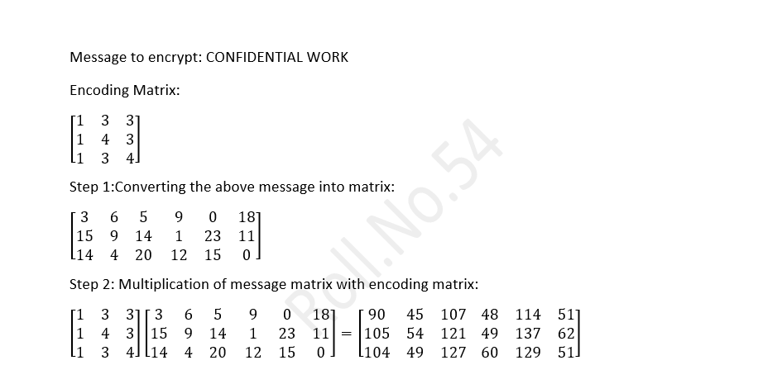
Example of Encoding Message 4
Roll.No 54
Using 3x3 encoding matrix

Slide 12
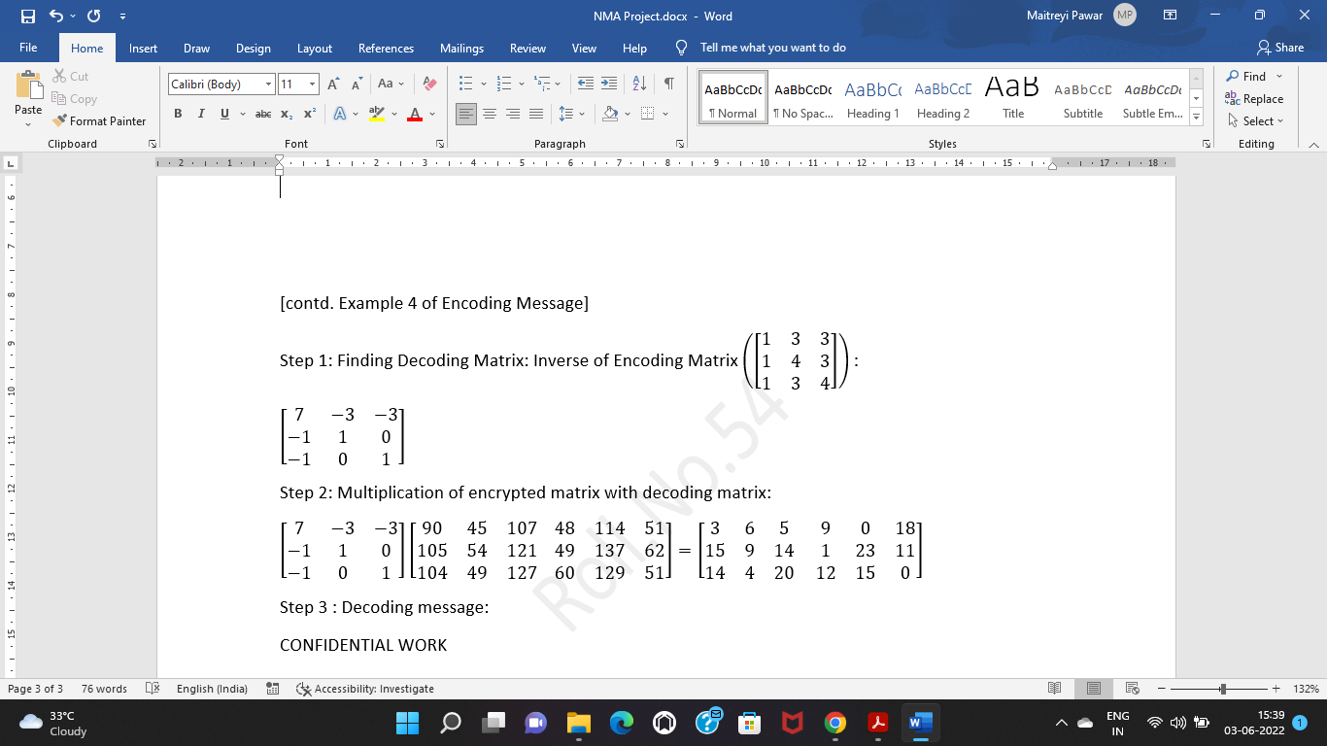
Example of Decoding Message 4
Roll.No 54
Using 3x3 decoding matrix

Slide 13
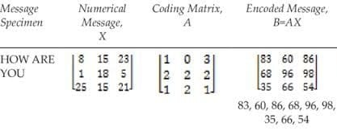
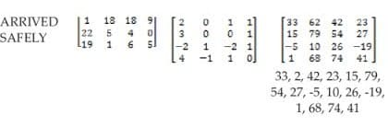
Example of Encoding Message 5
Roll.No 55

Slide 14
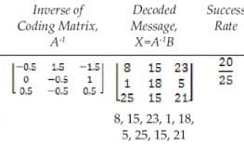
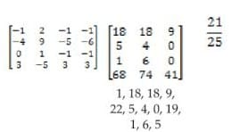
Example of Decoding Message 5
Roll.No 55
MESSAGESPECIMEN:
HOW ARE YOU
ARRIVED SAFELY

Slide 15
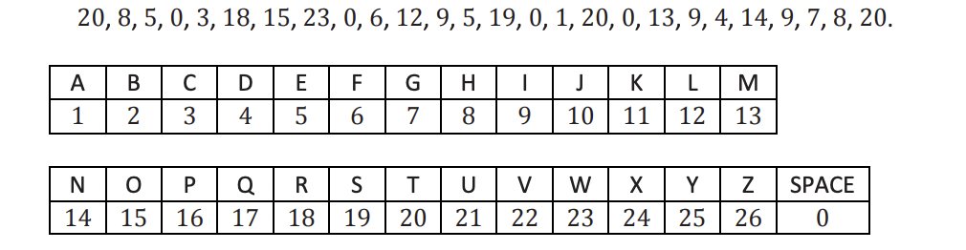
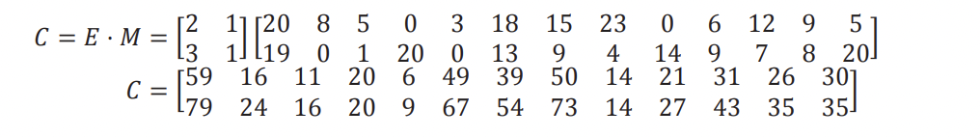
Example of Encoding Message 6
Roll.No 56

Slide 16
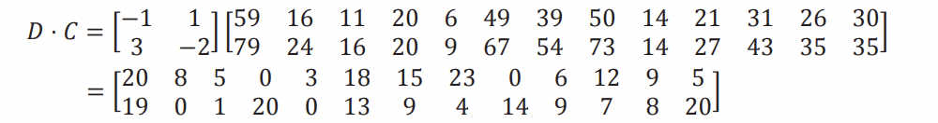
Example of Decoding Message 6
Roll.No 56
For decoding we find the inverse of matrix
The message is translated to “The crow flies at midnight” using the key given in the above slide.

Slide 17
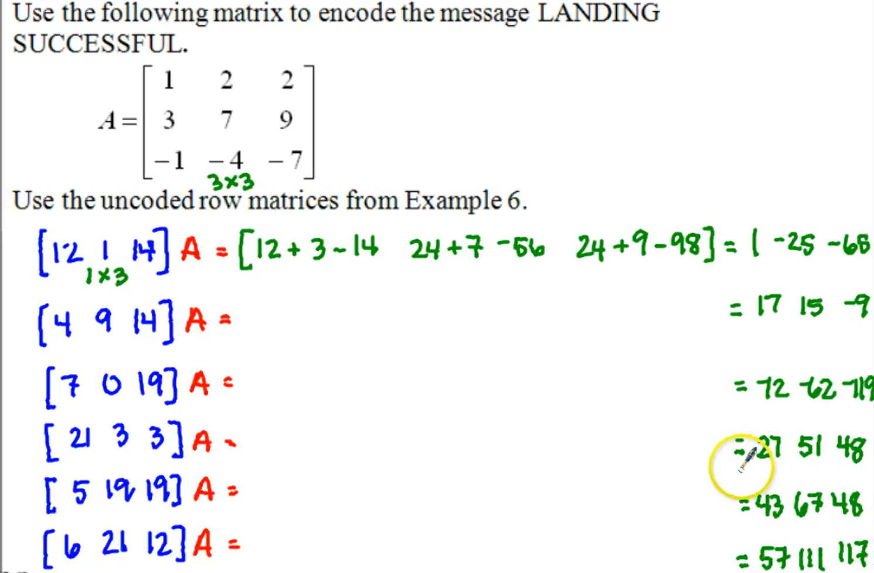
Example of Encoding Message 7
Roll.No 57

Slide 18
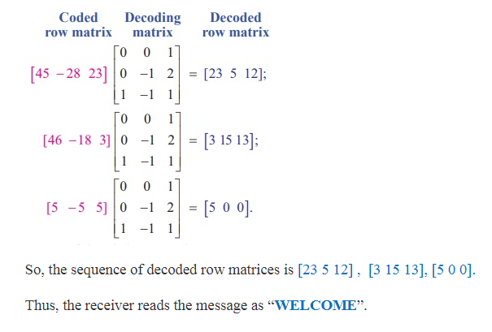
Example of Decoding Message 7
Roll.No 57

Slide 19
Significance of Encoding-Decoding Messages using Matrix Algebra and Inverse
Roll No. 52
Encryption dates back approximately 4000 years. Historical accounts indicate that the Chinese, Egyptians, Indian, and Greek encrypted messages in some way for various purposes. One famous encryption scheme is called the Caesar cipher, also called a substitution cipher, used by Julius Caesar, involved shifting letters in the alphabet, such as replacing A by C, B by D, C by E, etc, to encode a message. Substitution ciphers are too simple in design to be considered secure today.With the advent of the computer age and internet communication, the use of encryption has become widespread in communication and in keeping private data secure; it is no longer limited to military uses. Modern encryption methods are more complicated, often combining several steps or methods to encrypt data to keep it more secure and harder to break. Some modern methods make use of matrices as part of the encryption and decryption process; other fields of mathematics such as number theory play a large role in modern cryptography.

Slide 20
Group Members :
Roll No. 51 - Lokit Nagi
Roll No. 52 - Tirth Parmar
Roll No. 53 - Aaradhya Patil
Roll No. 54 - Maitreyi Pawar
Roll No. 55 - Tanishtha Poddar
Roll No. 56 - Mahe Popat
Roll No. 57 - Muskaan Punjabi

Slide 21
References
file:///Users/macbook/Downloads/precalculus-m2-topic-b-lesson-13-teacher.pdf
https://math.libretexts.org/Bookshelves/Applied_Mathematics/Applied_Finite_Mathematics_(Sekhon_and_Bloom)/02%3A_Matrices/2.05%3A_Application_of_Matrices_in_Cryptography
https://www.chegg.com/homework-help/questions-and-answers/example-5-cryptography-message-46-84-85-28-47-46-4-5-10-30-48-72-29-57-38-38-57-95-encoded-q24980019
https://images.app.goo.gl/ihWotX6fNvYsH6sX6

