Slide 1
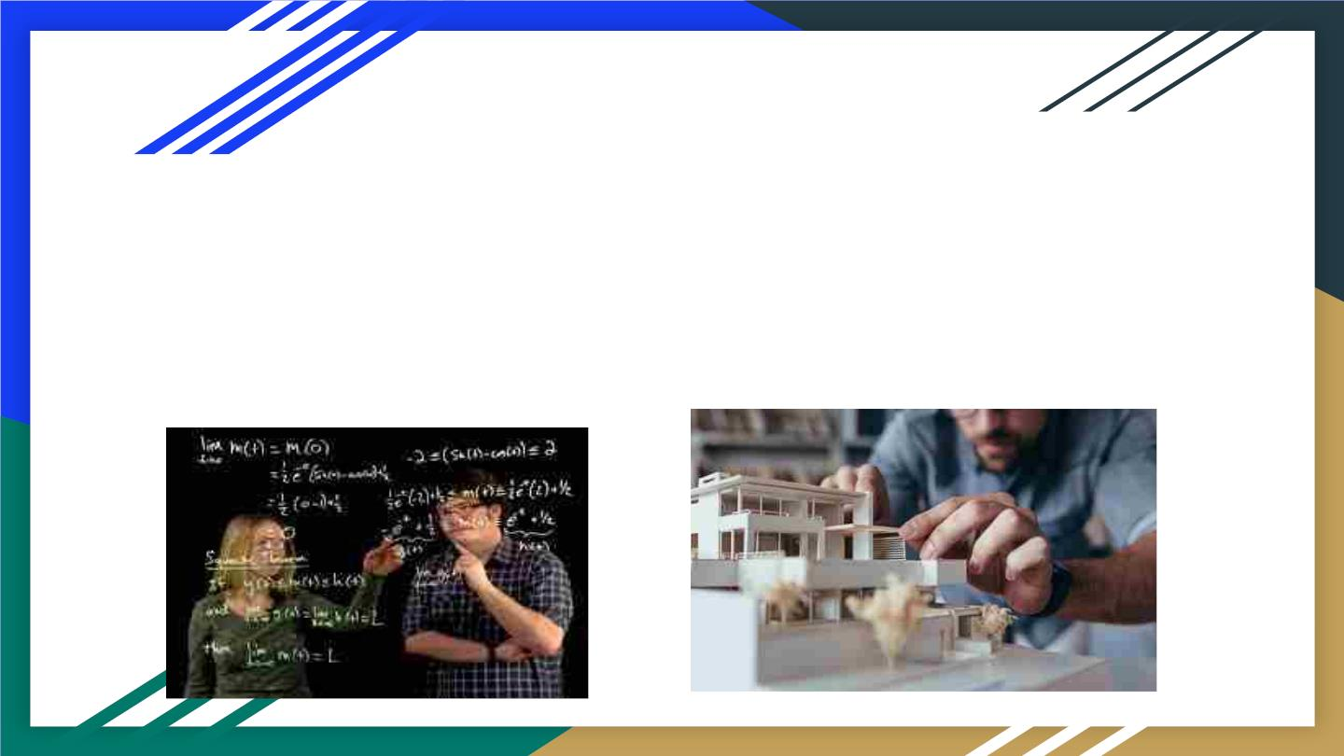
Introduction
Calculus is widely used for calculating the building's
heat loss, areas and masses of difficult geometric form
structures, for minimizing or maximizing areas of
designed structures.

Slide 2
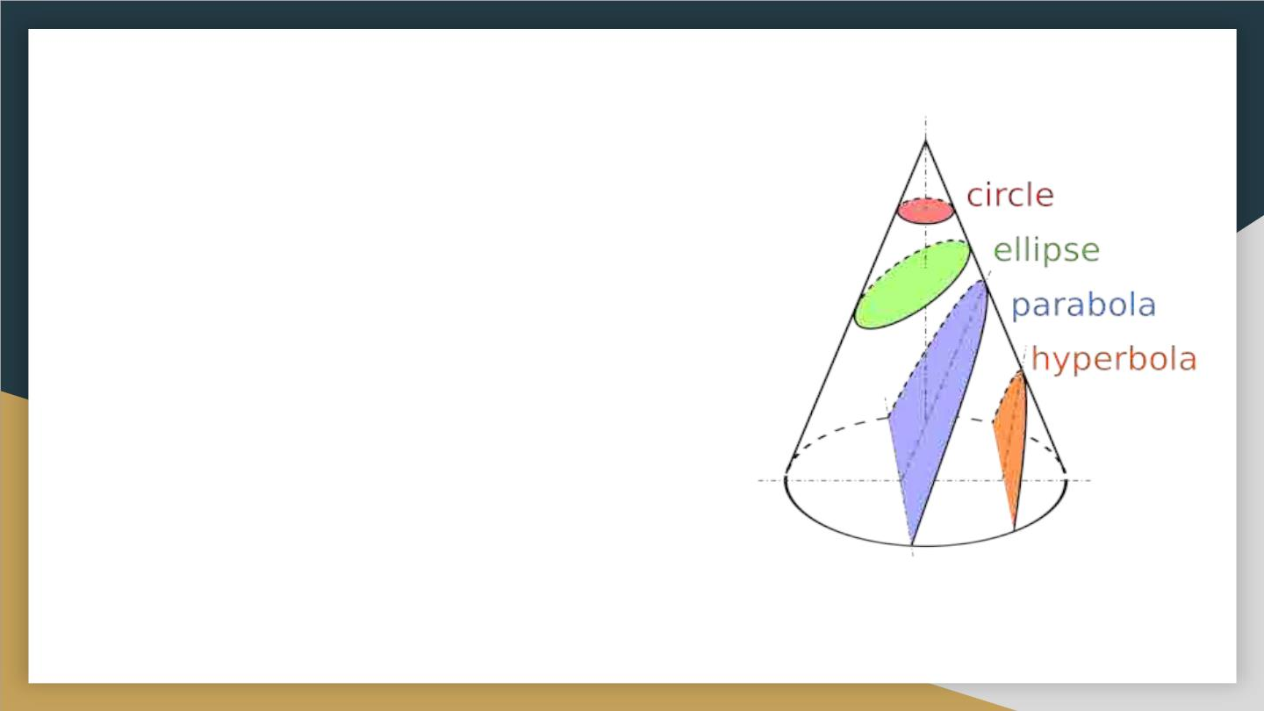
What is calculus?
The branch of mathematics that deals with
the finding and properties of derivatives and
integrals of functions, by methods originally
based on the summation of infinitesimal
differences. The two main types are
differential calculus and integral calculus.
Basically it is branch of mathematics
concerned
with
the
calculation
of
instantaneous rates of change (differential
calculus) and the summation of infinitely many
small factors to determine some whole
(integral calculus).

Slide 3

Where is it used?
1.Finance(Statisticians, Credit card companies, etc)
2.Chemistry (Inorganic Chemistry:The Rate of
Reaction)
3.Biology (Study of Population)
4. Physics (Mechanics)
5. Other Fields (Electrical Engineering, Architect,
Space flight engineers, Graphic artist)

Slide 4
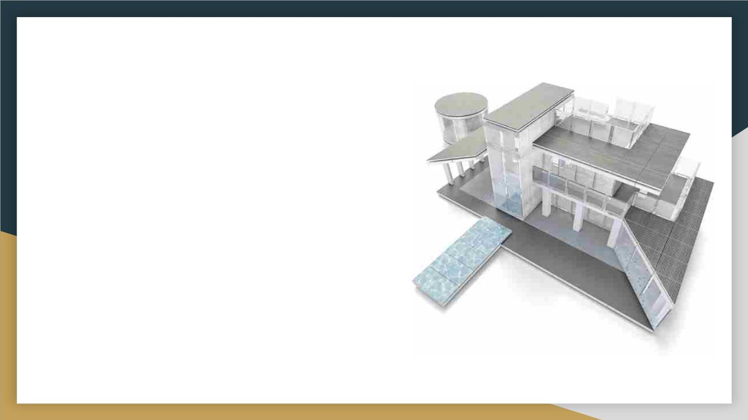
What is Architecture ?
● Definition: The style of design and method of
construction of buildings and other physical structures.
● Architecture is both the process and the product of
planning, designing, and constructing buildings or other
structures. Architectural works, in the material form of
buildings, are often perceived as cultural symbols and as
works of art. Historical civilizations are often identified
with their surviving architectural achievements.
● Architecture began as rural, oral vernacular architecture
that developed from trial and error to successful
replication. Indian and Chinese architecture influenced
forms all over Asia and Buddhist architecture in
particular took diverse local flavors.

Slide 5
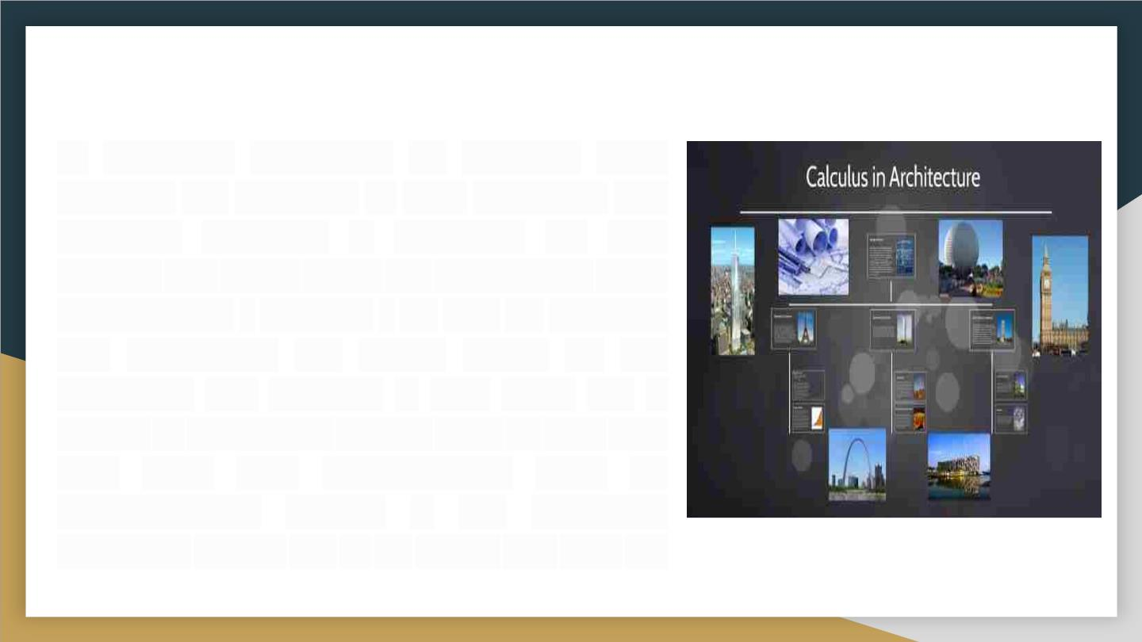
How is it used?
In designing structures, an architect must
visualize the solutions to both functional and
aesthetic problems – balancing art with
science and math. There are architecture math
requirements - calculus - so that an architect
can understand the forces acting on the
structures she designs. It also gives her a
means of calculating factors such as heat loss
over time. This understanding must be
mathematically precise if the structures
architects design are to be stable and safe for
use.

Slide 6
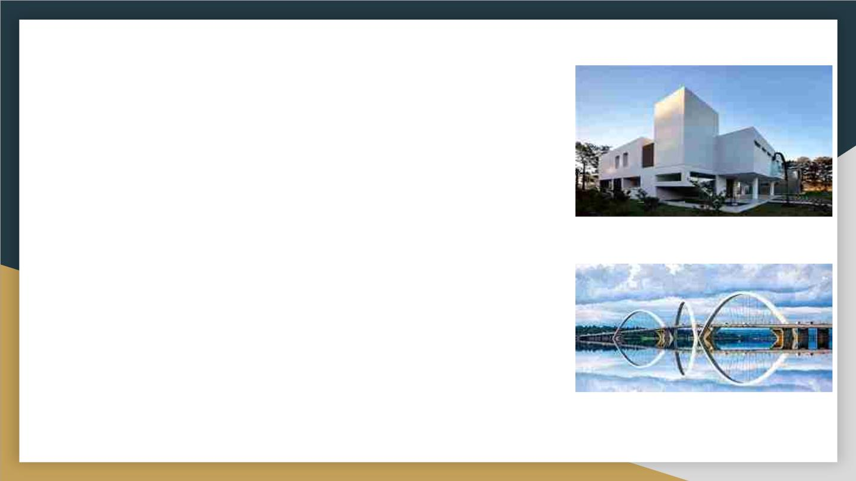
External architecture
Calculus is also used by architects in plotting buildings,
bridges, hotels, gardens, etc.
Architectural design optimisation is a subfield of
engineering that uses the method of optimisation to aid
and solve architectural design problem..
Differential calculus is used to determine the maximum or
minimum value of certain objects, such as the window size,
air duct space, etc. This translates to figuring out the
biggest possible size for a window, or finding the smallest
possible space that an air duct can maintain. Differential
calculus can also be used to determine the maximum
amount of material an architect can get for the cheapest
price or to find the balance between weight and strength
of a material.

Slide 7
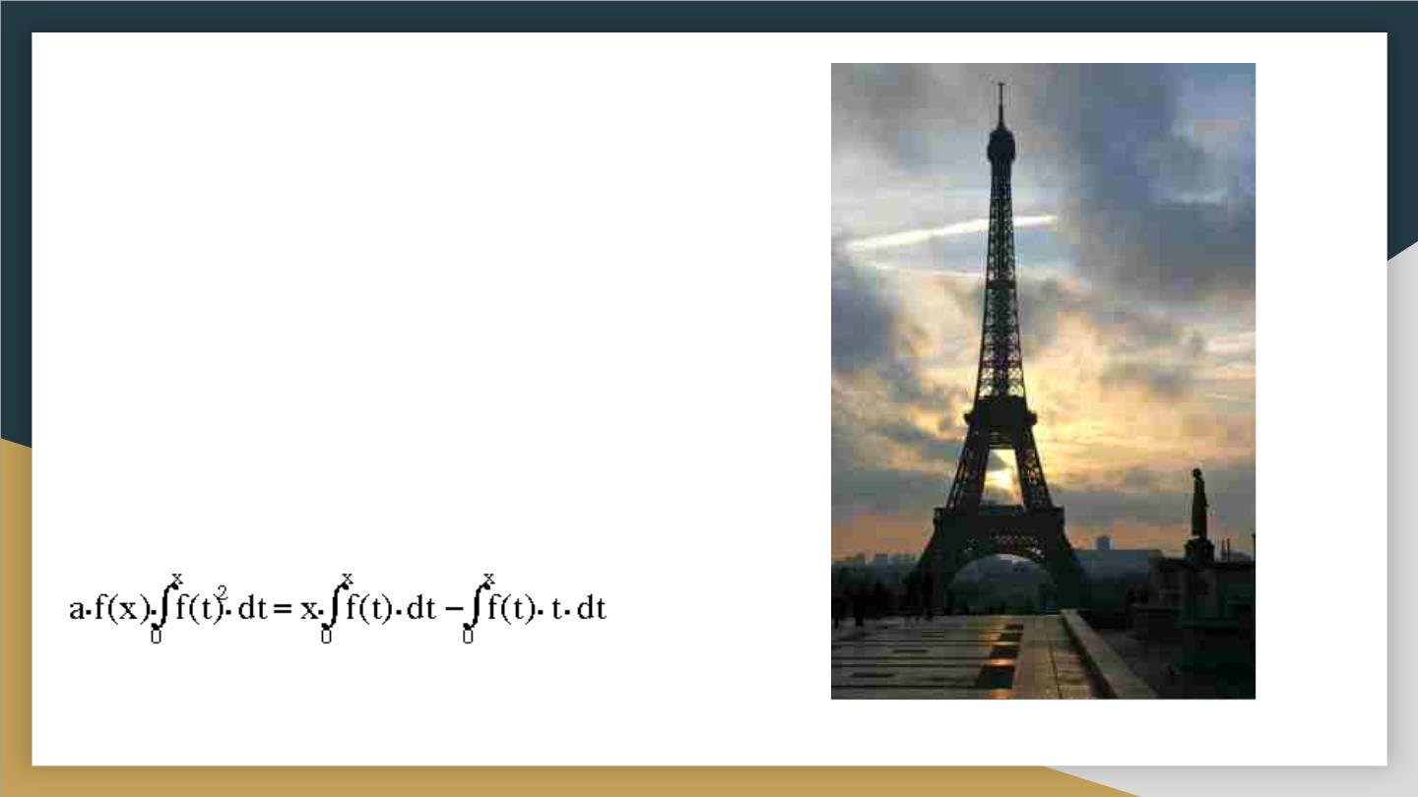
Example
The Eiffel Tower
Designed by Gustave Eiffel, the Eiffel Tower is one
of the most famous examples of calculus in
architecture because of it many curves, yet very
solid structure.
The Calculus!
The Eiffel Tower in a differential equation:
This is the width of the Eiffel Tower as a function
of the distance from top.
The Eiffel Tower in differential equation:
This is the width of the Eiffel Tower as a function of a
distance from the top.

Slide 8

Skyscraper
● Definition: The structural definition of the word “skyscraper” was
refined later by architectural historians, based on engineering
developments of the 1880s that had enabled construction of tall
multi-storey buildings. This definition was based on the steel
skeleton—as opposed to constructions of load-bearing masonry,
which passed their practical limit in 1891 with Chicago's
Monadnock Building.
● A skyscraper is a tall continuously habitable building having
multiple floors. Modern sources currently define skyscrapers as
being at least 100 metres or 150 metres in height, though there is
no universally accepted definition. Skyscrapers are very tall high-
rise buildings. Historically, the term first referred to buildings with
between 10 and 20 stories when these types of buildings began to
be constructed in the 1880s. Skyscrapers may host offices, hotels
and residential spaces.

Slide 9
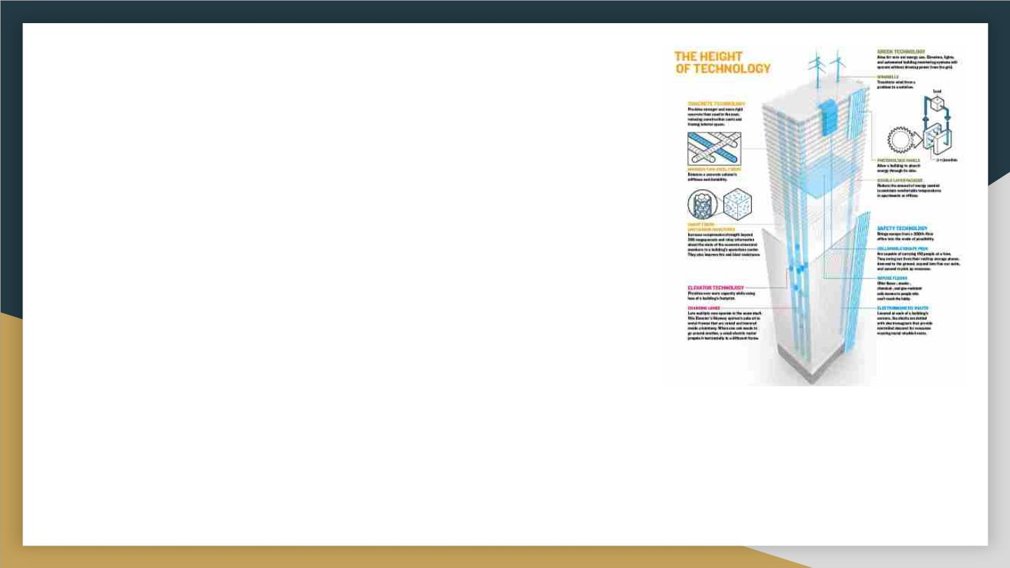
Many factors come into play when an architect
designs a building. Ascetics, lighting, size, and
even heating are taken into consideration. If an
architect is focusing on the heating of his/her
structure and wants to figure out how much heat is
being lost based on temperature variations
throughout the day, they can utilize calculus. They
can graph heat loss vs. time and find the area
under the curve. This area can be found by
evaluating a definite integral and finding the area
between the curve and the x-axis.

Slide 10
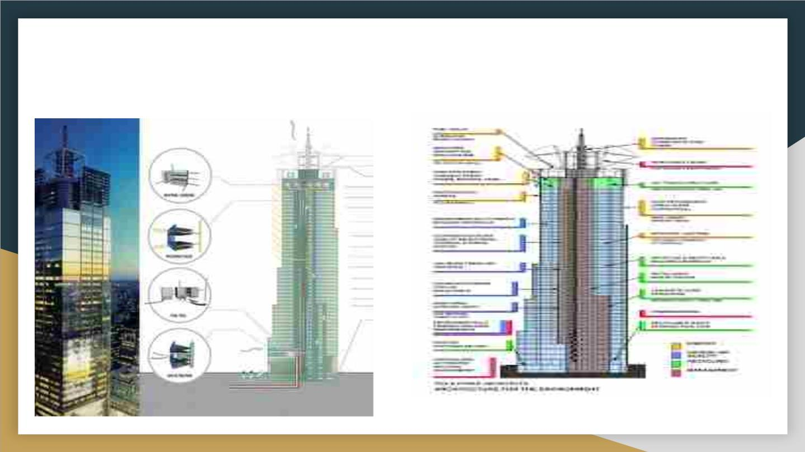
The role of system integration in the design
of sustainable skyscrapers

Slide 11
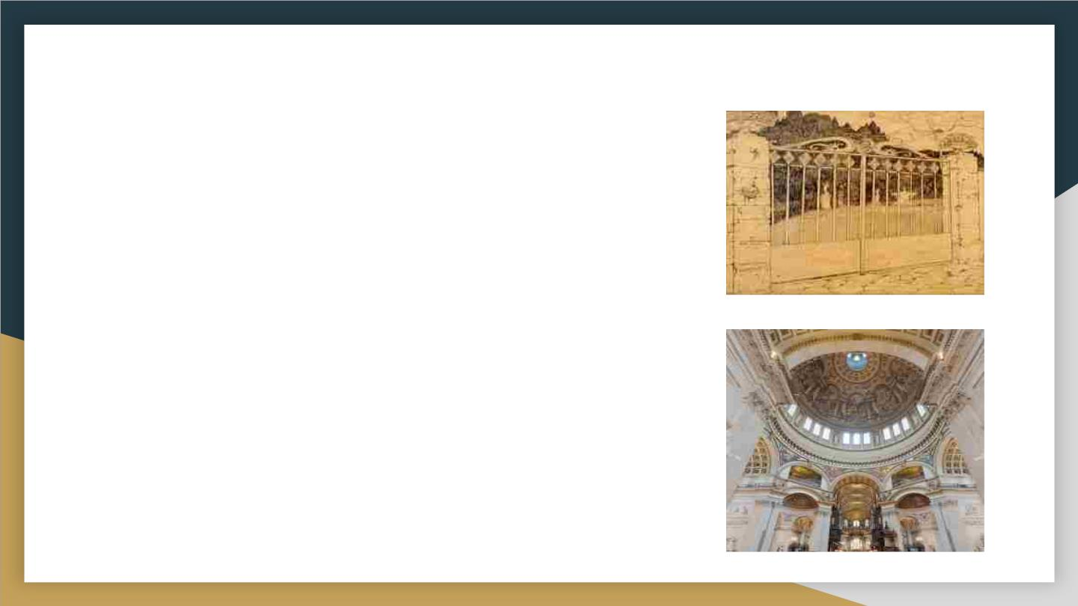
Relation of architecture and calculus.
The familiar hyperbolic curves math students learn
in calculus class are just one example of how this
branch of mathematics is important in architecture.
Famous landmarks, such as the Gateway Arch in St.
Louis and the dome of St Paul's Cathedral in London,
both incorporate hyperbolic curves called catenaries
into their design. When you hold a slack chain
between two hands you will recognize this curve if.A
catenary arch can support the weight of a structure
with a minimum amount of material.

Slide 12
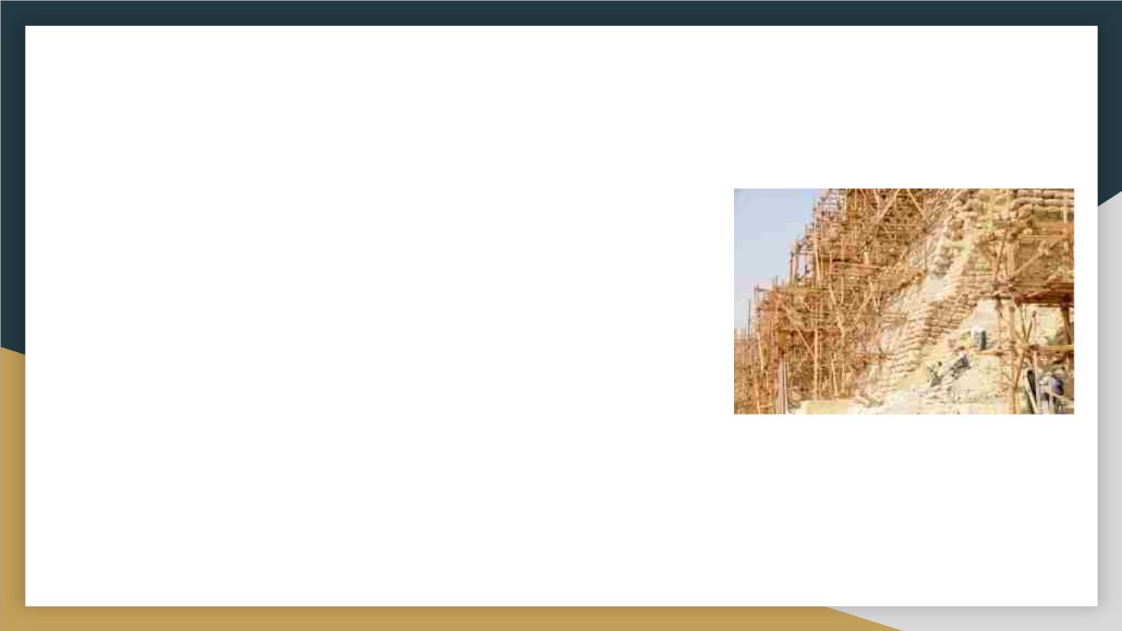
Calculus in Ancient Architecture.
The most remarkable ancient architecture of all may be
the pyramids of Egypt, constructed between 2700 B.C.
and 1700 B.C.
The accuracy in the construction of the pyramids in
ancient Egypt is evidence of the mathematical, especially
geometrical, knowledge that they possessed. They were
able to apply the principles of right triangles well, which is
evidenced by the accuracy of the pyramid corners at the
baseùa maximum error of 3'33"

Slide 13
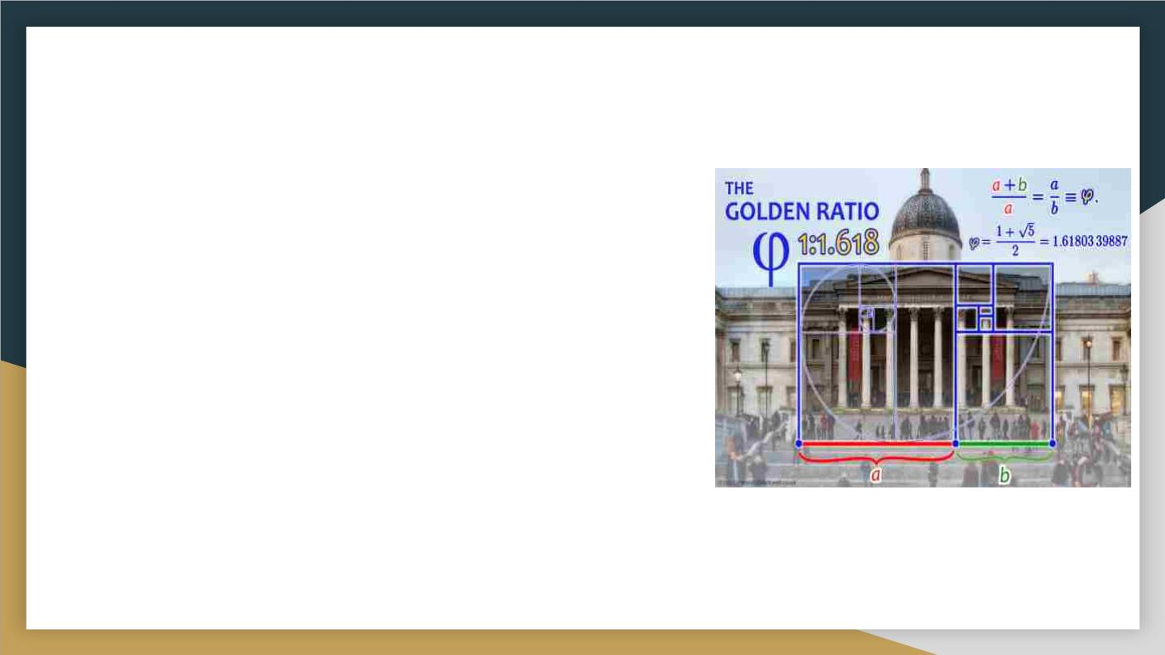
The Golden Ratio
The Golden Ratio still serves as a basic
geometric principle in architecture. You could
even call it a timeless archetype, as it evokes
in human beings a universal sense of
harmony when they see or stand in a building
designed with this principle. And perhaps not
surprisingly, we see the Golden Ratio
demonstrated throughout “architectures” of
the natural world

Slide 14
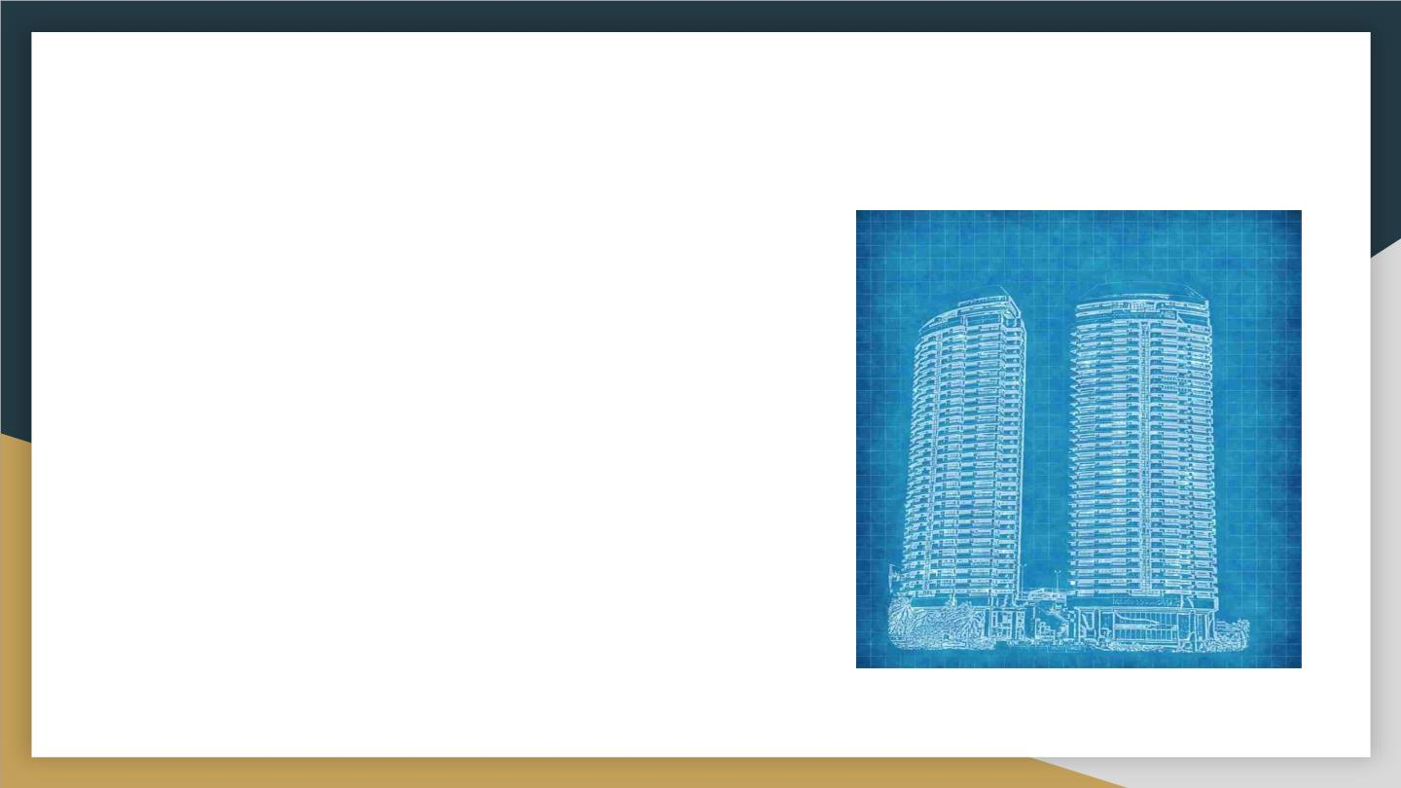
Blueprints.
Calculating ratio is essential, as well,
when it’s time to construct a building
from the architectural blueprints. For
example, it’s important to get the
proportions right between the height
and length of a roof. To do that,
building professionals divide the
length by the height to get the correct
ratio.

Slide 15
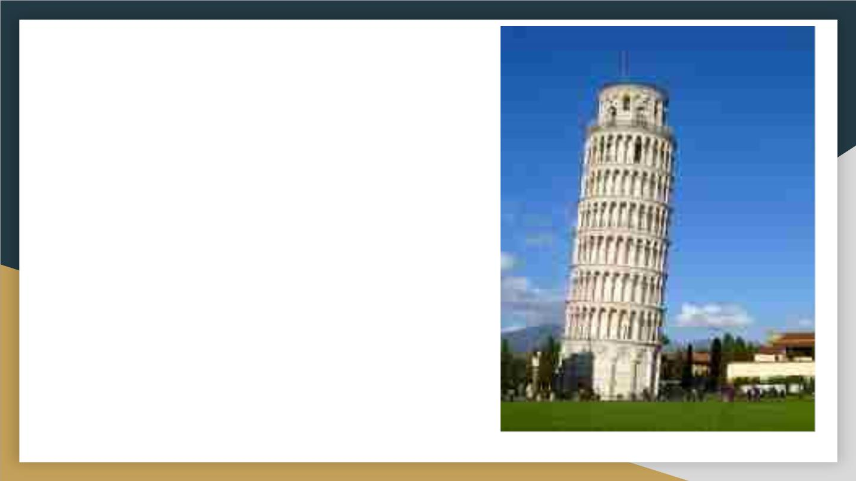
A Lack of Calculus
A well known example of neglect ti
towards the calculus is the
Leaning Tower of Pisa. The
building was intended to stand
straight, but the weight of the
structure was not taken into to
consideration. Therefore, over
time the building began to sink
and lean over.

Slide 16

Thank You
ROLL NO.25
ROLL NO.26
ROLL NO.27
ROLL N0.28
ROLL NO.29
ROLL NO.30
Harsh Gupta
Slide no. 9 and 15
Slide no. 2, 3 and 11
Slide no. 4 and 8
Trupti Hichkad
Mrinmayee Hole
Harshal Jagtap
Deepali Gupta
Grisha Jain
Slide no. 12, 13 and 14
Slide no. 5,6,7 and 10
Slide no. 1 and 16

