Slide 1

CASE STUDY 1- APPLICATIONS OF ECONOMETRICS IN THE BANKING INDUSTRY
JUILEE JAYADE
ROLL NUMBER – 15
SMR

Slide 2
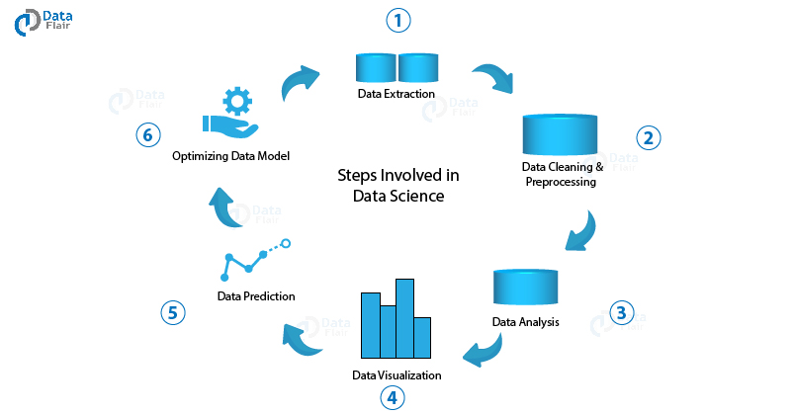

Slide 3
DATA EXTRACTION

Slide 4
DATA FILES EXTRACTION
Equity portfolio data has been extracted from, ’bankequityportfolio.xlsx
Macroeconomic data has been extracted from, ’historicmacroeconomicsdata.xlsx’
Baseline , adverse and severely adverse files have been extracted from baseline.xlsx, adverse.xlsx, severlyadverse.xlsx respectively

Slide 5
DATA CLEANING & PRE-PROCESSING

Slide 6
BANK EQUITY PORTFOLIO-Missing Values
QUARTER | BEFORE | AFTER
Q3 2016 | NA | 2168
Q4 2016 | 2239 | 2239
Q1 2017 | 2363 | 2363
Q2 2017 | 2423 | 2423
Q3 2017 | 2603 | 2603
Bank equity portfolio data contained missing values
These values were fixed using the method of interpolation using the package Impute TS

Slide 7
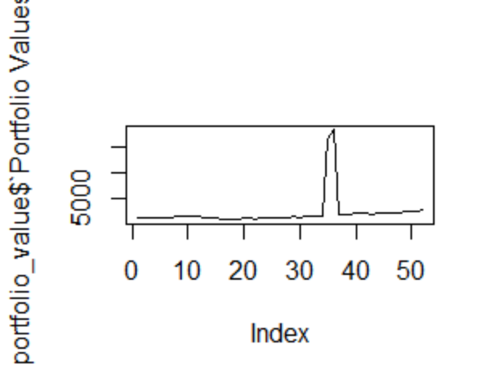
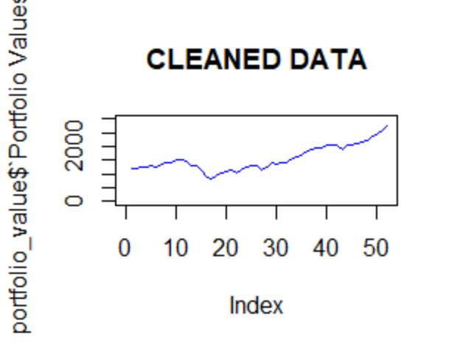
BANK EQUITY PORTFOLIO-Outliers
We can see there is a sudden jump in the portfolio values.
Outliers were detected and hence the data was altered

Slide 8
HISTORICAL MACROECONOMIC DATA
This data was checked for missing values and outliers and it was concluded that data is clean
It was filtered according to the time frame of portfolio values

Slide 9
DATA ANALYSIS

Slide 10
ANALYSIS OF MACROECONOMICS DATA
TEST | RESULTS
Mean of growth of real disposable income | 1.886538
Mean unemployment rate | 6.457692%
Median composite indicator | 100.3785
Mean Market volatility index | 26.225
Mean consumer confidence | 100.6529
Mean US EURO X | 1.289538
*Analysis will be explained during presentation

Slide 11
CORRELATION WITH PORTFOLIO VALUES
CORRELATION | MACRO VARIABLES
0.3166432 | Real.GDP.Growth
0.2375519 | Nominal.GDP.growth
0.06909554 | Real.Disposable.Income.Growth
0.05983924 | Nominal.Disposable.Income
-0.5591771 | Unemployment.Rate
-0.01667026 | CPI.Inflation.Rate
-0.2018549 | X3.month.Treasury.Rate
-0.3187435 | X5.year.Treasury.Yield
-0.5479168 | X10.year.Treasury.Yield
-0.7249941 | BBB.Corporate.Yield
-0.5573453 | Mortgage.Rate
-0.2038846 | Prime.Rate
0.5439221 | House.Price.Index
0.7827077 | Commercial.Real.Estate.Price.Index
-0.5032053 | Market.Volatility.Index
0.8603835 | Money.Supply
-0.1869378 | FED.Funds.Rate
-0.4725936 | VIX.CLS
-0.2267766 | TED.Spread
0.265771 | Composite.Leader.Indicator
0.8082417 | consumer.confidence.index
0.6348338 | Business.Confidence.Index
-0.6154113 | X.USD.euro
0.4654755 | X.yen.USD
-0.491476 | X.USD.pound

Slide 12
LINEAR MODEL OF PORTFOLIO VALUES WITH EACH INDEPENDENT VARIABLE
MACRO VARIABLES | CORRELATION | P VALUE
BBB Corporate Yield | -0.72500 | 1.219e-09
Commercial Real Estate Price Index | 0.78264 | 7.156e-12
Money Supply | 0.85820 | 2.994e-12
Consumer Confidence Index | 0.80825584 | 4.352e-12
Business Confidence Index | 0.63482 | 4.316e-12
USD/EURO | -0.61536 | 1.203e-06

Slide 13
CORRELATION AMONG PAIRS
Correlation Matrix
 | BBB Corporate Yield | Commercial Real Estate Price Index | Money Supply | Consumer Confidence Index | Business Confidence Index | (USD/euro)
BBB Corporate Yield | 1
Commercial Real Estate Price Index | -0.2420809 | 1
Money Supply | -0.7127515 | 0.547108663 | 1
Consumer Confidence Index | -0.7992596 | 0.48153871 | 0.70280153 | 1
Business Confidence Index | -0.3892171 | 0.67204981 | 0.22585326 | 0.462232945 | 1
(X.USD/euro) | 0.55692783 | -0.473500713 | -0.5804776 | -0.59606084 | -0.31397835 | 1
Inference – variable with high correlation ie money supply have been discarded

Slide 14
DATA VISUALIZATION

Slide 15
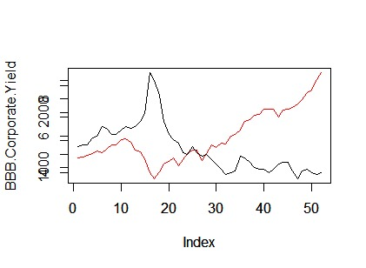
BBB CORPORATE YIELD

Slide 16
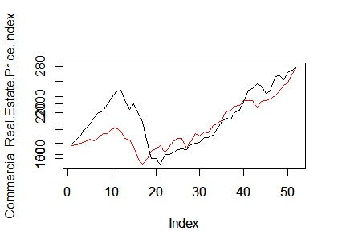
COMMERCIAL REAL ESTATE PRICE INDEX

Slide 17
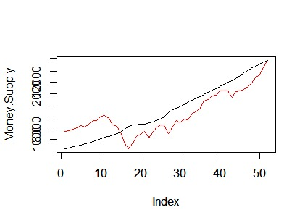
MONEY SUPPLY

Slide 18
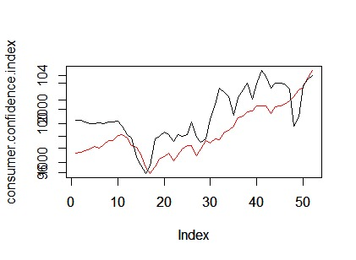
CONSUMER CONFIDENCE INDEX

Slide 19
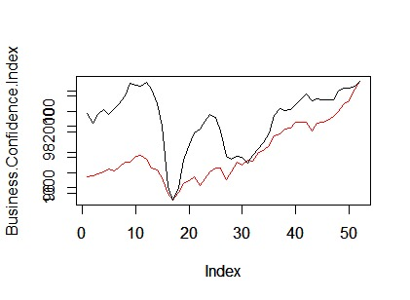
BUSINESS CONFIDENCE INDEX

Slide 20
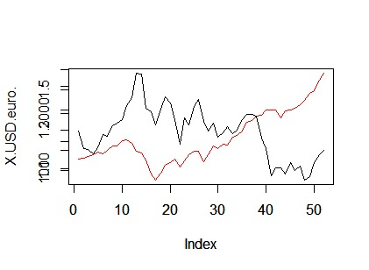
USD/EURO

Slide 21
MODEL BUILDING & PREDICTION

Slide 22
PATH TO FINAL MODEL
ITERATION 3
1
ITERATION 2
.
BBB Corporate Yield ***
Commercial Real Estate Price Index ***
2
ITERATION 1
BBB Corporate Yield ***
Commercial Real Estate Price Index ***
Consumer Confidence Index
3
BBB Corporate Yield ***
Commercial Real Estate Price Index ***
Consumer Confidence Index **
Business Confidence Index
(USD/euro)

Slide 23
PROCESS
Variables of iteration 3 were chosen as variables with high p values were discarded.
Log transformation was performed for this on portfolio values
Ramsay test was performed and it was found that the model is non linear (p value<0.05)
A log transformation was done on the final iteration for all the variables

Slide 24
FINAL MODEL
92%
 | Coefficients | Standard Error | t Stat | P-value
Intercept | 3.44512084 | 0.397703858 | 8.662528084 | 1.88779E-11
Log Transformed CRE | 0.974392585 | 0.068555364 | 14.21322159 | 5.21045E-19
Log Transformed BB Corporate Yield | -0.817189809 | 0.050744682 | -16.10394979 | 3.30583E-21

Slide 25
QUANTITATIVE TESTS
CONDITION | TEST | DF | P VALUE | THRESHOLD
LINEARITY | RAMSAY RESET |  | 0.5181 | LINEAR
HETEROSKEDASTICITY | BREUSCH PAGAN | 2 | 0.113 | HOMOSKEDASTIC
NORMALITY | JARQUE BERA | 2 | 0.5128 | NORMAL
STATIONARITY | ADF |  | 0.7495 | NON STATIONARY
AUTOCORRELATION | DURBINWATSON |  | 4.752e-05 | AUTOCORRELATION
NORMALITY | SHAPIRO |  | 0.1765 | NOT NORMAL
*Tseries & lmtest packages were installed

Slide 26
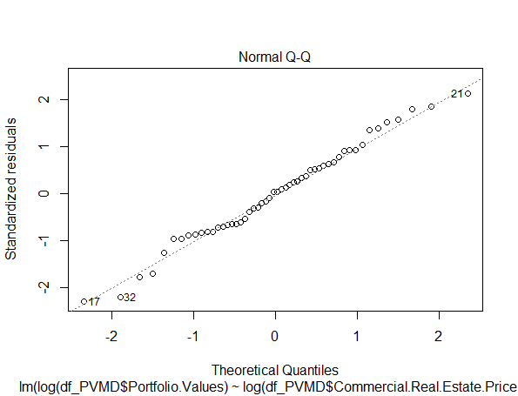
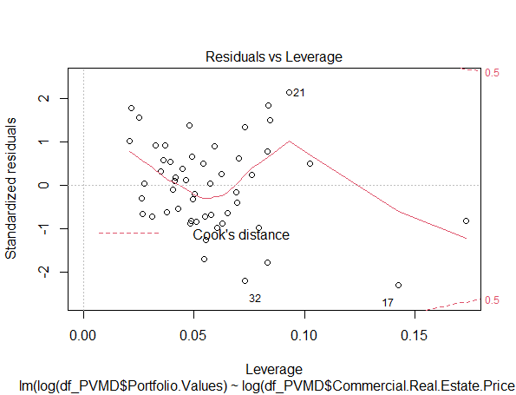
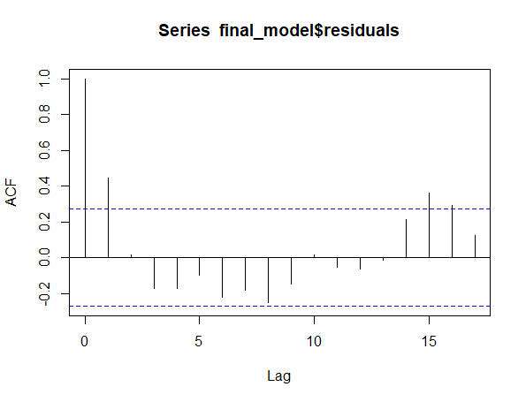
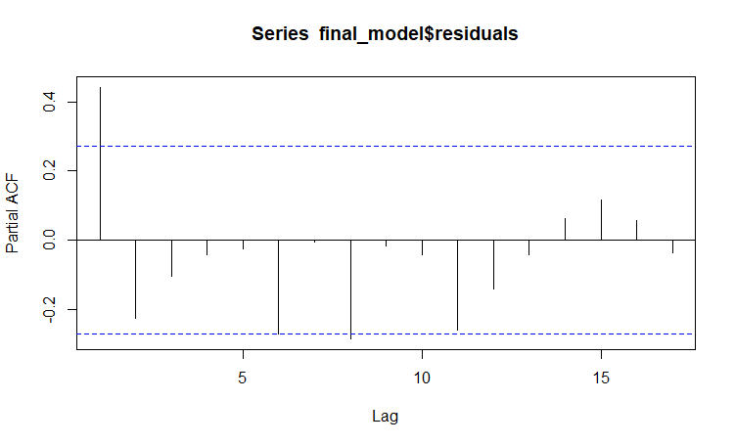
QUALITATIVE TESTS
STRENGTHS
Blue is the colour of the clear sky and the deep sea
WEAKNESSES
Yellow is the color of gold, butter and ripe lemons
NORMALITY
LINEARITY
ACF
PACF

Slide 27
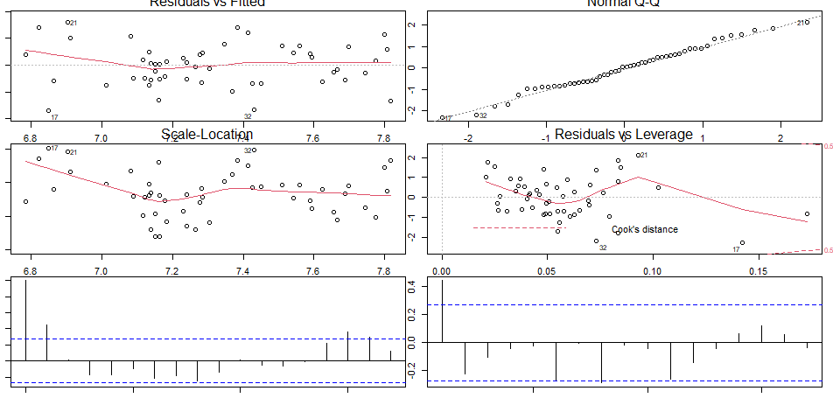
PLOT SUMMARY

Slide 28
IN SAMPLE ANALYSIS

Slide 29
RESULTS
QUARTER | PREDICTED VALUE
Q1 2005 | 1238.281
Q2 2005 | 1259.689
Q3 2005 | 1292.863
Q4 2005 | 1277.104
Q1 2006 | 1290.523
MSE | 14491.13
RMSE | 120.3791
MAPE | 6.27%

Slide 30
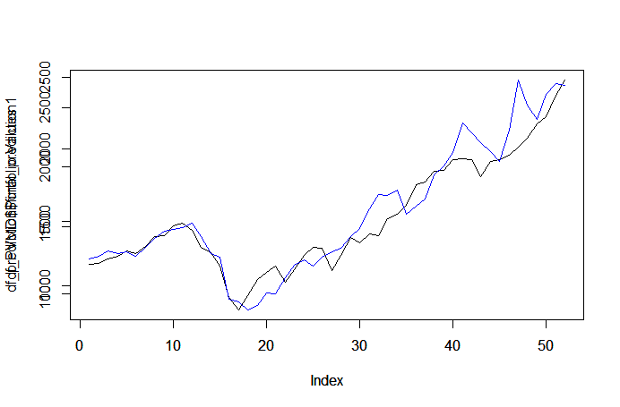
PREDICTION

Slide 31
OUT OF SAMPLE ANALYSIS

Slide 32
RESULTS
87%
Training and testing data had been separated
The model was thus used to predict the values
QUARTER | FITTED VALUE | ERRORS
Q3 2015 | 2010.995 | -90.96468
Q4 2015 | 1954.274 | 89.66590
Q1 2016 | 1889.866 | 169.87390
Q2 2016 | 2096.974 | 1.88612
MSE | 32281.59
RMSE | 179.6708
MAPE | 6.32%

Slide 33
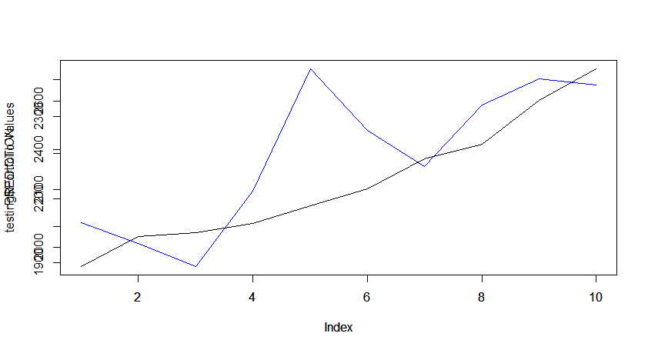
PREDICTION

Slide 34

FORECAST
Using the coefficients of the final model
Values for 3 scenarios – baseline, adverse and severely adverse were forecasted
These were combined into a single data frame
Quarter | Baseline | Adverse | Severely Adverse
Q1 2018 | 2,415.13 | 2,481.02 | 1,435.27
Q2 2018 | 2,355.04 | 2,204.24 | 1,203.13
Q3 2018 | 2,334.83 | 2,058.86 | 1,070.11
Q4 2018 | 2,323.25 | 1,932.08 | 976.32
Q1 2019 | 2,312.24 | 1,829.22 | 898.79
Q2 2019 | 2,294.32 | 1,807.12 | 877.81
Q3 2019 | 2,284.48 | 1,823.49 | 884.92
Q4 2019 | 2,275.10 | 1,855.82 | 925.46
Q1 2020 | 2,215.86 | 1,855.82 | 970.37
Q2 2020 | 2,236.75 | 1,932.38 | 1,038.29
Q3 2020 | 2,215.24 | 1,977.09 | 1,108.02
Q4 2020 | 2,228.95 | 2,023.69 | 1,200.03
Q1 2021 | 2,249.50 | 2,123.11 | 1,325.95
.

Slide 35
EXPECTED LOSS FOR QUARTER
 | Expected Q9 Loss for each category
Initial Portfolio Value (Q4 2017) | Baseline | Adverse | Severly Adverse
2,733.48 | 517.62 | 877.66 | 1,763.11
The 9th quarter i.e. ,Q1 2020 had been chosen
The expected loss under each scenario was found by subtracting the Q4 2017 from 9th quarter values

Slide 36
REQUIRED CAPITAL
166.09
required_capital = 0.2*(0.5*loss_baseline + 0.35*loss_adverse + 0.15*loss_severlyadverse)

Slide 37
THANKYOU

