Slide 1
ARCHITECTURE: APPLICATION OF CALCULUS IN SKYSCRAPER DESIGN
GROUP 5

Slide 2
Group Members
Name | Roll Number
Saloni Tayshete | 76
Gargi Tendulkar | 77
Prati Thakkar | 79
Raj Tripathi | 80

Slide 3

Background info
Historically, architecture has been a part of mathematics, so much so the two disciplines were indistinguishable. Ancient architects were mathematicians, as well. Throughout time, architects have created mathematically amazing structures such as; temples, pyramids, ziggurats, and integration projects. Architects could use simple geometry if buildings were simple squares and triangles, but a vast majority of buildings involve curves and strange angles- this is where calculus comes into play.

Slide 4
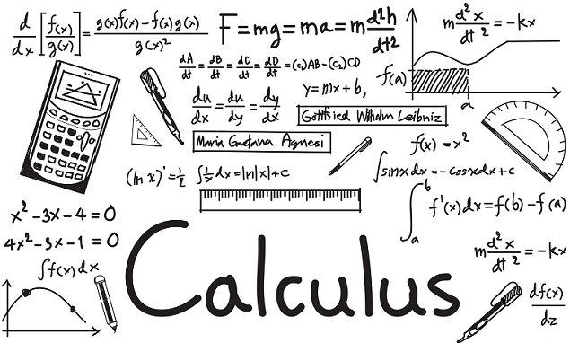
Application of Calculus
Calculus can be utilized by architects to express design plans through graphs or drawings. They can mathematically describe surfaces for the adaptation of drawings to computer software. This can be done through various differential equations. Calculus was used in the designing and construction of the mathematically sound Eiffel Tower.

Slide 5
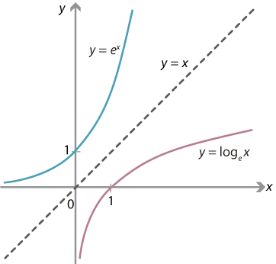
Derivatives in use
Although the tower looks complex, surprisingly, it can be graphed with two simple equations;
y= e^-x
y= -e^-x
As the tower was being built, wind became a major concern for the architects. But by utilizing calculus they found the tangent lines of the towers main curves (their derivatives). The tangent lines were used to locate the center of the tower or where its mass is focused. By knowing this center the architects balanced the tall structure by using wind as an ally instead of an obstacle. Thus, the tower was molded by wind.
A

Slide 6
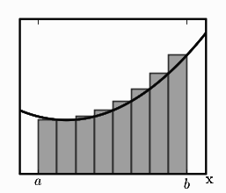
Integrals in use
Many factors come into play when an architect designs a building. Ascetics, lighting, size, and even heating are taken into consideration. If an architect is focusing on the heating of his/her structure and wants to figure out how much heat is being lost based on temperature variations throughout the day, they can utilize calculus. They can graph heat loss vs. time and find the area under the curve. This area can be found by evaluating a definite integral and finding the area between the curve and the x-axis.

Slide 7




Modern Architecture and Mathematics
Until the twentieth century, architecture students were
obliged to have a grounding in mathematics.
Salingaros argues that first "overly simplistic, politically-driven" Modernism and then "anti-scientific"
Deconstructivism have effectively separated architecture from mathematics. He believes that this "reversal of mathematical values" is harmful, as the "pervasive aesthetic" of non-mathematical architecture trains people "to reject mathematical information in the built environment"; he argues that this has negative effects on society.

Slide 8
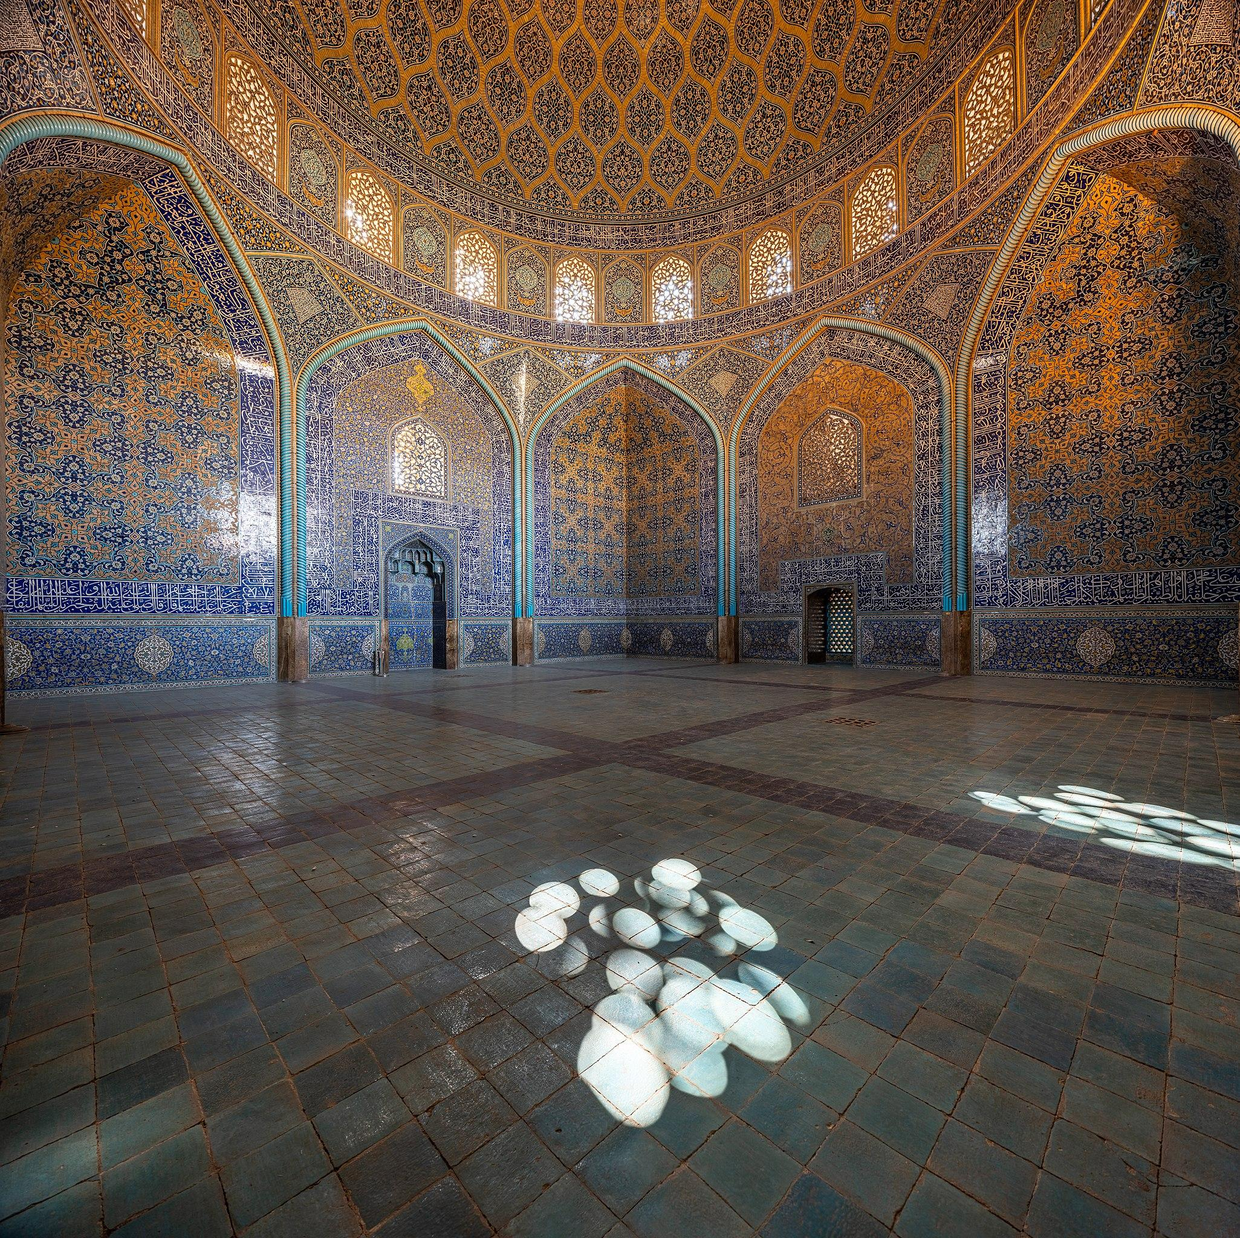
Mathematical decoration
Islamic architectural decoration
Islamic buildings are often decorated with geometric patterns.
Symmetries such as stars with six, eight, or multiples of eight points are used in Islamic patterns.
Some of these are based on the 'Khatem Sulemani' or Solomon's seal motif,which is an eight-pointed star made of two squares, one rotated 45 degrees from the other on the same centre
Sheikh Lotfollah Mosque

Slide 9
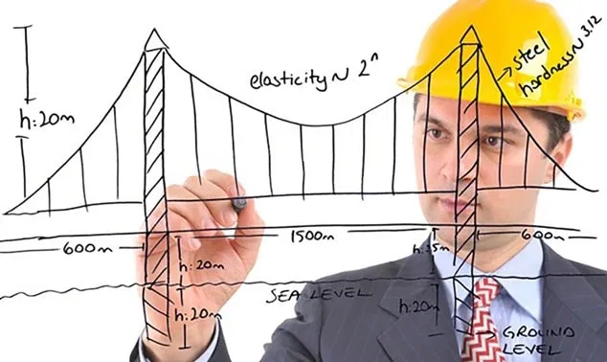
Calculus in Structural engineering:
Calculus is widely used for calculating the building’s heat loss, areas and masses of difficult geometric form structures, for minimizing or maximizing areas of designed structures (for example to find the heat loss of heat during the day all you have to do is create a graph (heat loss vs. time) and calculate the area under the curve using integral).

Slide 10
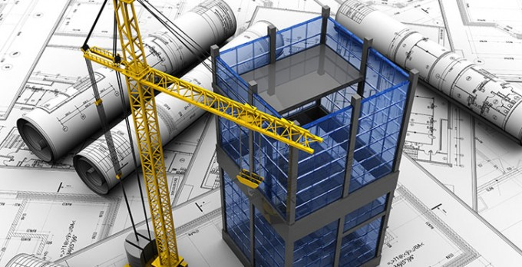
Calculus in Structural engineering:
The structures as in the picture on the left are made with a number of shells that are interconnected and supported by concrete. So, the density of each shell may differ. Therefore it is more difficult to find the total density of the structure. And this is where calculus can be applied we use vector calculus to calculate the total mass. Architects also use integral calculus to calculate the amount of materials needed for construction and the type of support systems required to prevent constructions from collapsing.

Slide 11
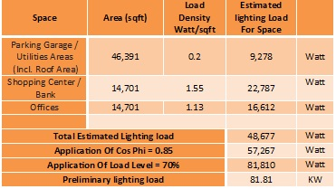
Calculus in Lighting analysis and design inside buildings:
a] Watts per Square Metre Method:
This is principally a “rule of thumb” method, very handy for rough calculation or checking. It consists in making an allowance of watts per square metre of area to be illuminated according to the illumination desired on the assumption of an average figure of overall efficiency of the system.

Slide 12
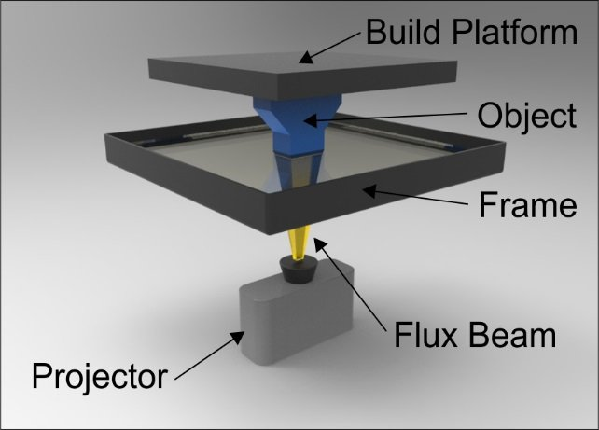
Calculus in Lighting analysis and design inside buildings:
b] Lumen or Light Flux Method:
This method is applicable to those cases where the sources of light are such as to produce an approximate uniform illumination over the working plane or where an average value is required. From the size of lamp or lamps employed and from their efficiency total lumens output are determined.

Slide 13

Calculus in Lighting analysis and design inside buildings:
] Lumen or Light Flux Method:
Multiplying the total lumens output from the source by coefficient of utilization, the lumens received on the working plane are determined. If the lamps and surroundings are not perfectly clean, then in determination of lumens received on working plane, the depreciation factor or maintenance factor should be included,
b

Slide 14
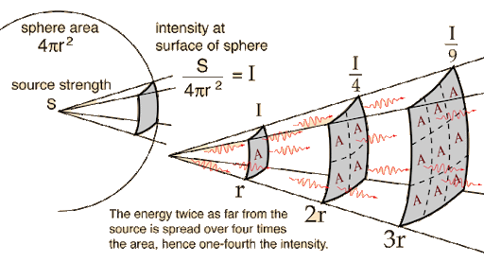
Calculus in Lighting analysis and design inside buildings:
c] Point to Point or Inverse-Square Law Method:
This method is applicable where the illumination at a point due to one or more sources of light is required, the candle powers of the sources in the particular direction under consideration being known. If a polar curve of lamp and its reflector giving candle powers of the lamp in different directions is known, the illumination at any point within the range of the lamp can be calculated from the inverse square law.

Slide 15
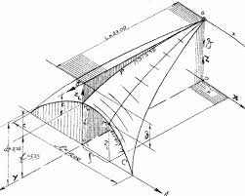
Calculus in Lighting analysis and design inside buildings:
c] Point to Point or Inverse-Square Law Method:
If two and more than two lamps are illuminating the same working plane, the illumination due to each can be calculated and added. This method is not much used because of its complicated and cumbersome applications. It is employed only in some special problems, such as flood lighting, yard lighting

Slide 16
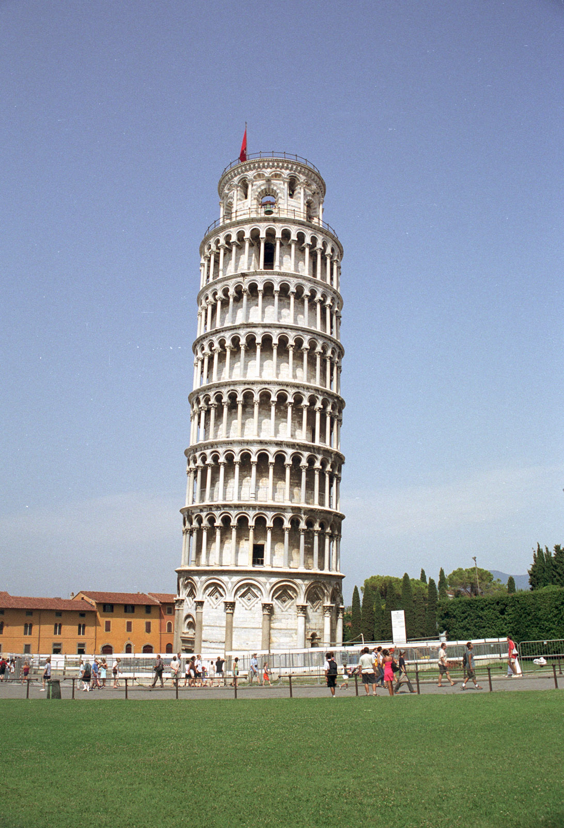
When Calculus is neglected
A well-known example of a design plan gone wrong is
the Leaning Tower of Pisa. The building was originally
intended to stand upright, but the weight was not
accounted for and early on in it's construction began
leaning over. Wet soil and decay have caused the
structure to sink downward and tilt. The tower is
just one example of a result of neglecting the math
that goes along with the architecture process.

Slide 17
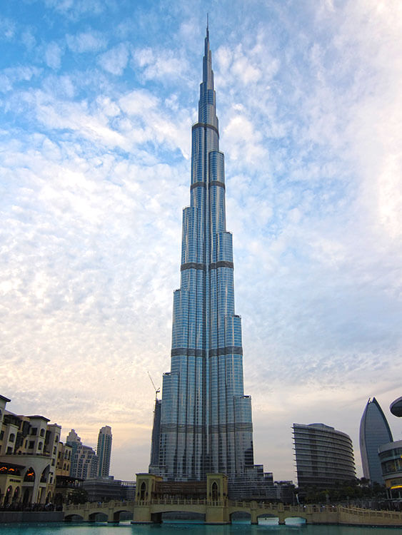
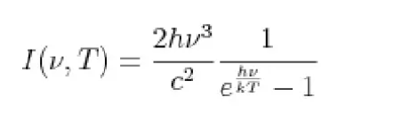
Examples in Real Life
Architecture is the field in which calculus is used most often in real world. One of the example is the use of calculus in constructing Burj Khalifa the tallest skyscraper and building in the world with a height of 830 metres.
The calculus integral used to calculate the energy needed to raise all 180 floors upto a height h which is 828.8m was:-

Slide 18
Thank you

